Slide 1
Daily Cerebral Exercise
To lose 1lb per week, how many kcals should a person cut out of their diet a day?
If our body does not produce enough lactase to break down milk sugars what would we experience?
What occurs when our large intestine does not absorb water?

Slide 2
3/5/13 Today’s Agenda:
Students will complete daily cerebral exercise
TO: What are the 11 therapeutic diets, and what type of pts would each diet affect?
Announcement: Nutrition project to be turned in on 3/6 instead of 3/6/14. We will be in the computer lab 3/4/14.
Class assignment, What’s for dinner? Will be completed with a partner.
State Standards:
9:1 Apply behaviors that promote health and wellness.
9:3 Apply practices that promote prevention of disease and injury.
EQ: How will your knowledge of nutrition affect the care you provide?

Slide 3
Maintenance of Good Nutrition
1. Eat a variety of foods.
2. Maintain healthy wt.
3. Choose a diet in low fat, & chol.
4. Choose a diet high in nutrients.
5. Use sugars, salt, sodium only in moderation.
6. Consume alcohol in moderation.

Slide 4
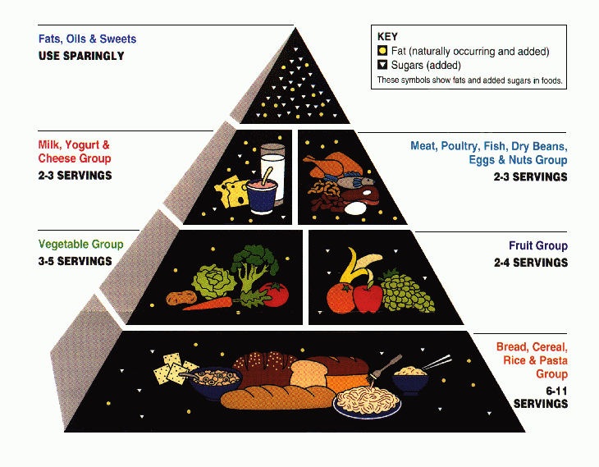

Slide 5
Therapeutic Diets
Modification of the normal diet used to improve health conditions.
Prescribed by doctor
Planned by dietician
May not be appeasing therefore, HC worker must use patience and tact to convince the pt to eat the foods.

Slide 6
1. Regular Diet
Balanced
Ambulatory pt
Dec desserts, creams, salad dressings, fried foods.

Slide 7
2. Liquid Diet
Clear/full liquids
Nutritionally inadequate
Used for short periods
Used post sx, acute infs

Slide 8
3. Soft Diet
Regular diet, but requires little chewing
Easy to digest
Avoid meat, shellfish, coarse cereals, raw fruit, nuts
Used for digestive disorders, or chewing problems.

Slide 9
4. Diabetic Diet
Pts c diabetes mellitus
Pts body does not produce enough insulin to metabolize carbs
Avoid sugar-heavy foods such as cookies, honey, jams, gum

Slide 10
5. kCal-controlled
High cal controlled
Extra proteins/carbs
High bulk foods avoided: salads
High fat foods avoided b/c slow appetite
Low cal controlled
Avoid high cal foods: gravies, whole milk, butter, cream soups

Slide 11
6. Low Chol Diet
Used for pts c atherosclerosis & heart dz
Avoid foods high in saturated fats: beef, liver, pork, lamb, egg yolk, cheeses

Slide 12
7. Fat-Restricted Diets
Aka Low fat diets
Used for obese pts gallbladder or liver dz, or atherosclerosis
Avoid chocolate, nuts, fried foods, salad dressings.

Slide 13
8. Sodium Restricted Diet
Aka Low-salt diets
Avoid adding salt, smoked meats, pickles, olives
Used for cardiovascular dz (high b/p), kidney dz, and edema.

Slide 14
9. Protein Diets
Low protein for kidney dz pts
High protein for children c growth delay, pregnant women

Slide 15
10. Bland Diet
Easily digested foods
Used for pts c ulcers, colitis, and other digestive dzes.
Avoid pastries, raw fruits, whole-grain breads

Slide 16
11. Low-Residue
Eliminate foods in high bulk / fiber
Used for pts c digestive and rectal dzs
Avoid seeds, beans, peas, and coconuts.

Slide 17
What’s for dinner?
With your group you are sitting in:
You will create a one day menu for a given diet.
Your menu must cover breakfast, lunch, and dinner (ea of you must create one meal).
Turn in one page menu creation c/ your name next to the meal you created.
List all internet sources used for your menu.
You must stay true to the guidelines of your menu restrictions and serving per food guide recommendation.

Slide 18
Groups and Diets:
Diabetic
Cierra
Joseph
Jessica
Low-Residue
Andrew
Juan
Shey’von
Protein
Hope
Payton
Nekaybaw
Sodium Restricted
Daisy
Brienne
Matthew
Bland
Jennifer
Shanice
Danielle
Low Chol
Shelby
Brandy
Zach
Fat Restricted
Kim
Jazmin
Salasha
Soft Diet
Caleb
Ariel
Kayla

