Slide 1
3/5/14 Today’s Agenda:
Unit 5: What skills are necessary to be a Laboratory Assistant?
Students will grade Nutrition Test as a class.
TO: Identify parts of the microscope.
Students will complete A – Z Microscope Internet Activity.
Closure: You’re Stuck Here Until….
State Standards:
9.2 Describe strategies for prevention of diseases including health screenings and examinations.

Slide 2
Microscopes
Invented by Antony van Leeuwenhoek in 16C who then discovered bacteria.
2 Models -
Monocular has 1 eye piece
Binocular has 2 eyepieces
Epifluorescence microscope detects antibodies and specific organisms by using a fluorescent dye stain

Slide 3
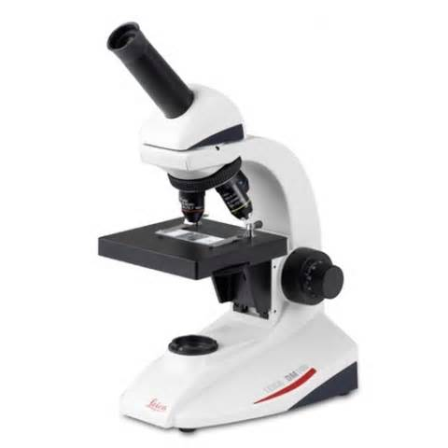
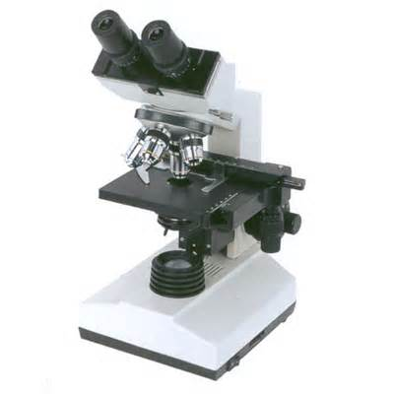
Monocular Binocular

Slide 4
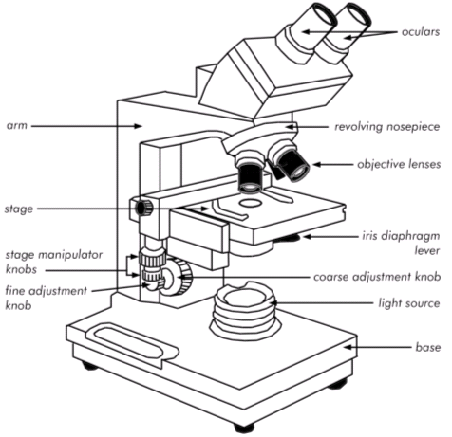
Parts of a Microscope
Base – solid stand
Arm – long stem,
used to carry

Slide 5
Parts of a Microscope
Eyepieces – aka Ocular viewpeice, magnifies the object usually 10x or 20x, piece that you look through

Slide 6
Parts of a Microscope
Objectives – magnify the object being viewed
Low-power = 4x
Low-power = 10x
High-power = 40x
High-power = 45x
Oil-immersion (OI) = 95x
Oil-immersion (OI) = 100x
(when image is too dark)

Slide 7
Parts of a Microscope
Revolving Nose Piece – where objectives attach, turn to use different objective
Stage – flat platform c slide clips to hold slide in place

Slide 8
Parts of a Microscope
Course Adjustment Knob – moves objective up and down, rough focus
Fine Adjustment Knob – moves objective slowly for clear focus

Slide 9
Parts of a Microscope
Iris Diaphragm– controls amount of light to enter the microscope
Illuminating Light– light source
Body Tube – connect the eye piece and objectives.

Slide 10
To Determine Magnification:
Multiply the power of the eye piece times the power of the objective in use.
Examples:
The eyepiece is 10x and the objective is 4x
(10)(4) = 40 times
The eyepiece is 20x and the objective is 40x
(20)(40) = 800 times

