Slide 1
3/13/14 Today’s Agenda:
Students will practice using a microscope. While waiting students will work on Infection Control page of weebly. Home page should already be completed.
TO: How do you obtain and examine culture specimen?
Students will practice obtaining a specimen from another classmate.
Unit 5: What skills are necessary to be a Laboratory Assistant?
Ability to use a microscope.
Obtaining specimens.
State Standards:
9.2 Describe strategies for prevention of diseases including health screenings and examinations.

Slide 2
In your lab notebook, title and date: LAS Skill#1: Using the Microscope
Part 1 – Label the Microscope #: ____
Number your sheet in (two columns) 1 – 8.
1
2
3
4
5
6
7
8
In the lab, each microscope has parts that are labeled. Write the name of each labeled part to its corresponding number.

Slide 3
Part 2 – Total Magnification:
In your lab notebook, title and date: LAS Skill #1: Using the Microscope
1. ______ Ring = _____ Magnification
2. ______ Ring = _____ Magnification
3. ______ Ring = _____ Magnification
Observe the three objectives. You will notice a color ring around each of them. Write down the color and the corresponding magnification on that objective.
For example:
Purple Ring – 30x Magnification

Slide 4
In your lab notebook, title and date: LAS Skill #1: Using of the Microscope
Below your labeled parts, draw one circle like the one below.
Part 3 – What do you see?
____________
Total Magnification - _____
In the lab each microscope has a slide. After labeling the eight parts of the microscope, turn the microscope on and place the slide on the stage. Use the fine adjustment knob and course adjustment knob to bring the slide into focus. Draw inside your circle what you see. On the blank write down what you think you are looking at, just take a guess.

Slide 5
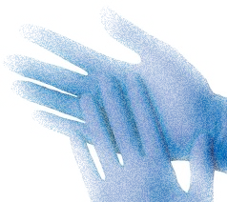
Standard Precautions:
Because any culture may contain pathogenic organisms, bld, & body flds standard precautions must be observed at all times while handling cultures.
Wash hands frequently
Gloves
Protective lab coats
Infectious waste bag for disposal
Clean up counter space used

Slide 6
Obtaining & Handling Specimen
Obtained when need to id the causative agent of a dz.
Obtained from lesions on skin, EENT, or other body openings.
Taken c sterile applicator swab (will show you how in just a bit).
Then, what do you do with the specimen?

Slide 7
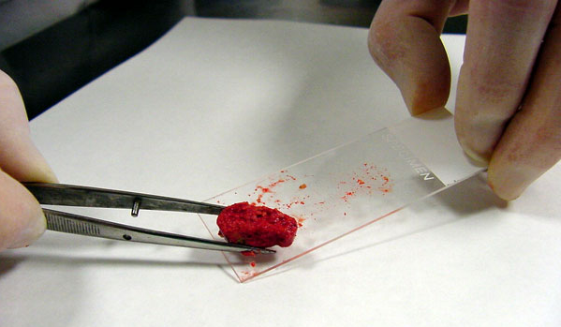
4 ways to examine specimen:
1. Direct Smear – placed directly on slide, air dried, & heat fixed so organisms will stick to the slide.

Slide 8
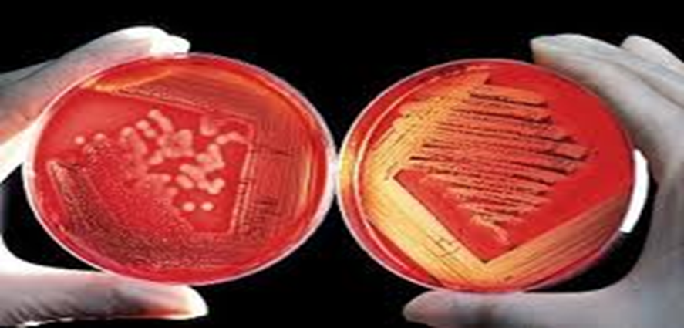
4 ways to examine specimens:
2. Agar Plate (petri dish) – medium provides nourishment for growth, incubatory for 24-36 hs, sample of the colony growth placed on slide.

Slide 9
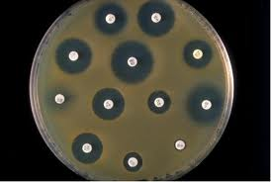
3. Culture & Sensitivity Study
Small, sterile disks containing different antibiotics are placed on the agar plate.
If the organisms grow up to the edge of a particular disk, the organism is resistant to that antibiotic.
If the organisms do not grow close to the disk, the organism is sensitive meaning the antibiotic would aid in curing of the disease.

Slide 10
4. Gram’s Stain
Staining technique so that organisms can be visible for identification.
Gentian violet stain applied for 1 min (primary dye)
Iodine applied for 1 min (adheres the dye)
95% alcohol applied until all purple is gone
Gram (+) organisms will absorb the purple
Safranin applied for 30 – 60 sec
Gram (-) organism will stain as red

Slide 12
3/13/14 Today’s Agenda:
Students will practice using a microscope. While waiting students will work on Infection Control page of weebly. Home page should already be completed.
TO: How do you obtain and examine specimen cultures?
Students will practice obtaining a specimen from another classmate.
Unit 5: What skills are necessary to be a Laboratory Assistant?
Ability to use a microscope.
Obtaining specimens.
State Standards:
9.2 Describe strategies for prevention of diseases including health screenings and examinations.

Slide 13
In your lab notebook, title a page & date: LAS #2 Obtaining a Buccal Culture Specimen
Check physician order
Assemble equipment
I WIPE:
Introduce
Wash Hands
Id pt
Privacy
Explain Procedure
Check body site for specimen collection.
Remove sterile applicator
Place tip on area to be cultured (use rotating motion).
6. Remove tip from culture site (do not touch anything else!)
7. Place applicator into the sterile tube (do not touch sides!)
8. Label the specimen with pt’s name, address, id #, doc name, date, type of test ordered, and culture site.
9. Take/send to lab.
10. Clean and replace equipment.
11. Remove gloves, wash hands.
THIS WILL NOT BE TESTED!!!

