Slide 1
3/16/15 Today’s Agenda:
Students will copy Medical Abbreviations for Friday’s quiz.
Find your food style?
3) TO: What are 6 essential nutrient groups and each groups function?
4) Students will be given Nutrition and Physical Activity Project.
EQ: How will your knowledge of nutrition affect the care you provide?
State Standard 9: Health Maintenance Practices
1. Apply behaviors that promote health and wellness.
2. Describe strategies for prevention of diseases including health screenings/examinations.
3. Apply practices that promote prevention of disease and injury.

Slide 2
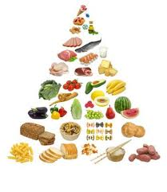
Fundamentals of Nutrition
Nutrition: all body processes relating to food.
Include digestion, absorption, metabolism, circulation, and elimination.
Nutritional status refers to the state of one’s
nutrition.
What is wellness? state of good health
c/ optimal body function.

Slide 3
Good nutrition may prevent or delay:
Hypertension
Atherosclerosis - arteries are narrowed by the accumulation of fats/minerals on their inner lining.
Osteoporosis
Malnutrition - poor nutrition.

Slide 4
6 Essential Nutrient Groups
Nutrient Groups | Functions
Carbohydrates | Provide heat & energy; supply fiber for good digestion and elimination.
Lipids (Fats) | Provide fatty acids needed for growth and development; provide heat and energy; carry fat-soluble vitamins to body cells.
Proteins | Build & repair body tissue; provide heat and energy; help produce antibodies.
Vitamins | Regulate body functions; build and repair body tissue.
Minerals | Regulate body functions; build and repair body tissue.
Water | Carries nutrients & wastes to and from body cells; regulates body functions.

Slide 5
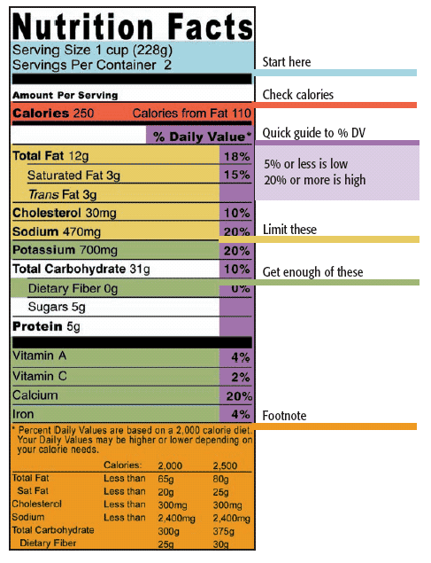

Slide 6
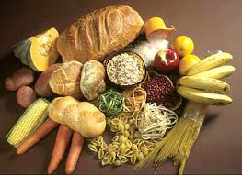
1. Carbohydrates (CHO)
Major source of E-
Starches or sugars mainly produced by plants
Breads, pastas, potatoes, peas, beans, grains (pick one)
Cellulose: fibrous, indigestible form of plant carb
Bran, whole-grain
Helps c bowel mvmts

Slide 7
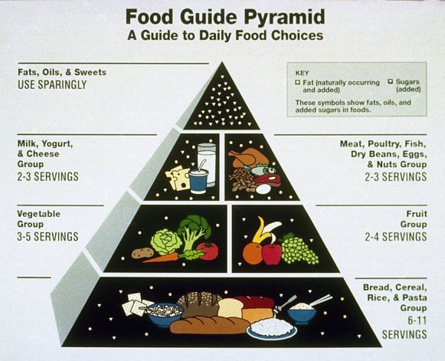
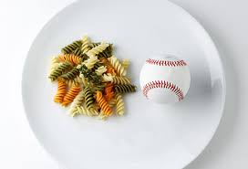
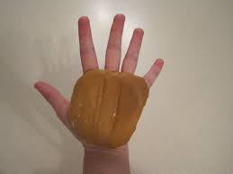
CHO Serving Size

Slide 8
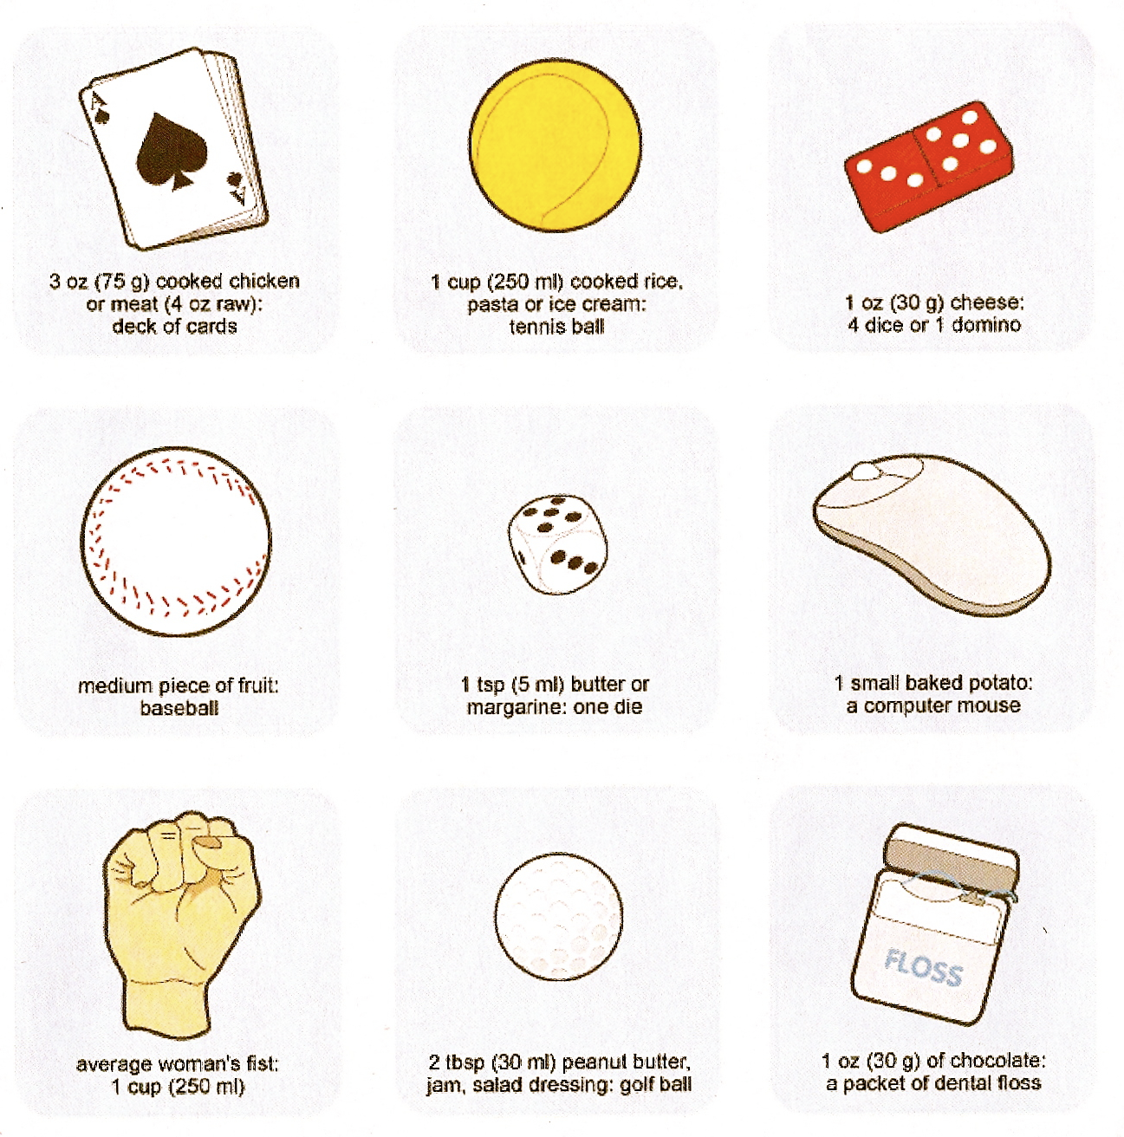

Slide 9
2. Lipids (Fats)
Provide E-
Maintain body temp
Cushion organs
Saturated – solids
Unsaturated – soft/oily
Provide flavor
3 common lipids:
1. Triglycerides
2. Phospholipids
3. Cholesterol

Slide 10
Fats Serving Size

Slide 12
Cholesterol (Chol)
Found in body cells/animal products
Produces:
Steroid hormones
VD
Bile acids
Common sources:
Egg yolk, fatty meats, shellfish, butter, cheeses (pick two)
What transports chol?
HDL (high density protein)
Good = Takes back to liver preventing plaque build up
LDL (low density protein)
Bad = Contributes to plaque build up leading to?
Atherosclerosis

Slide 13
Fats Continued: Triglycerides
Fat we eat broken down to fatty acids
Triglyceride main function:
Store E- for later; released when told by horomones
3 fatty acids =
1 Triglycerides – (also made from CHO)
Found in bld plasma
Elevated lead to coronary artery dz

Slide 14
Fats Serving Size

Slide 15
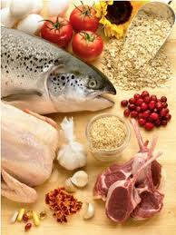
3. Proteins
Basic component of all cells
Build/repair tissue
Create digestive enzys
Made up of 22 amino acids
13 are incomplete
In beans/peas/corn
9 are essential/complete (22)
In fish/yogurt/milk

Slide 16
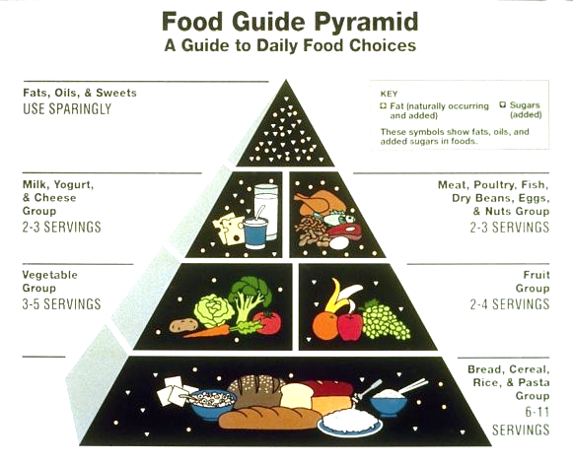
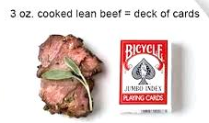
Proteins Serving Size

Slide 17
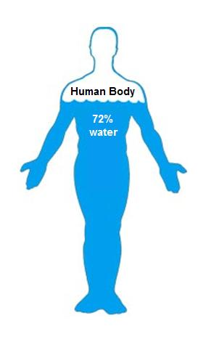
4. Water
In all body tissues
Lubricates jts
Protects spinal cord
Essential for digestion
Makes up blood plasma, cytoplasm of cells
Helps body absorb nutrients
Should drink 6 – 8 glasses a day

Slide 18
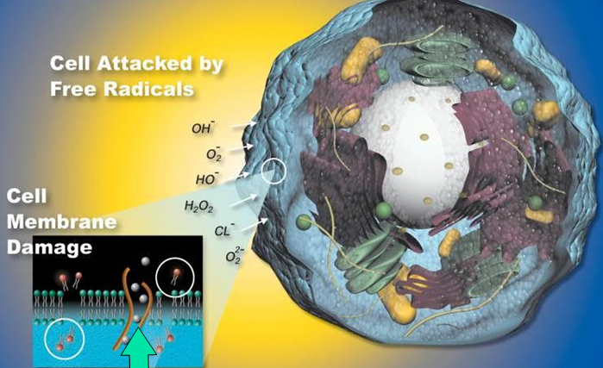
5. Vitamins
Organic compounds
Important for metabolism & bld clotting
Allow body to use E-
Some are Antioxidants (VA, C, E) – protect the body from harmful chemicals called free radicals;
In fruits/veggies
Free radicals are the results of O2 being used during metabolism
Can damage tissues/genes
Can lead to CA, CAD, arthritis

Slide 19
Vitamins Continued…
V are classified as H2O soluble or fat soluble
Water soluble v – dissolve in H2O & are not stored in the body.
-Includes VB, VC, & Folic Acid
Fat soluble v – dissolve in fat & are stored in the body.
-Includes Vitamins A, D, E, & K

Slide 20
6. Minerals
Inorganic (nonliving) elements found in all tissues
Some are antioxidants too (Mg, Zn, Cu)
- regulate body fluids (Na, K)
- contribute to growth (Ca, P, Mg, Zn)
- helps build tissues (Mg, S, Fe)
- formation of RBC’s (Fe, Cu)
- healthy skin, hair, nails (S)
- maintains heart rhythm (Ca, K)

