Slide 1
Today’s Objective:
Identify four types of synovial joints and their common mechanisms of injuries.

Slide 2
Types of Synovial Joints
Ball and Socket
Shoulder and hip
Allows all motion
Gliding
Non-axial joint
Carpal/tarsals

Slide 3
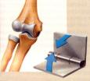
Types of Synovial Joints
3. Hinge
Uniaxial joint
Knee/elbow
Flexion/extension
4. Saddle
Biaxial joint
Allows two motions
Flexion/extension, ab/adduction, circumducion

Slide 4
Synovial Joint Injuries
Sprain
MOI = traumatic joint twist that results in ligamentous/capsule tearing
Grade 1 = pain, no instability, little swelling
Grade 2 = pain, moderate instability, swelling
Grade 3 = pain, instability, possible subluxation, gross swelling
5. Acute synovitis
Injured synovial membrane in conjunction with sprain

Slide 5
Synovial Joint Injuries
6. Subluxation
Partial separation between two articulating bones
7. Dislocation
Complete disunion between two articulating bones

Slide 6
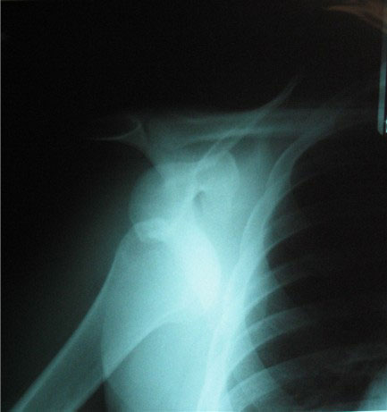

Slide 7
Synovial Chronic Joint Injuries
8. Osteochodrosis
Degenerative changes in the ossification centers of the bone ends (epiphysis)
Common in children during growth spurts
Causes:
Avascular necrosis
Trauma causing articular cartilage fx

Slide 8
Synovial Chronic Joint Injuries
9. Traumatic arthritis
Trauma to articular surfaces and structures causes thickening of bone and synovium
Pain, muscle spasm, and crepitus
Weakened ligaments and loose bodies are possible
10. Bursitis
Inflamed bursa due to constant pressure or trauma from overused muscles and/or tendons
May lead to a calcific bursa

Slide 9
Synovial Chronic Joint Injuries
11. Capsulitis
Inflammation of capsule following repeated microtrauma
Associated with synovitis
12. Synovitis
Joint congestion with edema
Synovial membrane becomes thickened and degenerative
Restricts movements

