Slide 1
12/11/14
Today’s Objective:
Describe mechanisms for skeletal injuries.

Slide 2
Bone Fractures (fx)
Open Fx – bone is visibly exposed through the skin.
Closed – bone is not visibly exposed through the skin.

Slide 3
3. Depressed fx
Mostly in flat bones (i.e. skull)
Indented fx caused by falling or striking an object
Compression force
4. Greenstick fx
Mostly in adolescent bones
Incomplete fracture, does not go all the way across the bone
5. Impacted fx
Bone is impacted causing a shortening of bone
Compression force

Slide 4
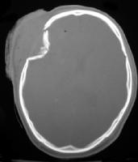
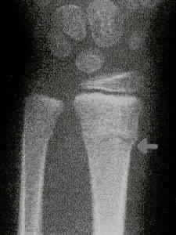
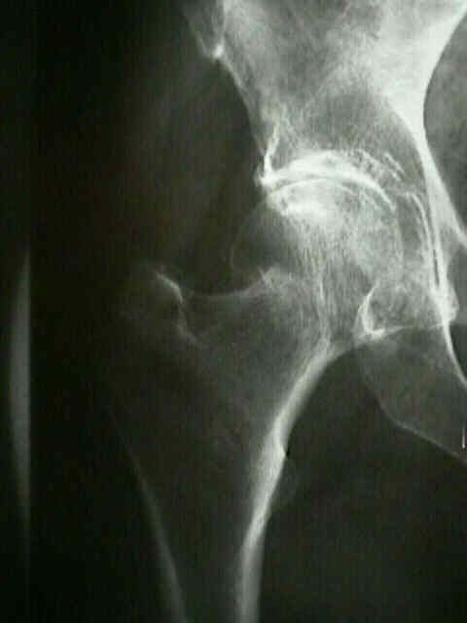
Depressed Fx
Greenstick Fx
Impacted Fx

Slide 5
6. Longitudinal fx
Bone splits along its length
Caused by jumping from a height or landing so to stress the longitude of the long bone
Bending force
7. Oblique fx
Fx line is diagonal to bone length
Created by a torsion force at one end with the other end fixed

Slide 6
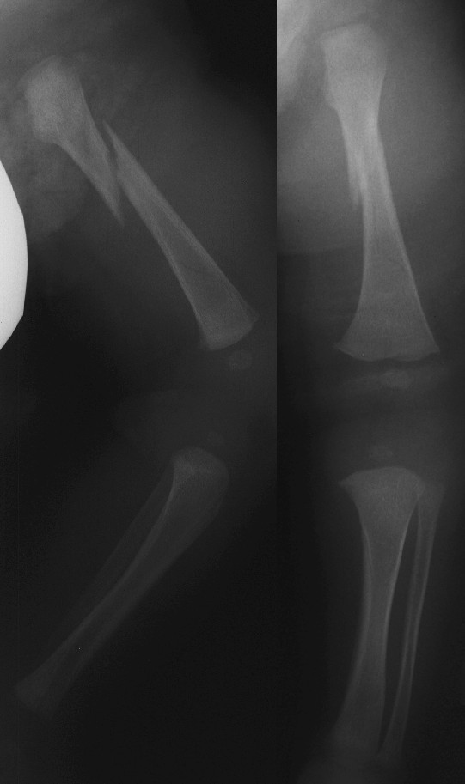
Oblique Fx

Slide 7
8. Spiral fx
S-shaped fx site
Created by a torsion force at one end with the other end fixed
9. Transverse fx
Fx line is at a right angle to length of bone
Caused by a direct blow
10. Comminuted fx
Fx site has 3 or more bone fragments
Caused by a direct blow or fall in an awkward position

Slide 8
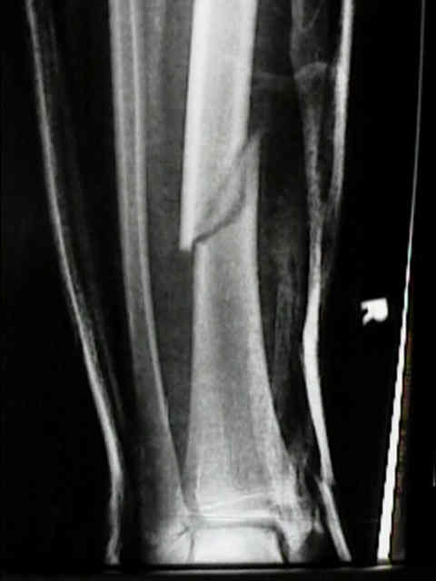
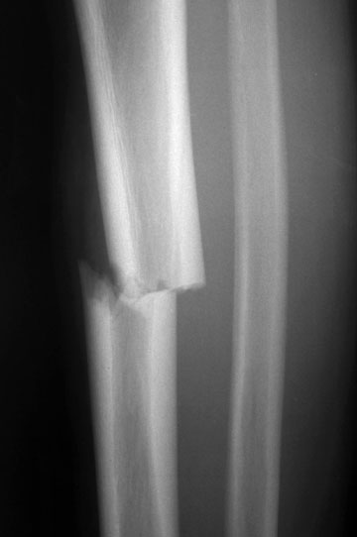
Spiral Fx
Transverse Fx

Slide 9
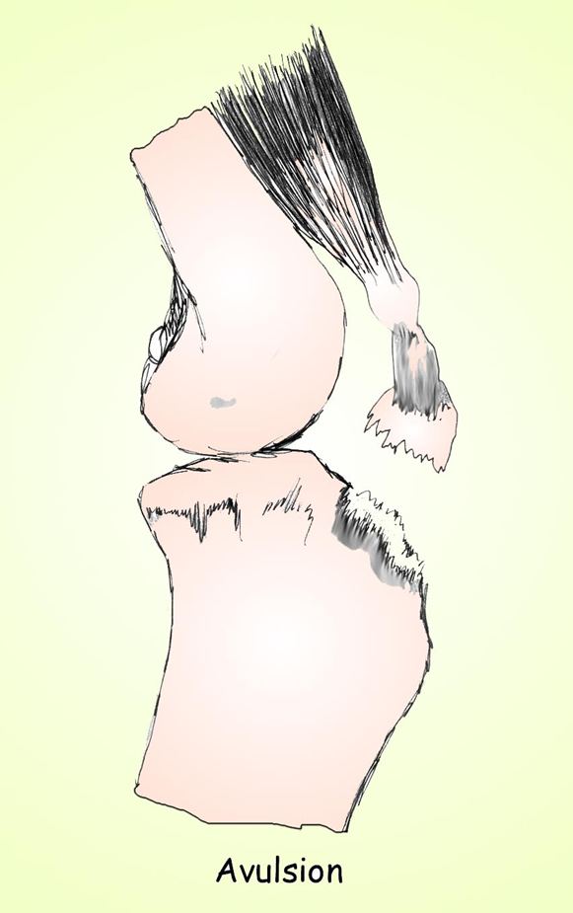
11. Avulsion
Separation of bone fragment from its attachment site of ligament or tendon
Caused by sudden twist or torsion

Slide 10
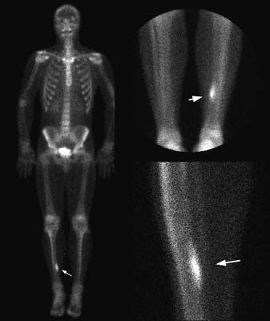
12. Stress fx
MOI
Altered stress distribution from fatigue
Rhythmic repetitive stress
Postural conditions
Flat feet, pronated feet, leg length discrepancy
Bone scan can provide an early dx

