Slide 1
Tanner Staging
Testes develop in the abdominal cavity.
Descend into scrotum before birth.
Grows slightly through childhood, begin to increase significantly in puberty.
Tanner Staging
Use to establish sexual maturity in children/adolescents by HC professionals.

Slide 2
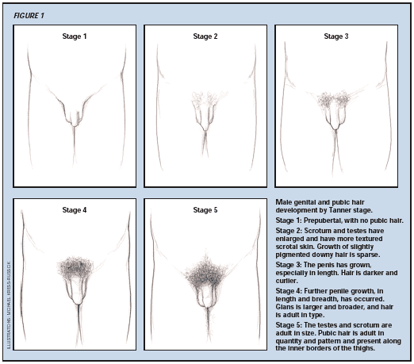
Refer to page 509 in your textbook:

Slide 3
Infancy Pathology
Anorchism – absence of testicles
a- absent; orchi- testes
Cryptorchism – failure for one or both of the tesicles to descent.
Crypt- hidden; orchi- testes
Polyorchism – having more than two testicles.
Poly- many; orchi- testes
Hermaphroditism – infant has both male/female sexual tissue
Hermes – male Greek god; Aphrodite – female Greek god;

Slide 4
Childhood / Adolescence Pathology
Testicular Torsion – typically occurs on the L side, testes rotates due to incomplete attachment of the testis on the wall of the scrotum.
Torsi- rotate
Tx: ER Sx
Priapism – prolonged erection, which is associated with sickle cell anemia; blockage of the bld flow in the penis causes it to become engorged c/ bld without the ability to exit the penis
Priapos – Greek god of procreation

Slide 5
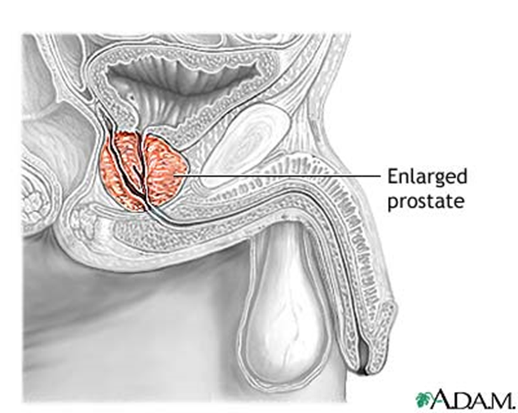
Adults/Senior Pathology
Benign Prostatic Hypertrophy (BPH)
An enlargement of the prostate gland which squeezes the urethra passing through it
S/S: painful, frequent urination
Over 50 y/o.

Slide 6
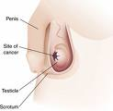
Testicular Cancer –
Cancer of the testes.
Commonly seen in ages 20 to 35.
S&S: Painless swelling of the testes, a heavy feeling, and an accumulation of fluid.
Treatment: Orchiectomy, or surgical removal of the testis, chemotherapy, and/or radiation.

Slide 7
General Pathologies
Epididymitis – An inflammation of the epididymis, usually caused by a pathogenic organism.
Epi- above; “didymos” Greek for twin
S&S: Intense p! in the testes, swelling, fever.
Tx: Antibiotics, cold application, and pain meds.

Slide 8
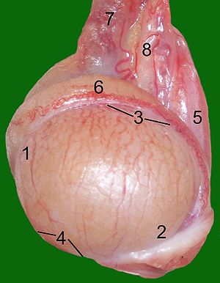
Orchitis
An inflammation of the testes, usually caused by mumps, pathogens, or injury.
S&S: Swelling of the scrotum, p!, and fever
Tx: Antibiotics (if indicated), antipyretics (for fever)!

Slide 9
Sterility
Term used for a variety of conditions related to the decrease or absence of sperm production.
Just because a male is sterile does not mean he is impotent and vice versa.
Aspermatogenesis – inability to produce sperm
A- absence; sperm- seed; -genesis formation.
What structure does is affected?
Aspermia – inability to produce semen
A- absence; sperm- seed; -ia condition of
What structures are affected?
Oligospermia – decrease in sperm production
Oligo- too little; sperm- seed; -ia condition of

