Slide 1
REPRODUCTIVE SYSTEM
Collectively for males and females, reproductive organs are referred to as gonads.
Collectively for males and females, sex cells are referred to as gametes.
- Female = ova (egg)
- Male = sperm
When a sperm penetrates through an ova the product is called a zygote (fertilized egg).

Slide 2
MALE REPRODUCTIVE SYSTEM
We will first look at the male reproductive system.
Urologists are physicians who specialize in the tx/dx of the male repro sys including sexual dysfunction.
- Infertility specialist handle pts who are unable to impregnate a woman for various reasons.
External organs are called genitalia. This is where sperm is produced and begins its journey, and where we will also start. First stop:

Slide 3
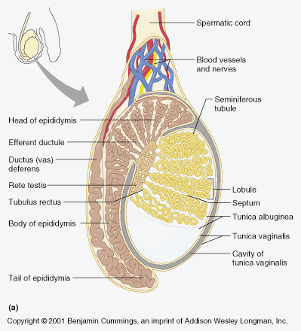
1.Testes
Is a gland
Located in the scrotum
Produces sperm
1000 long seminiferous tubules have cells that produce testosterone (the male sex hormone)
On your coloring sheet, color the testes (A) purple.

Slide 4
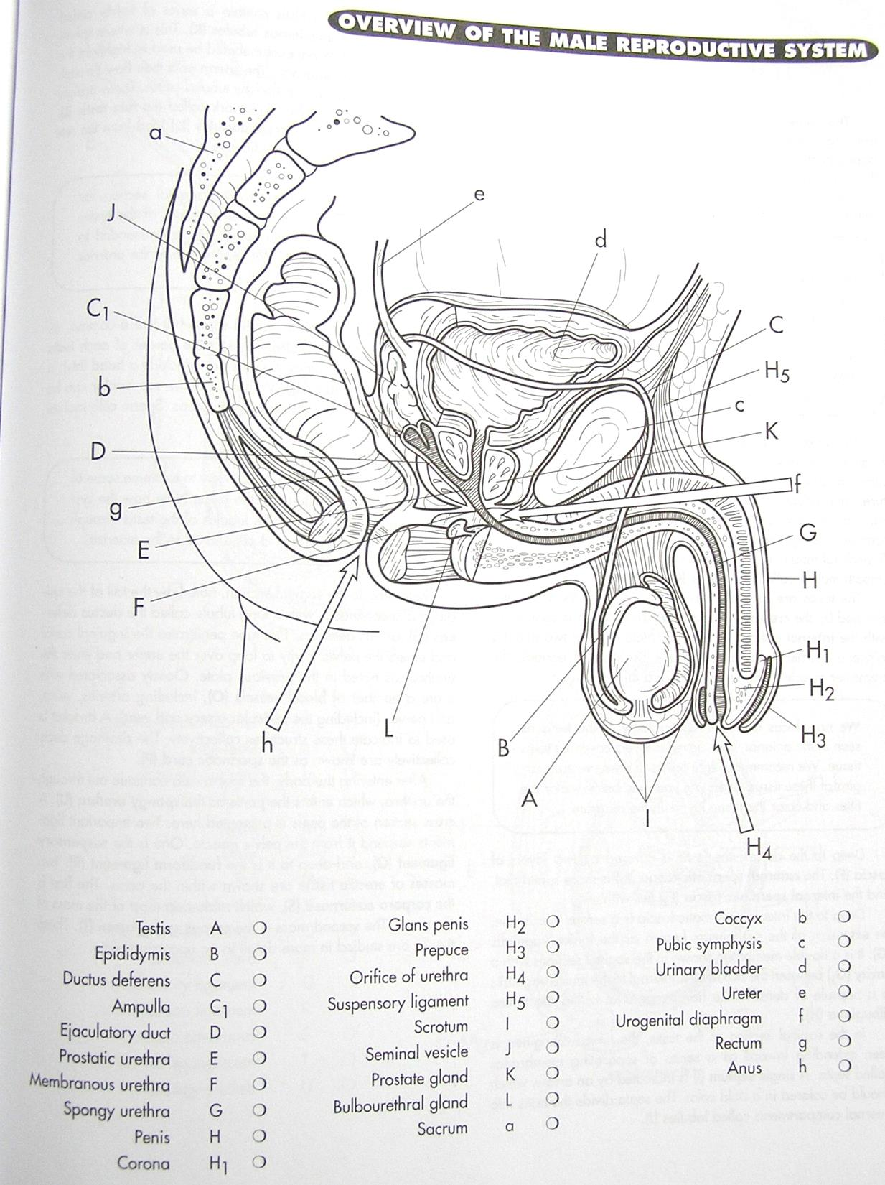

Slide 5
2. Epididymis
Stores the sperm while they mature and become mobile (able to move by themselves).
This can take 10 to 20 days.
Also produces a fluid that becomes part of the semen.
On your coloring sheet color the epididymis (B) light blue.
Sends mature sperm from the scrotum into the abdominal cavity by passing over the pubis symphysis (c – color yellow).
Cut during a Vasectomy (prevent future pregnancies).
On your coloring sheet color the Ductus Deferens (C) light green.
3. Vas Deferens (aka Ductus Deferens)

Slide 7
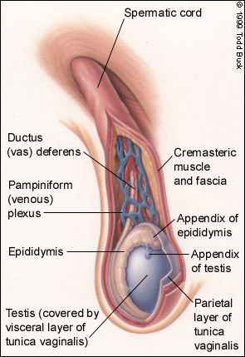
4. Spermatic Cord
Covers the Vas Deferens
Carries sperm over the top of and down the posterior surface of the bladder.
On your coloring sheet, color your urinary bladder (d) black.
It joins to the seminal vesicles.

Slide 8
5. Seminal Vesicles
Located behind the bladder
Creates about 60% of the volume of semen (fld containing sperm)
Produces a thick, yellow fluid that is rich in sugar and provides nourishment for the sperm.
On your coloring sheet, color the seminal vesicle (J) red.

Slide 10
6. Ejaculatory Ducts
The seminal vesicles join the ejaculatory ducts to carry the semen (sperm & fluids) through the prostate gland and into the urethra.
On your coloring sheet, color the ejaculatory duct (D) orange and the prostate gland (K) dark blue.

Slide 11
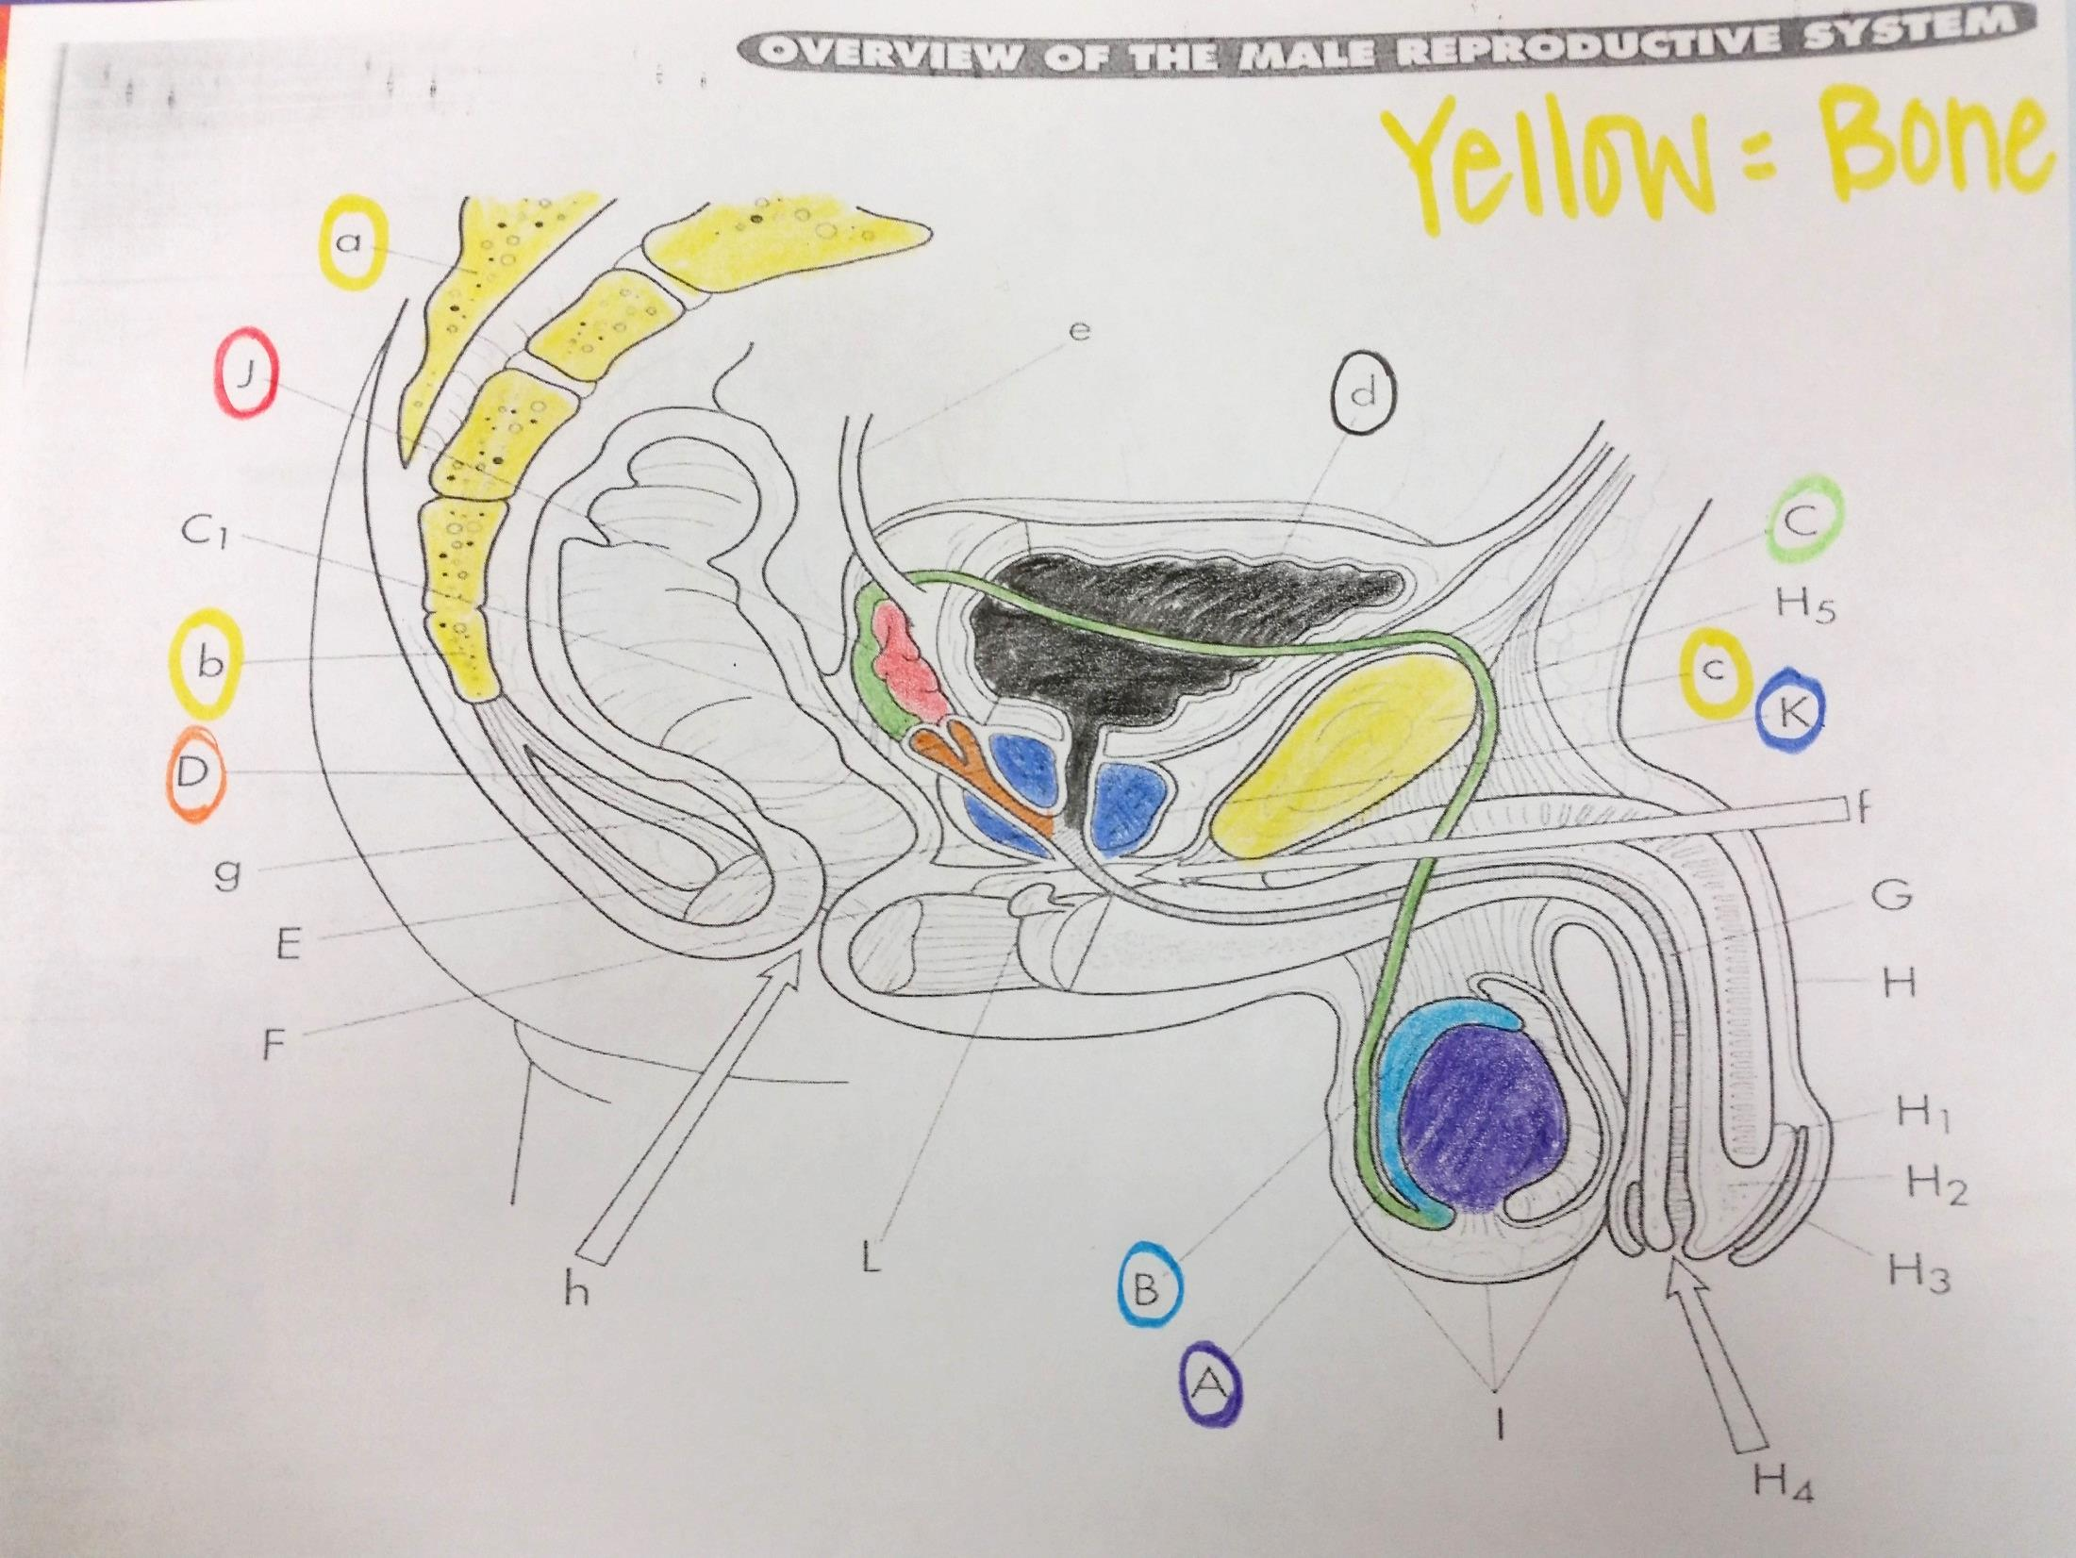

Slide 12
Prostate Gland
Doughnut-shaped gland located below the bladder.
Produces an alkaline secretion that increases sperm mobility and neutralizes the acidity in the vagina (better envir’t).
This accounts for another 30% of seminal fluids.
Contracts during ejaculation to aid in the expulsion of the semen.
Also closes off the urethra (prevents urine passage).

Slide 13
7. Cowper’s Gland
Located below the prostate gland
Secrete mucous for lubrication adding another 5% of seminal fluids.
Also secretes an alkaline fluid providing for a better environment for the sperm.
On your coloring sheet, color the Cowper’s Gland (L) pink.

Slide 14
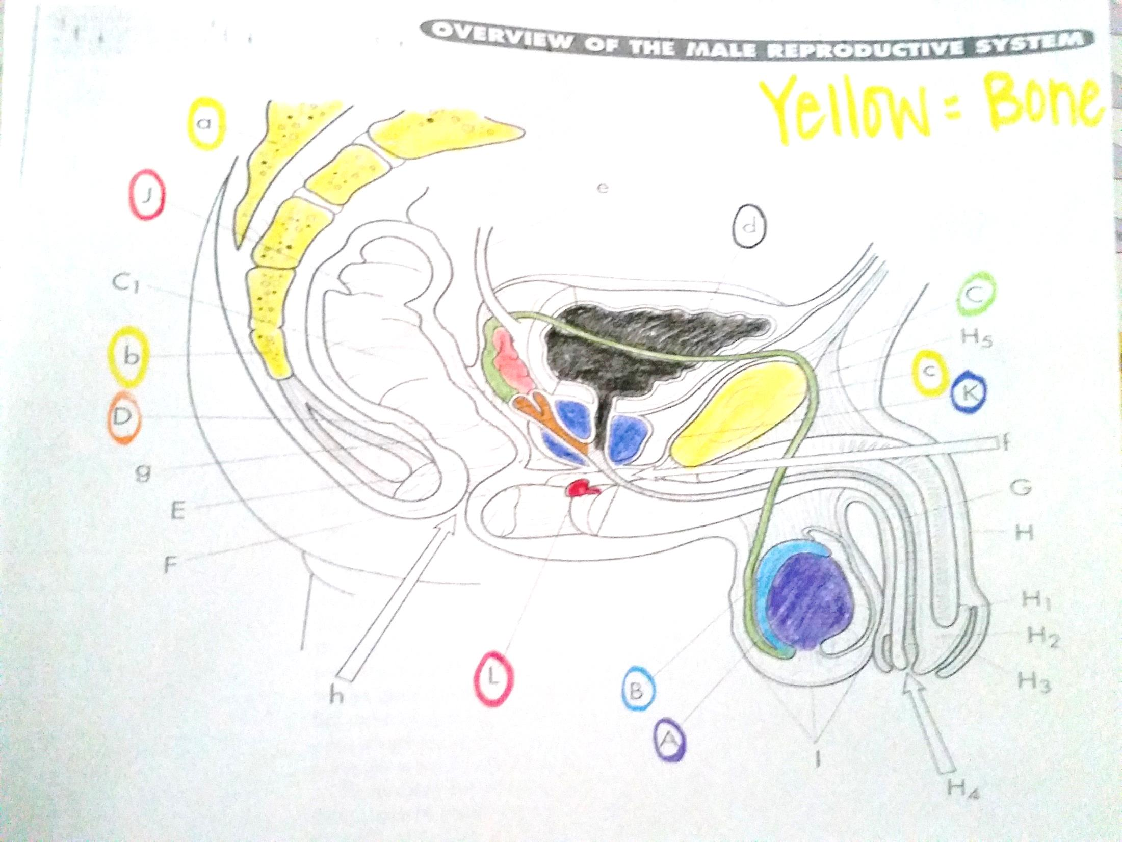

Slide 15
8. Urethra
Extends from the bladder to the outside of the body.
Carries urine and semen but not at the same time!
On your coloring sheet, color the Urethra (E,F,G) dark green.
Ejaculation is rapid expulsion of seminal fluid from the body.
~ 1 teaspoon
~100 million sperm

Slide 16
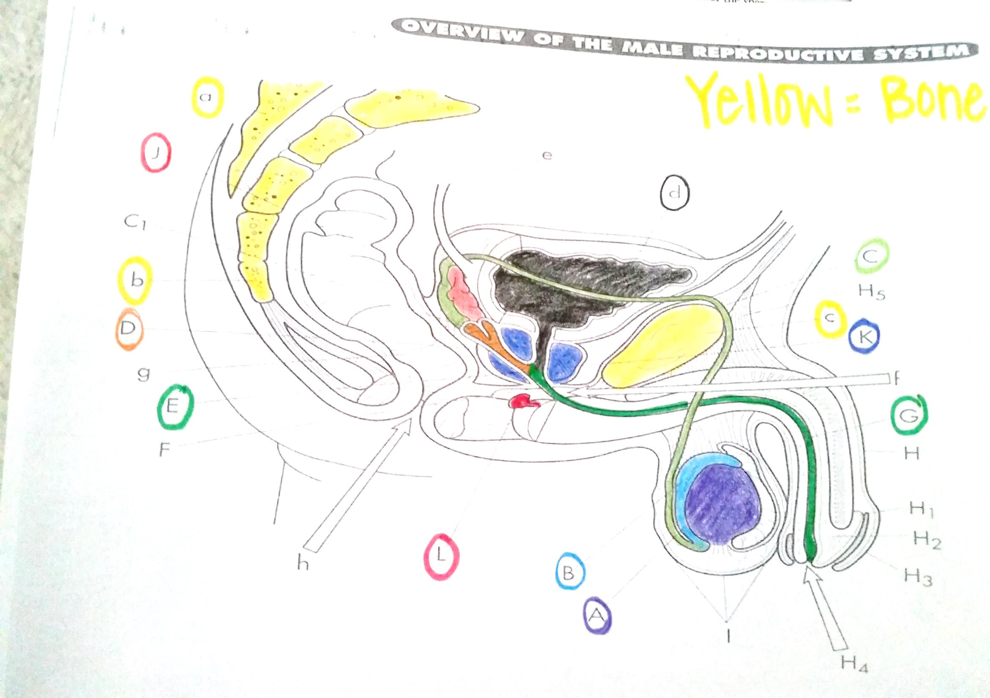

Slide 17
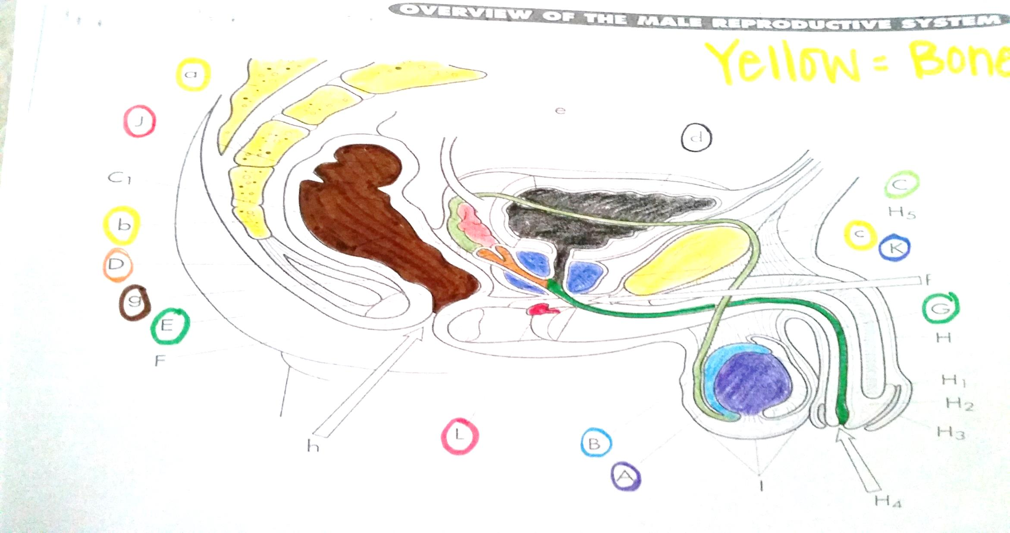
On your coloring sheet, color the rectum (g), brown..hehehe ☺

Slide 18
Penis
The external male reproductive organ.
Distal end is the glans penis.
On your coloring sheet, color the glans penis (H2) with a pink highlighter.
Covered with a prepuce (foreskin), which is sometimes surgically removed at birth (circumcision).
On your coloring sheet, color the prepuce (H3) with a yellow highlighter.
Fills with bld causing an erection.

