Slide 1
4/01/14 Today’s Agenda:
Unit 5: What skills are necessary to be a Laboratory Assistant?
Using a microscope
Obtaining/examining a cultural specimen
Spun HCT test
Hgb & Leukocyte test
ABO Test
Glucose Testing
Students will complete Daily Cerebral Exercise – turn in permission forms for lab.
TO: How do you test for blood sugar?
Students will perform LAS Lab #4 – Testing for Blood Sugar.

Slide 2
Daily Cerebral Exercise
The presence of _______ on the surface of a erythrocyte determines bld type.
When _____ occurs, the test is positive for the anti-serum being tested.
Describe erythroblastosis and its possible outcomes.
4. List 3 reasons why blood typing is important.

Slide 3
Blood Sugar
Glucose sugar found in bldstream.
Insulin produced in pancreas allows glucose to cross cell membranes so it can be metabolized and used for E-.
Insufficient insulin = diabetes mellitus
Cannot metabolize glucose (break it down for E-)
Builds up in bldstream thus kidneys filter it out & body eliminates it
Hyperglycemia – high bld sugar
Glycosuria – sugar in urine
2 main signs of diabetes

Slide 4
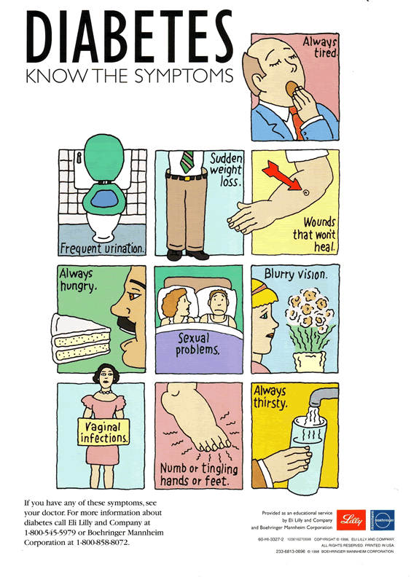

Slide 5
Diabetics
Control dz by calculated diets that control amount on sugar being consumed.
Control dz by insulin injections, but amount injected depends on exrs, metabolism, food intake, and stress.
Pts are taught to test bld sugar
Too much insulin can lead to hypoglycemia (low bld sugar)

Slide 6
Types of Diabetes
Type 2 Diabetes
Chronic dz
High level of glucose
Most prevalent form of diabetes
Type 1 Diabetes
Pancreas cannot produce any/enough insulin in beta cells.
Insulin (hormone) that allows sugar to be taken into cells to be converted to E-
Have to inject insulin qd to get the insulin they are lacking

Slide 7
Ways to Measure Bld Sugar
1. Glucose Meter
Uses reagent strips (plastic c chemical reagent pad)
Drop of bld from finger prick
Glucose reacts c chemicals and color changes occur
Compare color of reagent strip to color chart on bottle of reagent strips
Accurate?? No
Photometer more accurate

Slide 8
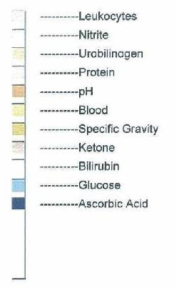
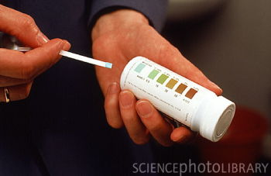

Slide 9
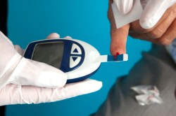
Ways to Measure Bld Sugar
2. Fasting Bld Sugar (FBS) performed in labs
No food/drink for 8 – 12 hrs pre-test
Venipuncture performed
Normal 70 – 110 mg / dL of bld

Slide 10
Normal Values of GTT
Hypoglycemia – low blood sugar
Normal Reading - 70 to 100 mg / dL (no food 8-12 hs pre test)
Hyperglycemia – high blood sugar

Slide 11
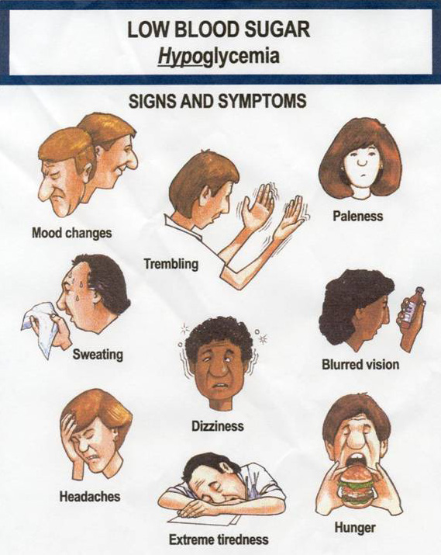

Slide 12
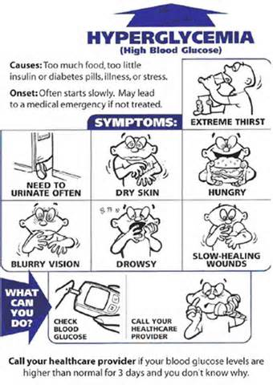

Slide 13
LAS #6: Glucose Testing 4/1/14
In lab notebook!
Assemble eqpmt: glucose reagent strips, glucose meter, latex gloves.
Wash hands, gloves
IWIPE
Perform skin puncture procedure (cleanse area first)
Use sterile gauze to remove first drop of bld.
Remove one reagent strip from the bottle.
Press the start button on glucose meter, wait for flash or beep.
When sufficient blood has been obtained have pt hold gauze over puncture.

Slide 14
LAS #6: Glucose Testing 4/1/14
In lab notebook!
9. Stat insert strip into meter.
10. Record the reading in mg / dL
11. Ck pt to ensure blding has stopped, band-aid.
Clean and replace all eqmt.
Remove gloves, wash hands.
Recoard all required information on pt chart.
Pt Name: _______________ Date: __/__/__
Time: _______ (military)
Test: Bld Glucose Reading: _____
Interpretation of Reading: _________________
Signature: _________________ Title: LAS

