Slide 1
Daily Cerebral Exercise
What are the five types of leukocytes?
A leukocyte is more commonly known as a _________.
In your own words describe the process of performing a differential count including how to prep the slide.
Hemeglobin test is run to test for what? What are the normal values for a man? A woman?

Slide 2
3/21/14 Today’s Agenda:
Unit 5: What skills are necessary to be a Laboratory Assistant?
Students will complete Daily Cerebral Exercise.
TO: How do you test for blood type?
Students will perform LAS Lab #3 – Determining Blood Types.

Slide 3
Testing for Blood Types
Classified in 1901 by Carl Landsteiner.
Inherit bld type from parents
Determined by presence of antigens on erythrocytes.
Antigens cause body to produce a protein-antibody that reacts against that antigen.
Two major blood type systems:
ABO Bld
Rh

Slide 4
1. ABO Bld Type Sys
2 main aggultinogens: A or B
4 main bld types: A B AB O
Letters refer to agglutinogens/antigen present on surface of RBC
Type A - A antigen
Type B - B
Type AB - both A & B
Type O - neither A nor B
After birth antibodies (agglutinins) against A & B antigens begin to build up in bld plasma.

Slide 5
Bld Type | Antigens on Erythrocytes (Agglutinogens) | Antibodies in Plasma (Agglutinins) | Can Give Blood To | Can Receive Blood From | % of Population
A | A | B | A, AB | O, A | 39%
B | B | A | B, AB | O, B | 12%
AB | AB | Neither Anti A nor B | AB | O, A, B, AB | 4%
O | Neither A nor B | Both Anti – A and B | O, A, B, AB | O | 45%

Slide 6
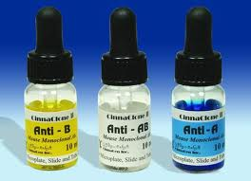
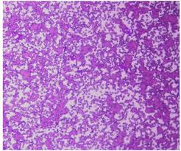
Process of Aggultination
Simple test, c antiserum containing high levels of anti-A and anti-B agglutinins to determine blood type.
3-4 drops of antiserum is added to the blood sample
Aggultination = clumping

Slide 7
Agglutination Rxn of ABO Bld Typing Serum
Reaction Anti-A Serum | Reaction Anti-B Serum | Blood Type
Agglutination | No Agglutination | A
No Agglutination | Agglutination | B
Agglutination | Agglutination | AB
No Agglutination | No Agglutination | O

Slide 8
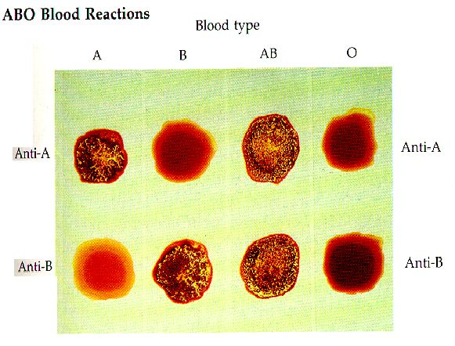

Slide 9
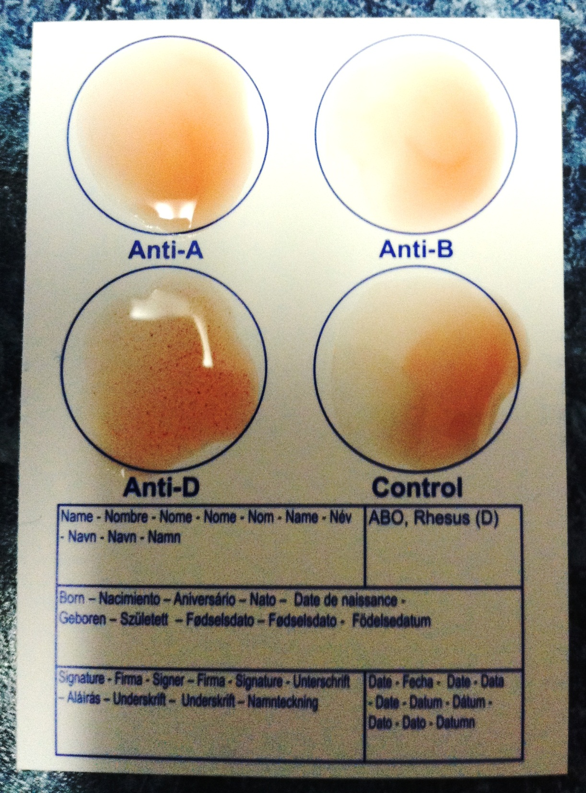

Slide 10
Rh System
1900 & 1940 more research was done on the presence of other antigens in human RBC
Rabbit sera contained antibodies for the RBC of Rhesus Monkeys, which agglutinated the RBC of 5% of Caucasians
These 6 antigens became known as the Rh factor
D is present in: 85% Caucasians
94% of African Americans
99% Asians
If agglutination occurs / D is present, Rh+
If no agglutination occurs / D is not present, Rh-

Slide 11
What about Pregnant Mothers?
Bld typing performed bc Rh incompatibility can cause hemolytic dz of the newborn (erythroblastosis).
Mother Rh – and fetus Rh +
D antigen enters mother through placenta
Mother produces antibodies
Those antibodies return to the fetus where hemolysis occurs in fetus
RhoGAM injection given 1 – 2 times throughout pregnancy & again 72 hrs post delivery
To save baby from the attack infants’s Rh+ bld is replaced by Rh-

Slide 12
Bld Transfusions
Typing must be performed 1st
Type must match or body will produce antibodies thus destroying new RBCs
Antibody Screen checks for unexpected antibodies that may be present to prevent incompatibility reaction.
Jehovah’s Witness, Christian Scientist will refuse bld transfusions.

Slide 13
Why is bld typing important?
Can only receive bld transfusions from certain types
If the wrong types are mixed erythroctye destruction & agglutination can occur
Identification of paternity (parents)
Cannot prove, but can rule out
Child is AB, mother is A, what can the father not be?
Criminal investigations
O

