Slide 1
3/19/14 Today’s Agenda:
Students will complete Daily Cerebral Exercise.
Students will watch video of a HCT test being performed.
TO: Define Hemoglobin, Leukocyte, and Blood Smear.
Students will complete Chapter Review for LAS. Turn into class box when finished.
Unit 5: What skills are necessary to be a Laboratory Assistant?
Ability to use a microscope.
Obtaining specimens.
Performing HCT
Performing Hemoglobin Test and Blood Smears
State Standards:
9.2 Describe strategies for prevention of diseases including health screenings and examinations.

Slide 2
Daily Cerebral Exercise:
What does a Crit test test for?
In your own words describe the steps for completing and HCT test.
For a skin puncture, why is the first drop of blood not used in testing?
For a culture sensitivity test, what does it mean if the pathogen does not grow up to the antibiotic disc?

Slide 3
3/19/14 Today’s Agenda:
Students will complete Daily Cerebral Exercise.
Students will watch video of a HCT test being performed.
TO: Define Hemoglobin, Leukocyte, and Blood Smear.
Students will complete Chapter Review for LAS. Turn into class box when finished.
Unit 5: What skills are necessary to be a Laboratory Assistant?
Ability to use a microscope.
Obtaining specimens.
Performing HCT
Performing Hemoglobin Test and Blood Smears
State Standards:
9.2 Describe strategies for prevention of diseases including health screenings and examinations.

Slide 4
Hemoglobin Test (Hgb)
Def – used to determine the oxygen-carrying capacity of bld
Hemoglobin is found on RBC
Composed of two parts:
Heme – iron
Globin – protein
Transports O2 to the body and CO2 to the
lungs
Before hemoglobin concentration can be
determined, the blood must be hemolyzed.

Slide 5
Hemolysis
Def – destruction of RBCs releases hemoglobin into the solution that surrounds cells.
Normal bld is red & cloudy.
During hemolysis, bld becomes clear.

Slide 6
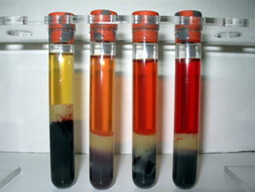
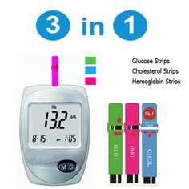
Two ways to test: both compare hemolysis coloring to get a reading for an individual pt
1. Hemoglobinometer
Not accurate bc relies on human eye.
2. Automated Photometer
Does not depend on human eye, therefore more accurate

Slide 7
Normal Values:
Males = 13 to 18 g of Hgb per 100 mm of bld
Females = 12 to 16 g
Newborns = 16 to 23 g
1 – 10 y/o = 10 to 14 g
Low Hgb = anemia
High Hgb = polycythemia

Slide 8
Blood Smear
Def: prepared by placing a small drop of blood on a slide; used for many blood test.
Differential count of WBCs (leukocytes) is one such test.
100 Leukocytes are counted.
A total of each of the five types of leukocytes is kept.
i.e. 27 lymphocytes = 27% lymphocytes
Increase in WBCs can diagnose infections.

Slide 9
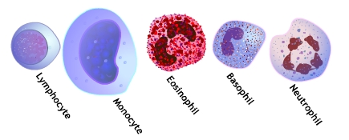
Increase = viral infection, TB
Decrease = HIV
Increase = bacterial infection
Increase = allergic rxn
Increase = bacterial infection
Increase = Malaria

Slide 10
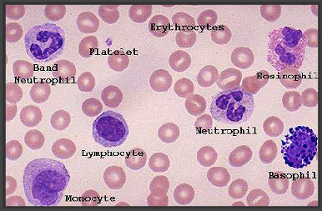
NAME THAT LEUKOCYTE!

Slide 11
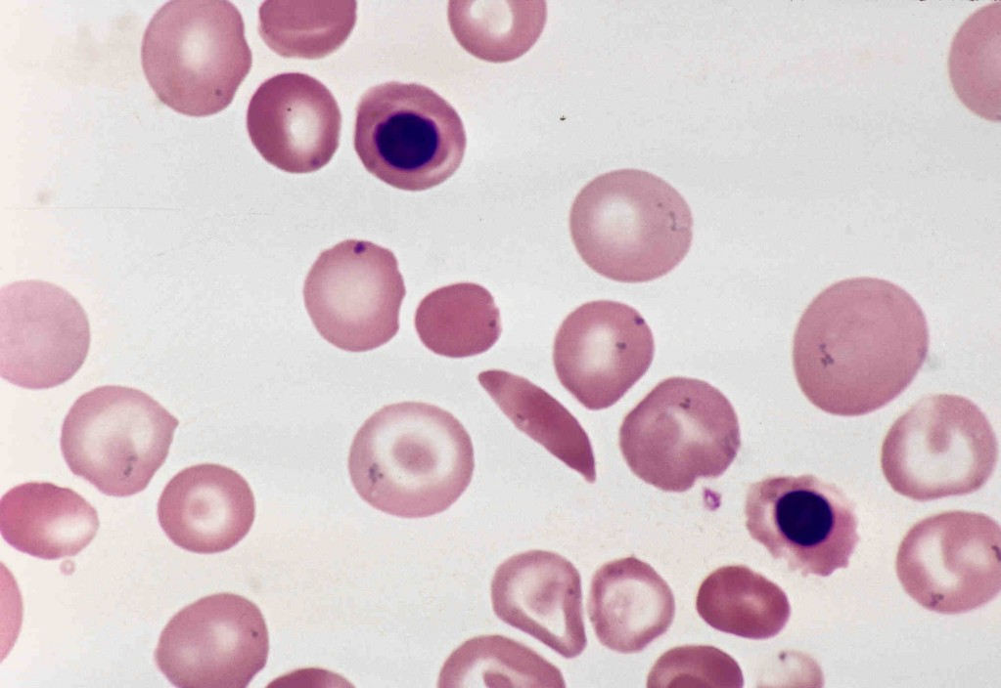
Blood Smear Continued
Used to examine the form, structure, & # of erythrocytes, leukocytes, & platelets.
Abnormal shapes can also be a sign of disease…i.e. Sickle Cell Anemia
Abnormal count & shape can both be seen in types of leukemia.

