Slide 1
3/17/14 Today’s Agenda:
Students will record M & N abbreviations for a quiz on Friday.
Students will complete Daily Cerebral Exercise.
LAS Lab #2 - Students will practice obtaining a specimen from another classmate.
TO: What is a microhematocrit test and how is it performed?
Students will review LAS Lab #1 – Using a Microscope AND Closure
Unit 5: What skills are necessary to be a Laboratory Assistant?
Ability to use a microscope.
Obtaining specimens.
Hematocrit Skin Puncture
State Standards:
9.2 Describe strategies for prevention of diseases including health screenings and examinations.

Slide 2
M & N List Abbreviations
MICU
min
mL, ml
mm
MN
mod
MOM
MRI
N
N/A
Na
NA
N/C
neg
Neur
NG, ng, N/G
nil
no
noc, noct
NPO
N/S, NS
N/V. N&V

Slide 3
3/17/14 Daily Cerebral Exercise
Describe the difference between a direct smear and an agar plate.
What is a culture sensitivity study? What is the difference between resistant and sensitive?
Describe in 4-5 sentences how to take a swab specimen.

Slide 4
3/17/14 Today’s Agenda:
Students will record M & N abbreviations for a quiz on Friday.
Students will complete Daily Cerebral Exercise.
LAS Lab #2 - Students will practice obtaining a specimen from another classmate.
TO: What is a microhematocrit test and how is it performed?
Students will review LAS Lab #1 – Using a Microscope AND Closure
Unit 5: What skills are necessary to be a Laboratory Assistant?
Ability to use a microscope.
Obtaining specimens.
Hematocrit Skin Puncture
State Standards:
9.2 Describe strategies for prevention of diseases including health screenings and examinations.

Slide 5
In your lab notebook, title a page & date: LAS #1 Obtaining a Buccal Culture Specimen
Check physician order
Assemble equipment
I WIPE:
Introduce
Wash Hands
Id pt
Privacy
Explain Procedure
Check body site for specimen collection.
Remove sterile applicator
Place tip on area to be cultured (use rotating motion).
6. Remove tip from culture site (do not touch anything else!)
7. Place applicator into the sterile tube (do not touch sides!)
8. Label the specimen with pt’s name, address, id #, doc name, date, type of test ordered, and culture site.
9. Take/send to lab.
10. Clean and replace equipment.
11. Remove gloves, wash hands.
THIS WILL NOT BE TESTED!!!

Slide 6
3/17/14 Today’s Agenda:
Students will record M & N abbreviations for a quiz on Friday.
Students will complete Daily Cerebral Exercise.
LAS Lab #2 - Students will practice obtaining a specimen from another classmate.
TO: What is a microhematocrit test and how is it performed?
Students will review LAS Lab #1 – Using a Microscope AND Closure
Unit 5: What skills are necessary to be a Laboratory Assistant?
Ability to use a microscope.
Obtaining specimens.
Hematocrit Skin Puncture
State Standards:
9.2 Describe strategies for prevention of diseases including health screenings and examinations.

Slide 7
Blood Test
Skin Puncture – requires only small amt of bld obtained from peripheral
Clean skin c/ alcohol pad
Sterile lancet (infant heel, earlobe, finger tip) 2 – 4 mm deep
First drop removed b/c contaminated
Do not squeeze finger b/c tissue fld will mix in
Cover c sterile gauze
Venipuncture – large amt taken from vein by phlebotomist

Slide 8
Performing a Microhematocrit
Hematocrit (HCT or “crit”) – measures the volume of packed erythrocytes (RBCs carry O2 & CO2)
Small amt bld is placed in a tube lined with an anticoagulant (Heparin)
Ends are filled with a clay seal
Centrifuge, spins ~10k/min
F separates bld into 3 layers:
Plasma
Buffy coat (WBCs/platelets)
RBCs

Slide 9
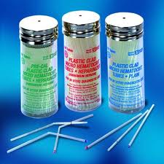
1. Tubes for bld to be placed in…

Slide 10
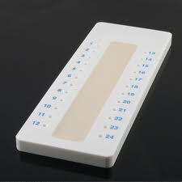
2. Seal ends of tube with clay…

Slide 11
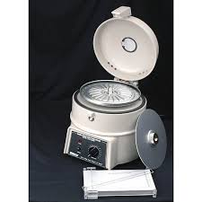
3. Spin in centrifuge for 10 min…

Slide 12
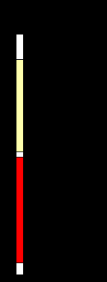
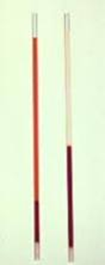
4. Separates into three layers…
-Plasma
-Buffy Coat
-RBC

Slide 13
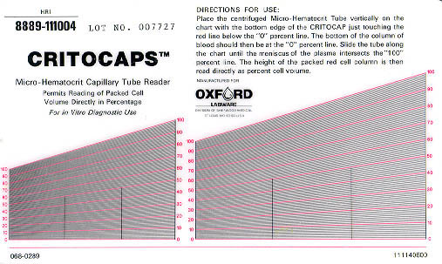

Slide 14
HCT Test Results
Normal values:
Women = 35 – 45%
Men = 40 – 55%
Newborns = 51 – 61%
1 y/o = 32 – 38%
6 y/o = 34 – 42%
Anemia: low hematocrit
Polycythemia: high hematocrit

Slide 15
Part 1 Closure - Create 3 test questions (1 parts of microscope, 1 cultures/stains, 1 HCT)
Summarize Match Rate List
Select Name Outline Identify
Choose Draw Change Diagram
Compare Discuss Diagram Distinguish
Contrast Decide Tell Conclude
Part 2 Closure – Return to your microscope WITH your notes over the parts of the microscope. Correctly label each part that you did not previously know or answered incorrectly.

