Slide 1
Gastrointestinal System Anatomy
Responsible for the physical and chemical breakdown of food so it can be used by the body cells and tissues.
2 Parts:
Alimentary Canal
Accessory Organs

Slide 2
1. Alimentary Canal
A long, muscular tube that begins at the mouth, pharynx, esophagus, stomach, small intestine, large intestine, and anus.

Slide 3
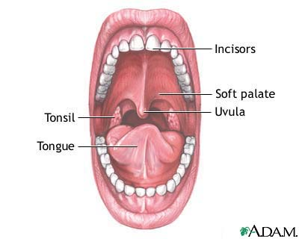
Mouth – Buccal Cavity
Food is tasted; lubricated & partially digested by saliva; and swallowed.
Teeth – physically break down food by chewing and grinding. (Mastication)
Tongue – muscular organ; taste buds.
Hard palate – Roof of the mouth; separates the mouth from the nasal cavities.
Soft palate – separates the mouth from the nasopharynx.
Uvula – prevents food from entering into nasopharynx
Salivary glands – produce saliva
Bolus – chewed food

Slide 4
1. Alimentary Canal Continued...
Pharynx (throat) – A tube that carries both food and air.
Esophagus – the muscular tube behind the trachea.
Carries bolus to the stomach
Peristalsis (rhythmic, wavelike, involuntary movement of its muscles)
Stomach – An enlarged part of the canal.
Food enters the stomach, sphincters close. 1 to 4 hrs.
Rugae – folds of the stomach lining that disappear as stomach fills
Chyme – bolus turned into semifluid material

Slide 5
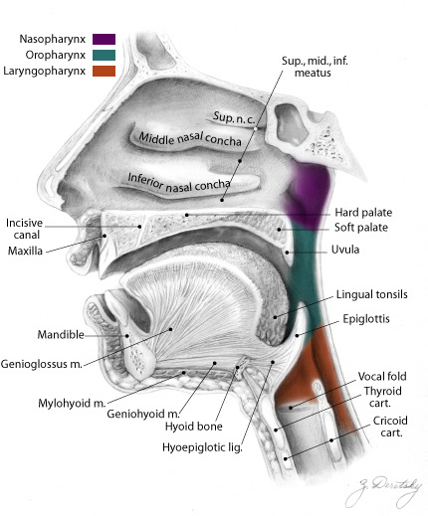
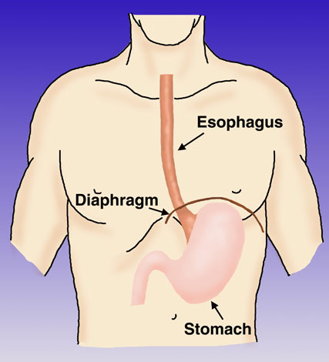

Slide 6
Gastric Juice Contents:
Turns a bolus into chyme using:
Pepsin (brkdn proteins)
Lipase (brkdn fats)
Hydrochloric Acid (kills bact, absorb Fe)
Mucus
Enzymes
Maltase, sucrase, amylase, and lactase (sugars)
Peptidases and Trypsin (protein)
Bile (fats)

Slide 7
1. Alimentary Canal Continued…
Small Intestine – 3 sections; duodenum, jejunum and ileum.
20 feet in length, 1 inch diameter
Villi - finger-like projections for absorption of nutrients
Duodenum – First 10 inches of small intestine
bile and pancreatic juice enter
Jejunum – 8 feet in length
Ileum – Final 12 feet, connects with the large intestine
Digestion is complete; absorbed into bldstream.
Only wastes, indigestible materials, and excess water remain.

Slide 8
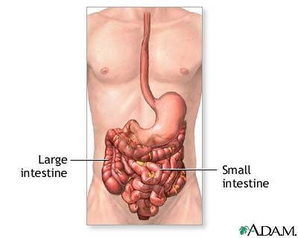
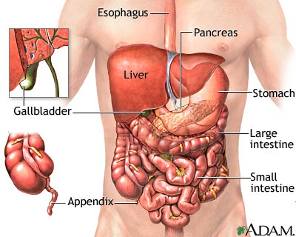

Slide 9
1. Alimentary Canal Continued…
Large Intestine – Final section of the canal.
5 feet in length, 2 inch diameter
Absorption of H20 & any remaining nutrients; storage of indigestible materials before elimination; absorption of some vitamins; and transportation of waste out of the body.
Cecum – First part of the large intestine
Also has the Appendix projected
Colon
3 sections; ascending, transverse, descending. (Sigmoid – connects colon to rectum)
Rectum – Final 6 to 8 inches of the large intestine
Storage for indigestibles and wastes
Anus

Slide 10
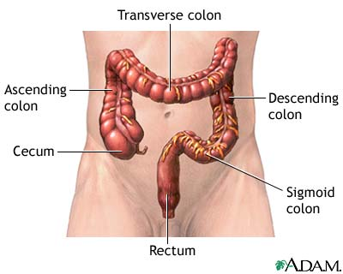

Slide 11
2. Accessory Organs
Liver
Largest gland in the body
Secretes bile (emulsify fats)
Stores sugar (glycogen – glucose)
Stores iron and other vitamins
Heparin – prevents clotting & proteins to help clotting
Detoxifies substances
Gallbladder
Stores & concentrates bile
Pancreas
Produces pancreatic juices
Produces insulin (regulate glucose)

Slide 12
