Slide 1
Today’s Agenda: 1/6/15
TO: What are 9 common head/face injuries seen in sports?
2. Students will begin UE injuries flashcard set.
Unit 5 Essential Question- Identify and describe causes of injuries to the upper extremity.

Slide 2
1. Cranium Fx
Protects the brain
MOI: compression force
s/s: severe headache, nausea, deformity (indention), edema, possible bld or CSF from the ear, raccoon eyes
Tx: stat neuro-referral
Prevention: Proper fitting helmet

Slide 3
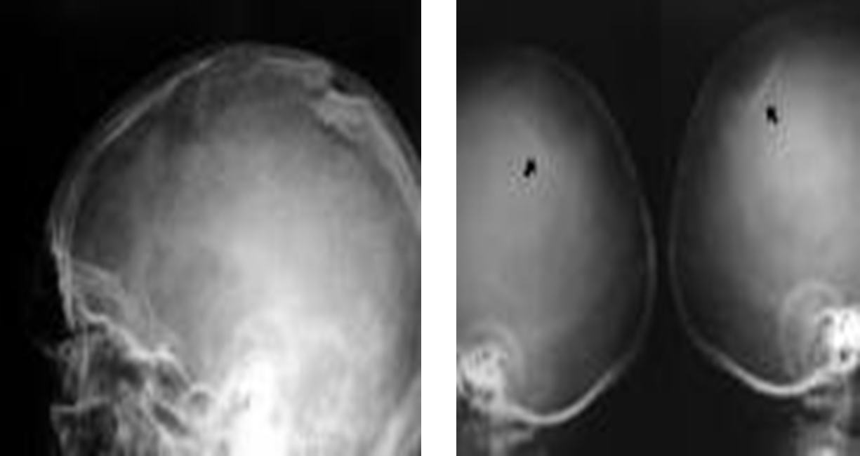

Slide 4
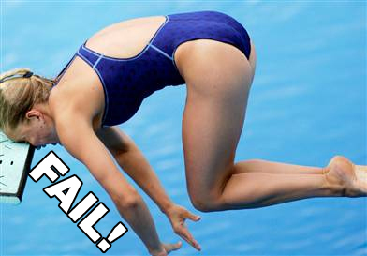

Slide 5
2. Acute Conjunctivitis
Et: Bacteria or allergens; inflammation of the conjunctiva (back of the eyelid).
s/s: Eyelid swelling, discharge, itching, burning.
Tx: Highly infectious. Refer to MD for meds.

Slide 7
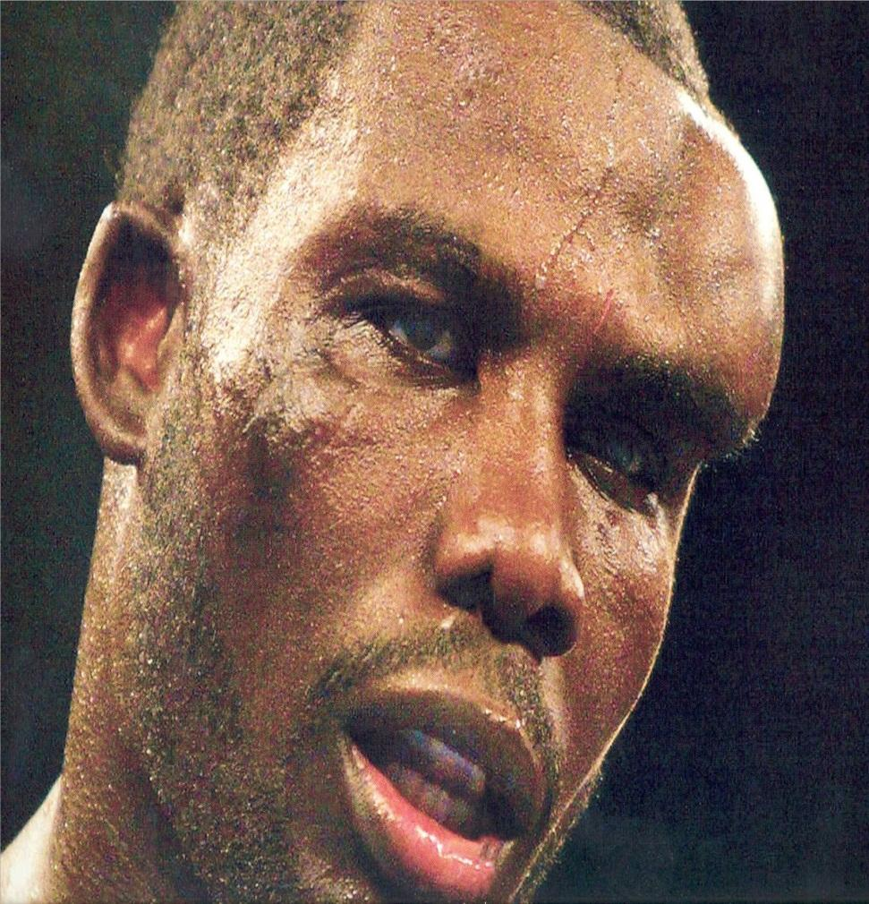
3. Orbital Fx
MOI: direct blunt trauma; compression
S/S: raccoon eyes, downward displacement of eye, double vision, swelling, restricted eye mvmt
Tx: Ice, X-Ray, sx

Slide 9
4. Nasal Fx
MOI: Blunt trauma to the nasal area
S/S: Deformity, p!, epistaxis
TX: Control blding, X-Ray

Slide 10
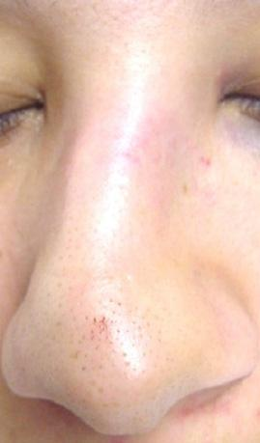

Slide 11
5. Epistaxis (Nosebleed)
MOI: blunt trauma to septum, sinus inf, high humidity, allergies
S/S: Blding
TX: Sit upright c/ ice; finger pressure on artery; gauze in the nostril; gauze placed between the upper lip/gum.

Slide 12
6. Tooth Fx, Sublux, Avulsions
MOI: Impact to the upper or lower jaw
S/S: Slightly loosened tooth to complete loss of tooth, blding, p!
TX: Keep tooth in the socket, if not possible place tooth in sav-a-tooth solution, milk, or inner check, refer dentist stat
Prevention: proper fitting mouthpiece

Slide 13
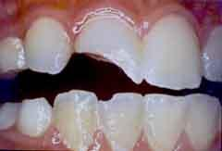

Slide 14
7. Mandible Fx
MOI: Direct blow
s/s: deformity, loss of normal occlusion of teeth, p! c biting down, bleeding around teeth, numb lower lip.
Tx: Immobilization, referral to MD.
Prevention: Mouthpiece

Slide 16
8. Otitis Externa
aka: Swimmer’s Ear
MOI: Infection of the ear canal.
s/s: Itching, discharge, or partial hearing loss, p!, dizziness.
Tx: Dry ears, referral to MD, antibiotics
Prevention: Dry ears!

Slide 17
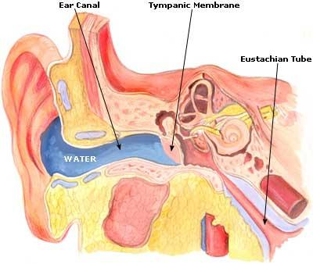

Slide 18
9. Auricular Hematoma
Cauliflower Ear
MOI: Compression or a shearing injury to the ear that causes blding into the cartilage.
s/s: edema, p!.
Tx: Ice, compression, aspiration.
Prevention: protective headgear, Vaseline

Slide 19
