Slide 1
Today’s Agenda:
Next class – quiz over GI anatomy, be prepared to label. Also know quadrants and regions.
Common GI word parts to know.
TO: Identify common GI pathologies.
Finish chapters 32 – 35 of Henrietta Lacks.
GI Weebly Pathology – check the weebly to see which one you have been assigned.

Slide 2
Common GI Word Parts
Gloss- (tongue)
-ia, -iasis, -osis (condition of)
-ic (pertaining to)
Herni- (rupture)
Trach- (windpipe)
Lact- (milk)
Re- (back,again)
Hepat- (liver)
Hem- (blood)
-rrhea (flow)

Slide 6
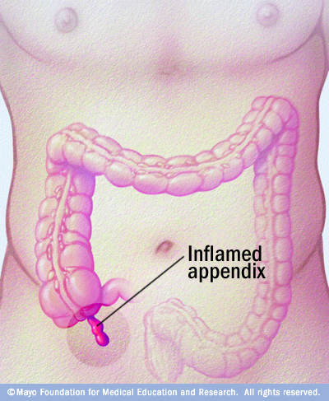
1. Appendicitis
An acute inflammation of the appendix, usually resulting from an obstruction and inf.
Abdominal p!
Nausea & vomiting
Fever, inc WBC
Rupture = peritonitis
Surgery to remove

Slide 7
2. Cholecystitis
An inflammation of the gall bladder.
Cholelithiasis – gall stones crystallized salt/bile
After fatty foods….
Indigestion, N & V
P! under rib cage & up to right shoulder
Rupture = peritonitis
Tx: low-fat diet, lithotripsy (shock waves), surgery

Slide 8
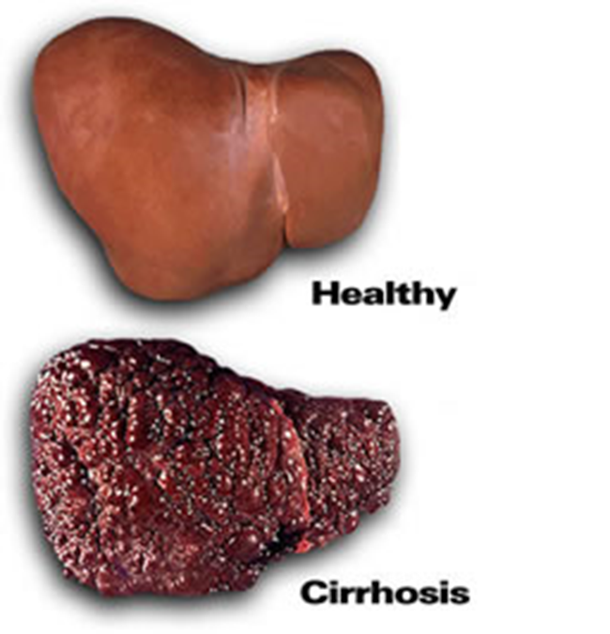
3. Cirrhosis
A chronic destruction of liver cells accompanied by the formation of fibrous connective and scar tissue.
Causes: hepatitis, bile duct disease, chemical toxins, malnutrition w/ alcoholism.
Symptoms:
Anemia, indigestion, nausea, vomiting, nosebleeds, jaundice.

Slide 9
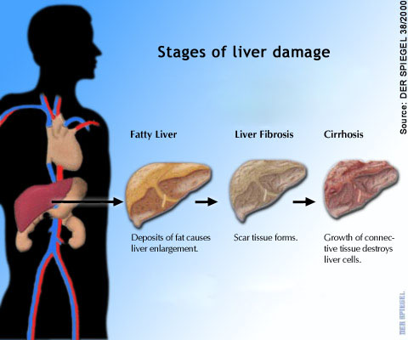
Tx: Avoid alcohol, proper nutrition,
vitamin supplements, rest, exercise

Slide 10
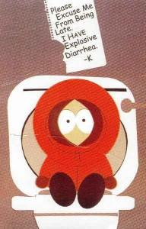
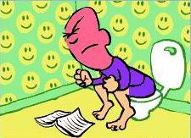
4. Constipation – When fecal material remains in the colon too long, causing excessive reabsorption of water.
High-fiber diet, flds, exrs, laxatives.
5. Diarrhea – A condition characterized by frequent watery stools.
Eliminate the cause, flds, modify diet.

Slide 11
6. Diverticulitis – An inflammation of the diverticula, pouches (or sacs) that form in the intestine as the mucosal lining pushes through the surrounding muscle.
Abd p!, irregular BM, flatus; constipation or diarrhea; abd swelling; nausea; fever.
Antibiotics, p! meds, sx.

Slide 12
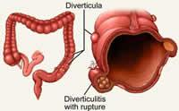
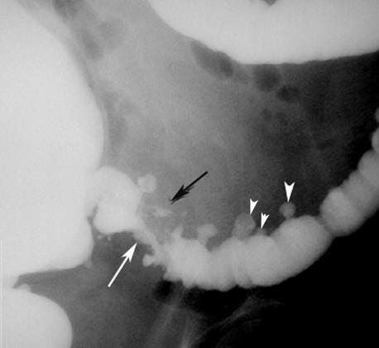

Slide 13
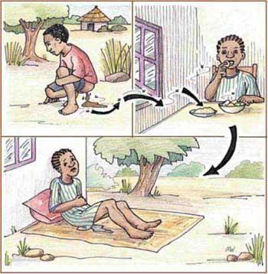
7. Gastroenteritis – An inflammation of the mucous membrane that lines the stomach and intestinal tract.
Food poisoning, infection, toxins.
Rest, fluids, antibiotics

Slide 14
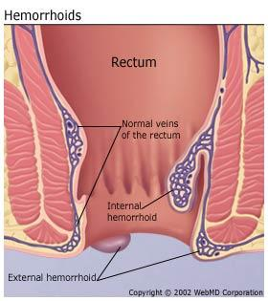
8. Hemorrhoids – P!, dilated or varicose veins of the rectum or anus.
Straining to defecate, constipation, pressure from pregnancy, low fluids, laxative abuse, prolonged sitting.
High-fiber diet, increase fluids, stool softeners, Prep H medication.

Slide 15
9.Hepatitis – A viral inflammation of the liver.
Type A,B,C,D, and E.
S/s:
Pyrexia, lack of appetite, N&V, fatigue, dark-colored urine, clay-colored stool, enlarged liver, jaundice
Tx:
Rest, diet high in protein, high in calories, low in fat, Transplant is necessary.

Slide 16
10. Hernia – Occurs when an internal organ pushes through a weakened area or natural opening in a body wall.
s/s:
Heartburn, stomach distention, chest p!, difficulty swallowing (dysphagia)
Tx:
Bland diet, small frequent meals, staying upright after eating, surgical repair.

Slide 17
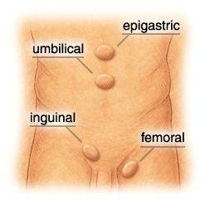
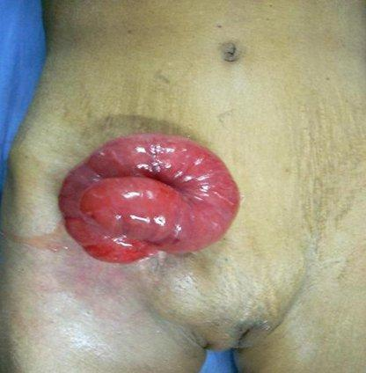
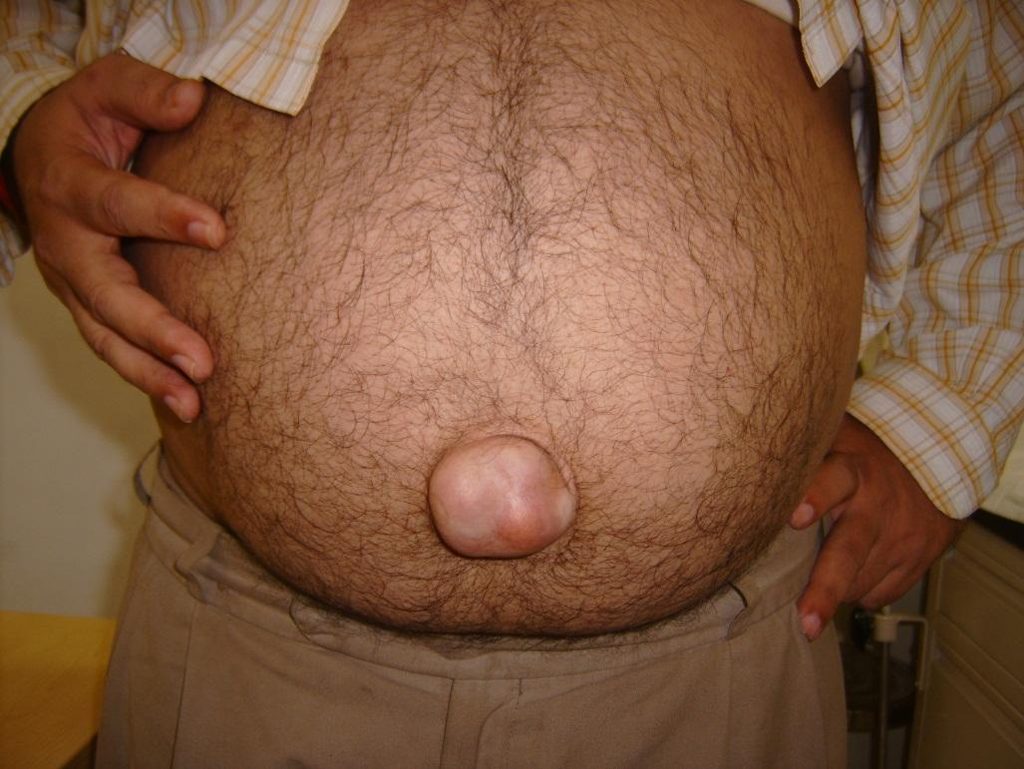

Slide 18
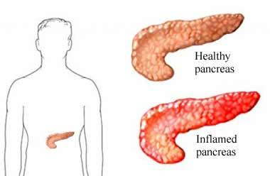
11. Pancreatitis – An inflammation of the pancreas due to excessive alcohol consumption or gallstones.
Symptoms:
Severe abd p!
N&V
Diaphoresis
Jaundice
Treatment depends on cause

Slide 19
12. Peritonitis – An inflammation of the abd peritoneal cavity, usually occurs when a rupture in the intestine allows the intestine contents to enter the peritoneal cavity.
s/s: Abd p! and distention, fever, N&V
tx: antibiotics, surgical repair of intestine

Slide 20
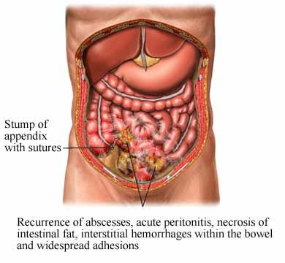

Slide 21
13. Ulcer – An open sore on the lining of the digestive tract due to a burrowing bacteria.
s/s:
Burning p!, indigestion, bloody vomitus, dark, tarry stool
tx:
Antacids, bland diet, dec stress, avoid irritants, antibiotics, Pepto-Bismol, surgery

Slide 22
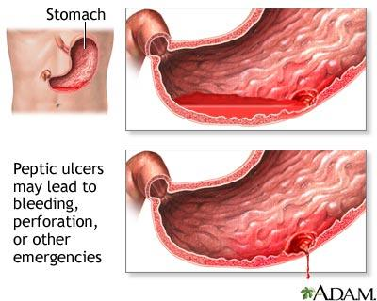
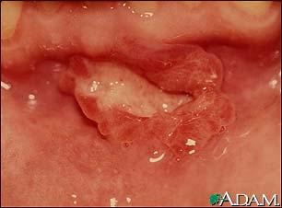

Slide 23
14. Ulcerative Colitis – A severe inflammation of the colon accompanied by the formation of ulcers and abscesses due to stress, allergens or autoimmune rxn.
s/s:
Diarrhea containing bld, pus, and mucus.
Wt loss, weakness, abd pain, anemia
Tx:
Controlling inflammation, reducing stress proper nutrition, surgery to remove

Slide 24
