Slide 1
DEATH AND DYING
Today’s Agenda: 1/6/15
TO: Name and define the 5 stages of grieving.
Blanche’s Dead Grammy
Closure - Death and Dying Reflection on Padlet using iPads.
U4 EQ: How will your role as a HC professional affect health care facilities and the care that you provide?
- Death and Dying
- Human Needs
- Geriatric Care

Slide 2
DEATH
“The final stage of growth.”
Experienced by everyone and cannot be avoided.
Terminal Illness: a dz that cannot be cured
Reactions: 5 stages of grieving

Slide 3
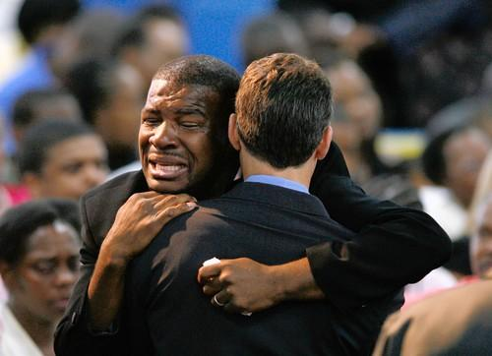
5 STAGES OF GRIEVING
May:
not occur in order.
overlap or be repeated several times.
not progress through all of the stages.
be in several stages at once.
The stages are……

Slide 4
1. DENIAL
TO
“No, not me!”
Cannot accept the reality of death or when the person feels loved ones cannot accept the truth.
Patients need to discuss their feelings.
Ask questions about the condition.

Slide 5
2. ANGER
TO
No longer able to deny death.
“Why me?” or “It’s your fault!”
Very hostile and bitter.
Blames everyone!
Continues until anger is exhausted or the patient must attend to other concerns.

Slide 6
3. BARGAINING
TO
When patients accept death but want more time to live.
Turns to religion and spiritual beliefs.
The will to live is strong and will make promises to God for more time.
Try to help them make their wishes come true.

Slide 7
4. DEPRESSION
TO
When patients realize that death will come soon and they will no longer be w/ their families or be able to complete their goals.
Express regrets or withdraw and become quiet.
Sadness and despair.
It’s “OK” to be sad.

Slide 8
5. ACCEPTANCE
TO
The final stage.
Patients understand and accept the fact that they are going to die.
Gradually separate themselves from the world.
At the end, they are at peace.
Golden Girls – Blanch’s Grammy

Slide 9
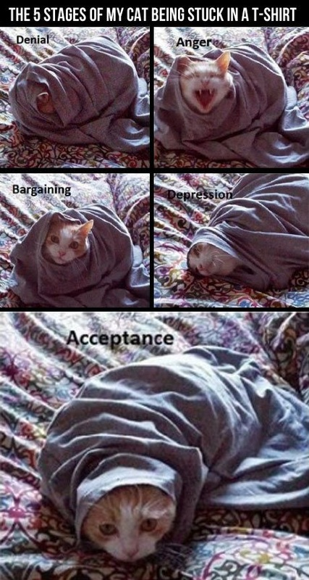

Slide 10
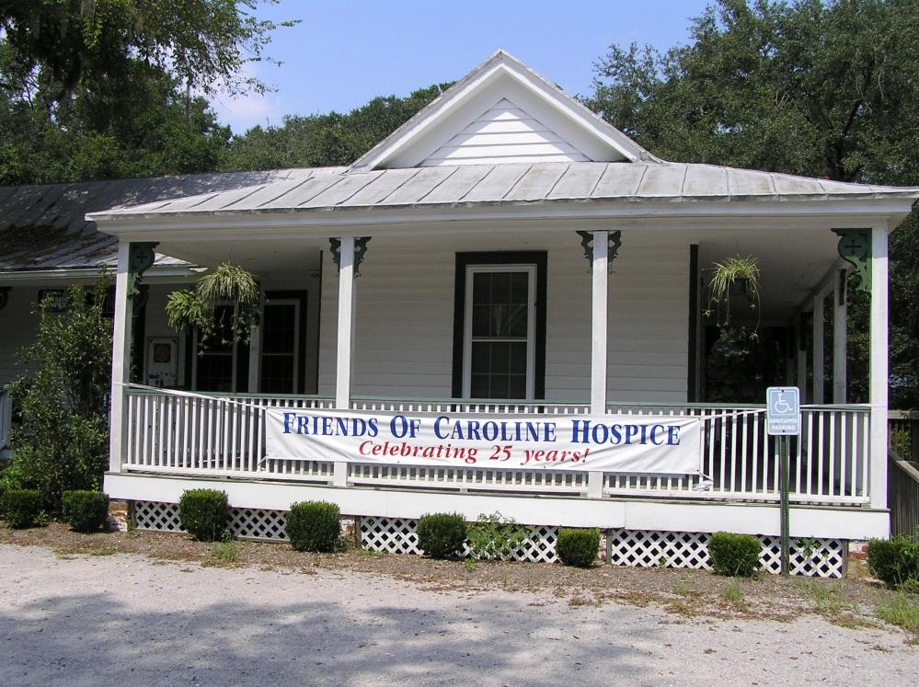
HOSPICE
Offers care that provides support and comfort.
6 months or less to live.
Allow the patient
to die w/ dignity &
comfort.
Right to die: if terminally ill can refuse treatment

Slide 11
IN YOUR LAB NOTEBOOK
Think of a time where you, or someone in your family has experienced the stages of grieving. Explain how they moved through the five steps of grieving. If you cannot think of a personal experience use one that you have seen in a movie or on television. Be sure to include the terminology you just learned.
http://padlet.com/lwill/HST2

