Slide 1
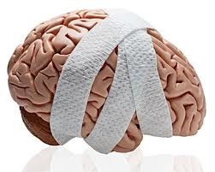
Today’s Agenda: 1/28/14
Students will read chapter 13 of Gifted Hands, and write reflection (10:10).
TO: What is a concussion, and what physiological affects occur due to a concussion?
Students will practice decoding the prompt using the DIVER Strategy.
Unit 4: What are popular injuries to the head/face, and how are they cared for?
SC State Standards:
3.1. Analyze injury and athletic training room statistics.
10.1 Demonstrate the appropriate assessment, care, and rehabilitation of the head.

Slide 2
Definition of a Concussion
A concussion is a BRAIN INJURY that occurs in sports.
“…a biomechanically induced neurological injury resulting in an alteration in mental status such as confusion or amnesia which may or may not involve a loss of consciousness.”
AAN, 1997

Slide 3
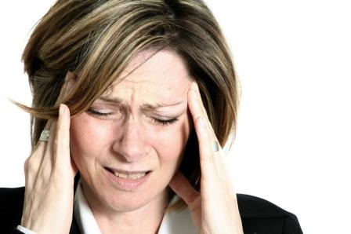
Prevalence
The Center for Disease Control (CDC) reports that a ~1.8 to 3.6 million concussion injuries occur in sports and recreational activities annually in the U.S.

Slide 4
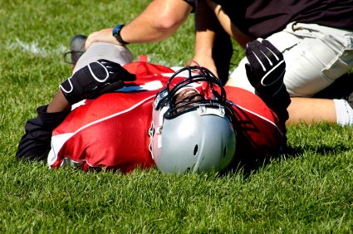
Concussion Rates
Boys Soccer
Girls Soccer
Boys Basketball
Girls Basketball
Baseball
Softball
Wrestling
Cheerleading
Football
(per 100,000 athlete exposure)
22.68
12.92
9.72
17.21
11.90
10.03
9.27
9.26
31.37

Slide 5
Concussion Rates by Gender
Males 19.91
Females 10.91*
If you take out FB, females actually have a higher percentage of concussions relative to all injuries, and suffer concussions more frequently.
Garratt, K T&C May/June 2009

Slide 6
Mechanisms of Injury
1. Coup – def: a forceful blow to resting head, producing maximal injury beneath the point of impact
example: being hit with a baseball or hockey puck

Slide 7
Mechanisms of Injury
2. Contrecoup – def: moving head hits an unyielding object, producing maximal brain injury opposite the site of impact as the brain bounces c/in the cranium
Example: head hits ground when being tackled

Slide 8
Mechanisms of Injury
3. Repeated Sub-concussive Blows
Many non-traumatic blows overtime
Example: Soccer players who head the ball frequently

Slide 9
The “HOW” of Concussions
Disruption of neuronal cell membrane and axonal stretching
Ions leak out of the membrane changing the ionic balance
Na/K pump works at maximum capacity to restore ionic balance
Energy stores become depleted – “metabolic crisis”!!

Slide 10
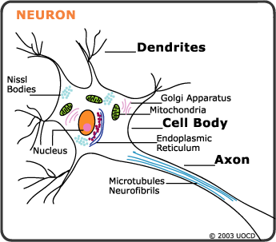

Slide 11
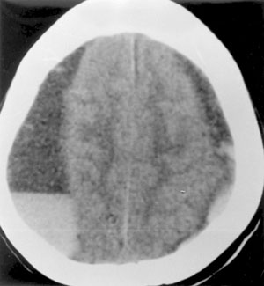
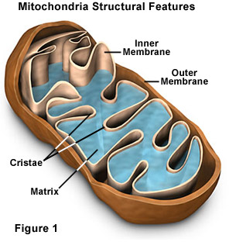
The “HOW” of Concussions
Mitochondria can’t keep up the E-, so lactate production incs.
Increased lactate levels = incs membrane permeability & cerebral edema.

Slide 12
Result of Metabolic Crisis
Cerebral hypofunction or permanent damage
Single – self-limited, transient changes
(Lasting only for a short period of time)
Multiple – more lasting derangement

Slide 13
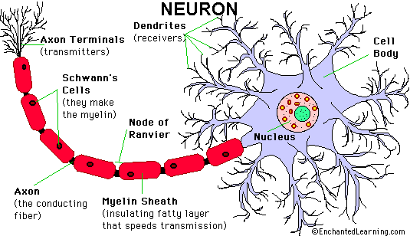
Axonal Injury
Axonal injury is felt to be reversible in mild cases.
Decreased speed of the impulse due to the damage.

Slide 14
Second Impact Syndrome
Potential catastrophic outcome as a result of a repeat concussion injury while recovering from the initial injury.
Cellular, metabolic, axonal, disturbances are amplified.
Profound cerebral edema develops which may lead to coma & severe neurological disability or death. (compresses brain stem)
Second Impact Syndrome News, Videos, Photos, and PodCasts - ESPN

Slide 15
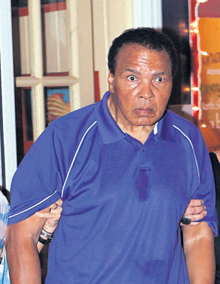
YOU MAKE THE CALL

Slide 16
Today’s Agenda: 1/28/14
Students will watch Heads Up Concussion Video
TO: What is a concussion, and why physiological affects occur due to a concussion?
Students will practice decoding the prompt using the DIVER Strategy.
Unit 4: What are popular injuries to the head/face, and how are they cared for?
SC State Standards:
3.1. Analyze injury and athletic training room statistics.
10.1 Demonstrate the appropriate assessment, care, and rehabilitation of the head.

Slide 17
Dolphin’s D.I.V.E.R Strategy
D – Decoding the Prompt
1. Circle direction words
2. Underline key words – “do what?”
3. Summarize the focus – put circle and
underline together
I – Identify the Evidence
V- Viewpoint Analysis
E – Evidence Analysis
R – Respond to Text

Slide 18
Daily Cerebral Exercise (write q&a)
List and define the three MOIs for a concussion.
Describe the physiological changes that results in a metabolic crisis.
Why is the speed of neurological impulses slowed down as a result of a concussion?
What is second impact syndrome?

Slide 19
Today’s Agenda: 1/30/14
Students will complete the DCE.
Students will finish Decoding the Prompt.
Students will read Chapter 14 of Gifted Hands and write a reflection based up on their thoughts. Included two pieces of cited evidence (with page number) to support their viewpoint.
Unit 4 EQ: What are popular injuries to the head/face, and how are they cared for?
SC State Standards:
3.1. Analyze injury and athletic training room statistics.
10.1 Demonstrate the appropriate assessment, care, and rehabilitation of the head.

Slide 20
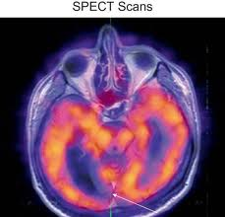
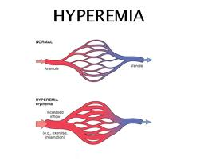
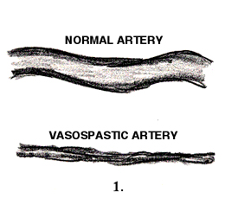
Vascular Response
Day 0 = Cerebral hypoperfusion
Day 1-3 = Cerebral hyperemia
Day 4-15 = Cerebral vasospasm
Loss of auto-regulation from the concussion!

Slide 21
http://www.sportslegacy.org/
What is CTE? » Center for the Study of Traumatic Encephalopathy » Boston University

Slide 22
Chronic Traumatic Encephalopathy (CTE)
Associated with memory disturbances, behavioral and personality changes, Parkinsonism and speech and gait abnormalities.
Atrophy of the different regions of the brain.
Increase levels of the tau protein.
(A protein that invades nerve cells and disables them effectively shutting them down. Due to trauma or injury.)

Slide 23
Concussion Classifications
Colorado Guidelines (1991)
Grades 1-3 based on symptoms and LOC
AAN Guidelines (1997)
Grades 1-3 based on symptom recovery and LOC
Cantu Guidelines (1998)
Grades 1-3 based on symptoms, LOC and PTA
Prague Guidelines (2005)
Simple vs complicated
Zurich Guidelines (2008)
No classification system

Slide 24
Concussion Modifiers
Symptoms – Number, duration and severity
Signs – Amnesia and prolonged LOC
Timing – Frequency of concussions and when was most recent concussion
Threshold – Repeat concussions with less force or with slower recovery time
Age
Co-morbidities – Migraines, depression or other mental health disorders, ADHD, learning disabilities and sleep disorders
Behavior – Style of play
Sport – Contact or collision sport, high-risk

Slide 25
Daily Cerebral Exercise (write q&a)
Using the DIVER strategy for decoding the prompt, what are the three steps for “D”?
As a result of mitochondria not being able to produce enough ATP, what builds up in the cells?
T/F: Cellular, metabolic, axonal, disturbances are not amplified with second impact syndrome.
Increase levels of lactic acid results in increase membrane ____________ and cerebral ______.

Slide 26
Today’s Agenda: 2/3/14
*Reminder – CEA due today*
Students will complete the DCE.
TO: How do ATCs assess and eval for a concussion?
Students will make individual SCAT Pocket Cards.
Closure: Students will obtain individual SCAT Pocket card baselines.
Unit 4 EQ: What are popular injuries to the head/face, and how are they cared for?
SC State Standards:
3.1. Analyze injury and athletic training room statistics.
10.1 Demonstrate the appropriate assessment, care, and rehabilitation of the head.

Slide 27
Early Symptoms Following Sports Related Mild Traumatic Brain Injury (mTBI)
Headache (71%)
Feeling slowed down (58%)
Difficulty concentrating (57%)
Dizziness (55%)
Fogginess (53%)
Fatigue (50%)
Visual blurring/ double vision (49%)
Light sensitivity (47%)
Memory dysfunction (43%)
Balance problems (43%)
Lowell et al, 2004

Slide 28
Memory Dysfunction
Appears dazed or stunned
Confused about events
Repeats questions
Answers slowly
Can’t recall events prior to the hit, bump, or fall
Can’t recall events after the hit, bump, or fall
Loses consciousness
85% will not
Shows behavior or personality changes
Irritable
Sad
Nervous
More emotional than usual
Forgets class schedule or assignments

Slide 29
http://www.sportconcussions.com/html/SCAT2.pdf
Sports Concussion Assessment Tool 2
Pocket Card http://bjsm.bmj.com/content/43/Suppl_1/i89.full.pdf

Slide 30
What you must include on your SCAT pocket card:
10 points - Symptom Score (out of 22)
10 points - Physical Sign Score
10 points - Sideline Maddocks Score
10 points - Cognitive Assessment
10 points - Balance Examination
10 points - Coordination Examination
10 points - Delayed Cognitive Assessment
30 points – Closure…
Omit – Glasgow Coma Scale due to interpretation

Slide 31
30 points - Closure:
You must obtain a baseline score for the classmate of your choice using your SCAT Pocket Card.
For each section fill in your classmate’s score.
At the end, be sure to tally their score and include it on the card as well.
Turn your completed SCAT pocket card in on the way out the door.

Slide 32
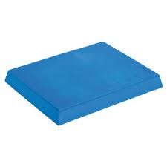
Balance Screening
Eyes Open
Eyes Closed
Abnormal if cannot maintain for 30 sec.
Eyes Open
Eyes Closed
Abnormal if cannot maintain for 30 sec.
Feet Together – Solid Surface
Feet Together – Foam Surface

Slide 33
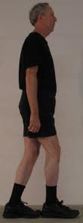
Balance Screening (cont.)
Tandem Stance
Eyes Open / arms out
Stable floor & foam pad
Abnormal if < 30 sec or unsteady
Eyes Closed / arms out
Stable floor & foam pad
Abnormal if < 30 sec or unsteady
Tandem Walk
Abnormal if unsteady or unable to perform

Slide 34
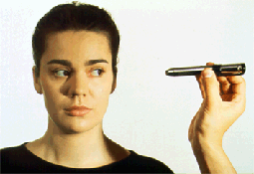
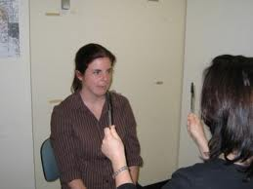
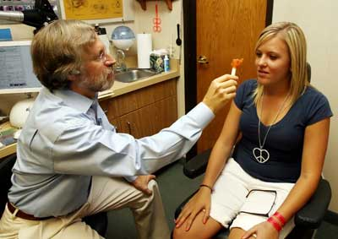
Visual Screening
Smooth Pursuits
“H-Test”
Saccades
Convergence
Move pen to the face

Slide 35
Movement-specific dizziness
Looking up
Getting out of bed
Quick head motions
Turning over in bed
Bending over
Lying down

Slide 36
Daily Cerebral Exercise (write q&a)
What are four common concussion symptoms?
What are three things that ATCs test for using the SCAT Pocket Card?
How may memory dysfunction present in a concussed athlete?
Predict why it is important to have a baseline score for athletes.

Slide 37
Today’s Agenda: 2/5/14
*Reminder – CEA due*
Students will complete the DCE.
TO: How do ATCs determine RTP for concussed athletes?
Students will watch NFL Crisis.
QUIZ NEXT CLASS!!!!
Unit 4 EQ: What are popular injuries to the head/face, and how are they cared for?
SC State Standards:
3.1. Analyze injury and athletic training room statistics.
10.1 Demonstrate the appropriate assessment, care, and rehabilitation of the head.

Slide 38
Today’s Agenda: 2/7/14
*Reminder – CEA due*
Students will complete quiz over Concussions.
Students will read chapter 15 and 16 of Gifted Hands. Write a reflection of your thoughts per chapter using two pieces of cited evidence to support your viewpoint.
Unit 4 EQ: What are popular injuries to the head/face, and how are they cared for?
SC State Standards:
3.1. Analyze injury and athletic training room statistics.
10.1 Demonstrate the appropriate assessment, care, and rehabilitation of the head.

Slide 39
Baseline Cognitive Testing
Baseline Testing – at start of seasons
Establishes personal benchmarks
Enhances post-injury management
Post-Injury Testing
Gives the concussion an objective measure
Aids in academic recommendations

Slide 40
ImPACT-Testing & Computerized Neurocognitive Assessment Tools

Slide 41
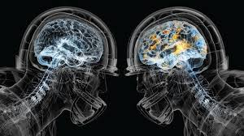
RTP
Progressing from very light to full practice.
Progress to next stage as long as symptom free.
If symptoms occur during activity, stop and wait 24 hrs before testing again. Do not move on to next stage!

Slide 42
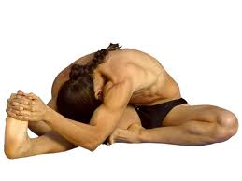
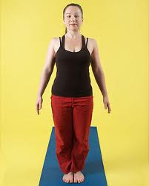
Stage 1 : Basic Movement
Walking – 10-15 minutes.
Stretching
Balancing – feet together.

Slide 43
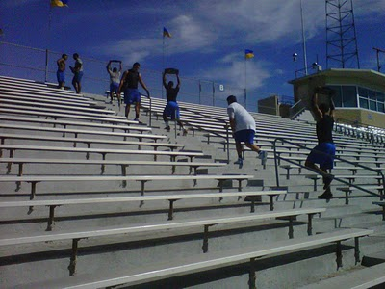
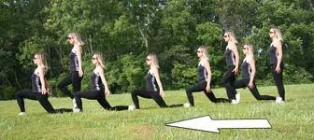
Stage 2 : Advanced Mvmt
Active Stretching (Dynamic stretches)
Bike, walk the bleachers or stairs for 20-25 mins
Elliptical, UBE, stairclimber, etc.
(No running or jogging in this stage).

Slide 44
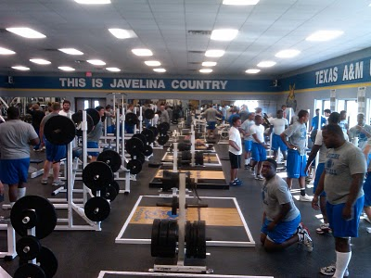
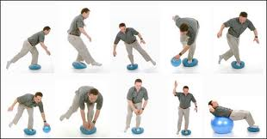
Stage 3 : Active Mvmt
Active Stretching – same as stage 2.
Agility Drills – zig-zag runs, shuffles, etc.
Balance drills – plyo balls, foam
Weight room (80% max)
Jogging/running can begin
Add helmet for FB

Slide 45
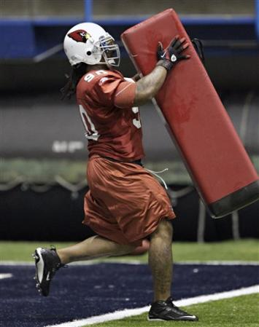
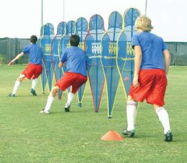
Stage 4 : Non Contact
Sport specific drills
Plyometric drills
Non-contact practice
Full pads, no hitting for FB

Slide 46
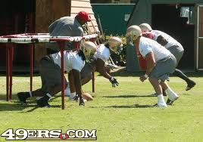
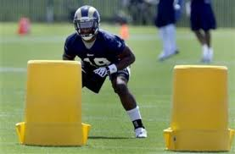

Slide 47
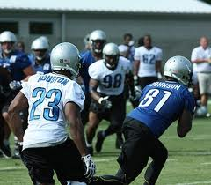
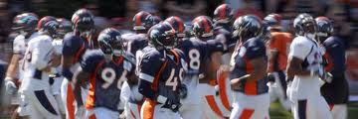
Stage 5 : Full Go!
Full practice, full contact
Cleared to practice, monitor afterwards.

Slide 48
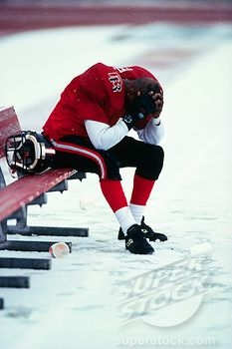
Example Case
Senior Linebacker
Helmet to helmet hit during practice
Complaints of:
Nausea
Dizziness
Sensitivity to light
Fogginess
No concussion history
No baseline test

Slide 49
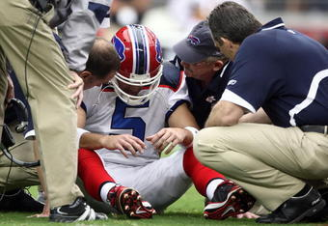
Physical Exam
Sensitive to light
Saccades test
produces dizziness
Lateral Nystagmus

Slide 50
ImPACT Test Results
Verbal Memory Composite: 36
Visual Memory Composite: 32
Visual Motor Composite: 12.77
Reaction Time: 1.27
Symptom Score: 45

Slide 51
Treatment
REST
No school for the next two days
No PE, FB practice
No texting, video games
Sunglasses PRN
Return for testing in two days

Slide 52
ImPACT Test Results
Verbal Memory Composite: 88 (36)
Visual Memory Composite: 78 (32)
Visual Motor Composite: 37.55 (12.77)
Reaction Time: 0.59 (1.27)
Symptom Score: 0 (45)

Slide 53
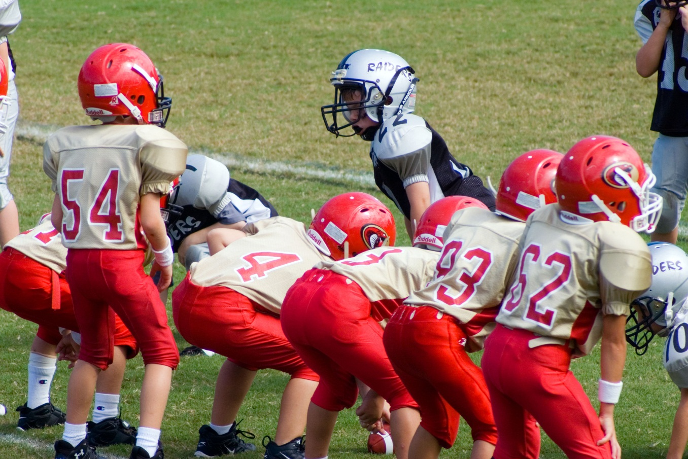
Treatment
Functional progression protocol
If asymptomatic, return to play.

Slide 54
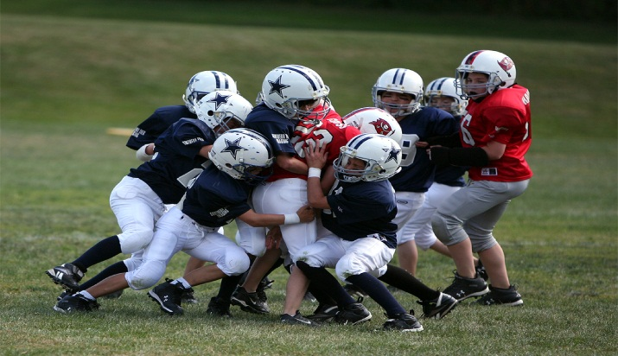
Return to Play
Effects of concussions usually subside within 7-14 days.
Some can last for months
No set timeline
Most athletes fully recover, but their brain has to be given time and protected from further injury

Slide 55
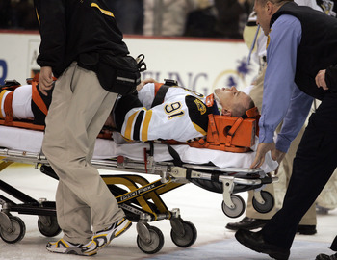
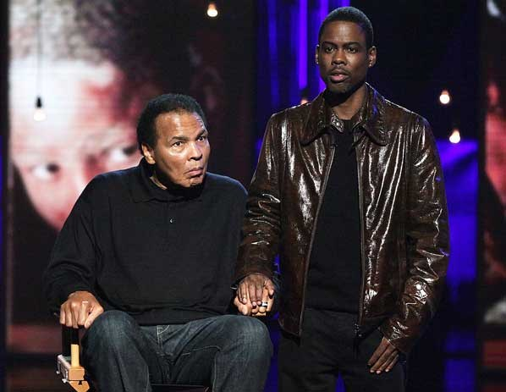
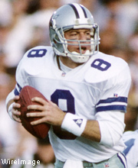
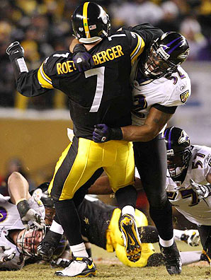
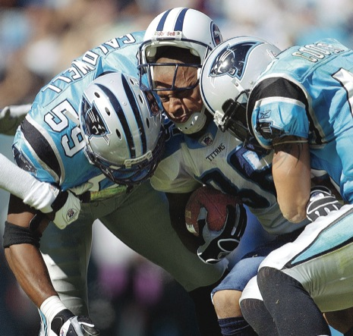
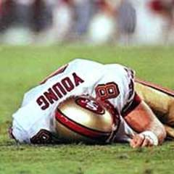
MULTIPLE CONCUSSIONS ADD UP

Slide 56
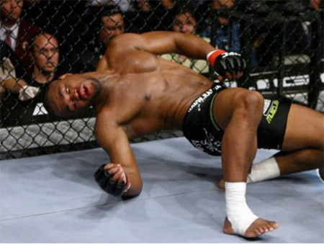
Myths about Concussion
Must be knocked out
“Its just a mild concussion”
You can easily tell when an athlete has a concussion
90% with no LOC
No longer graded concussions; ALL BAD!
Over 50% NEVER reported/diagnosed

Slide 57
Myths about Concussions
If you let your athlete fall asleep, they will die
If your CAT scan is negative, you’re clear to play
Players know what a concussion is….
It is safe to return the same game if the player recovers on the sideline
Asleep vs. unconscious
CT, MRI detect structural injury not functional
50% of college athletes don’t know concussions have negative consequences
Athletes that appear fully recovered will have deficits on tests 36 hrs later

Slide 58
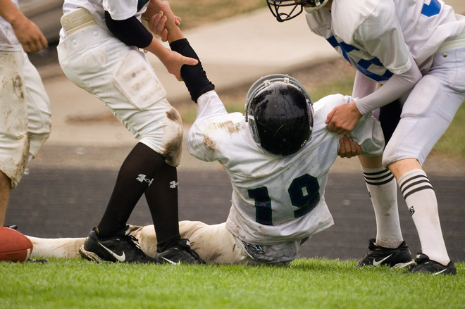
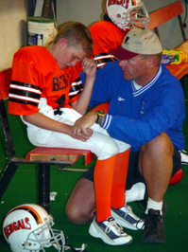
Myths about Concussions
Kids bounce back quicker from injuries including concussions
Children require much more time than adults
College athletes average 3-7 days
High school athletes 7-14 days

Slide 59
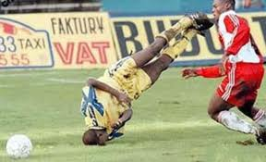
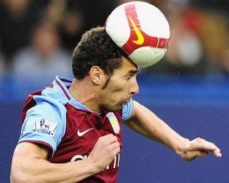
Myths about Concussions
If an athlete suffers a concussion he will be good to go the next week
50% of high school athletes have not recovered after 7 days
30% after 2 weeks
15% after 3 weeks

Slide 60
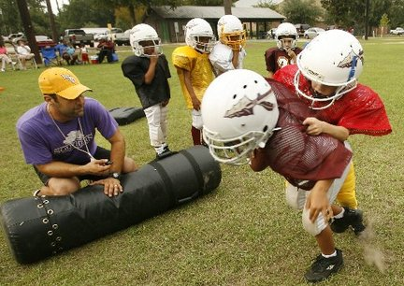
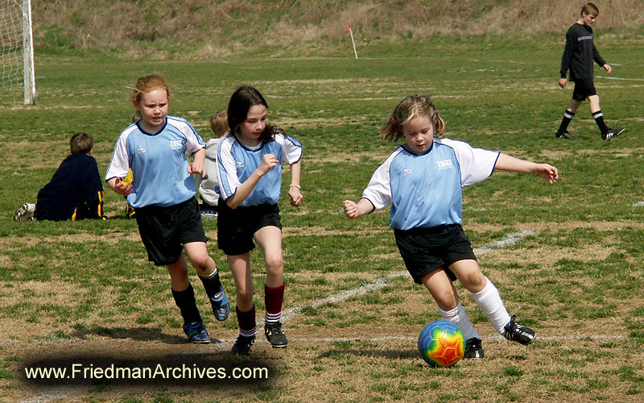
Poor Predictors for Recovery
Age
Younger is worse
History of Migraine Headaches
Usually has more symptoms
Repeat Concussions
Gender
Females worse than males

Slide 61
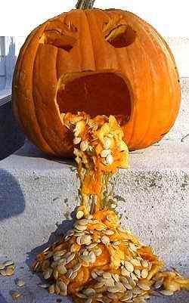
Symptoms that Predict Prolonged Recovery
Cognitive symptoms seem to have positive correlation with prolonged recovery
Fogginess
Difficulty concentrating
Vomiting

Slide 62
“When in doubt….keep them out!!”
Case Examples on Handout

