Slide 1
Circulatory System
The Heart, Blood Vessels, and Blood
TO: How does our heart beat and what are the components of blood?

Slide 2
The Heart
A muscular, hollow organ
Size of a closed fist
3 layers: Endocardium, Myocardium, & Pericardium.
Septum – A muscular wall dividing heart into right and left halves.
4 chambers; R atrium, R ventricle, L atrium, L ventricle.
4 valves; Tricuspid, Pulmonary, Mitral, Aortic.

Slide 3
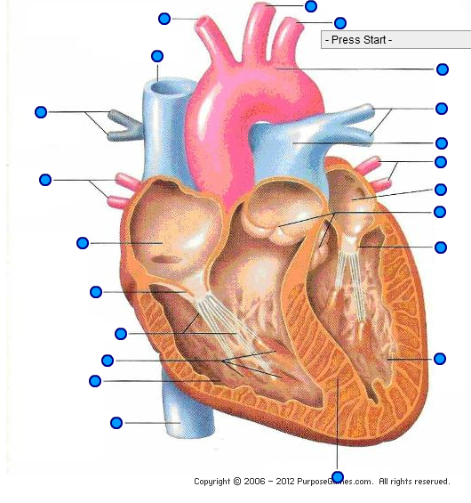

Slide 4
Cardiac Cycle
Diastole: cycle of rest (in b/w beats)
Systole: ventricular contraction
Sinoatrial (SA) node – “Pacemaker”; Atrium
Atrioventricular (AV) node – Ventricle
Arrhythmia – Abnormal heart rhythms
Defibrillator – A device that shocks the heart with an electrical current to stop the uncoordinated contraction and allow the SA node to regain control

Slide 5
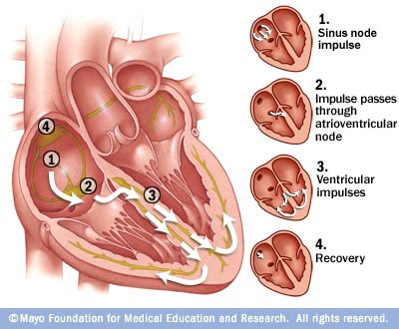

Slide 6
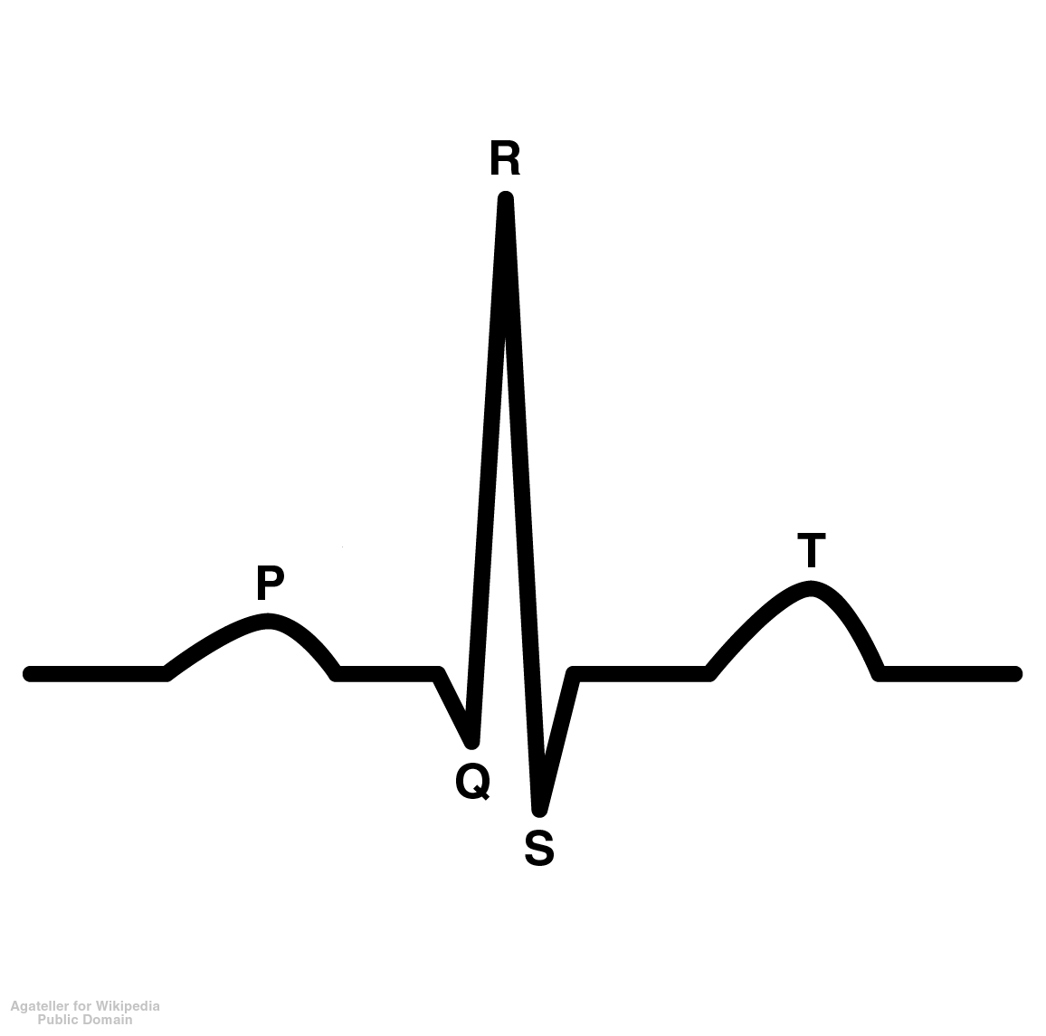
---------------Contraction------------------
-------Relaxation-----------
Impulse at SA node, travel thru artria
Recovery before next contraction
Impulse thru AV node, down bundle branches

Slide 7
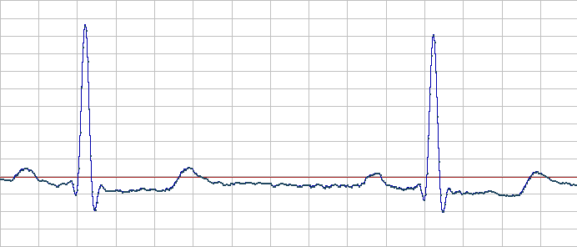
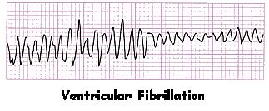

Slide 8
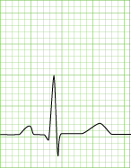
Normal Sinus Rhythm (SNR)

Slide 9
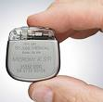
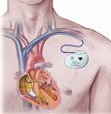
Pacemaker – A small battery-powered device with electrodes. Monitors the heart’s activity and delivers an electrical impulse through the electrodes to stimulate contraction.

Slide 10
BLOOD VESSELS
Arteries
Carry blood away from the heart
Aorta branches into arterioles
Capillaries
Connect arterioles with venules
Veins
Carry blood towards the heart
Venules take bld from tissues back
into veins back to Superior &
Inferior Vena Cava
Veins have one way valves

Slide 11
Blood (bld)
4 to 6 quarts of blood in the avg adult.
Carries…oxygen, carbon dioxide, nutrients, waste products, heat, & hormones.

Slide 12
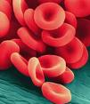
4 Parts of Bld:
Plasma – the fluid part of the bld.
90% water
Erythrocytes – RBC
Formed in bone marrow
4.5 to 5.5 million in a gtt of bld
25 trillion in body
Contains Hemoglobin
carries O2 and CO2.
Leukocytes – WBC
Formed in bone marrow &
lymph tissue
5,000 to 10,000 in a gtt of bld
Fight infection - Phagocytosis

Slide 13
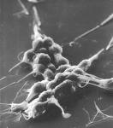
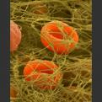
BLOOD
Thrombocytes (Platelets)
Formed in bone marrow
250,000 to 400,000 in a drop of blood
CLOTTING process!

