Slide 1
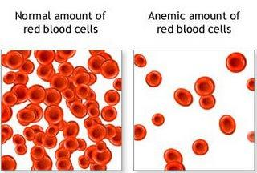
Anemia
Def: An inadequate number of RBC,Hgb, or both.
Fe deficiency anemia
Sickle cell anemia

Slide 2
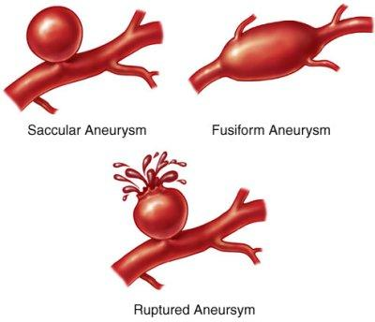
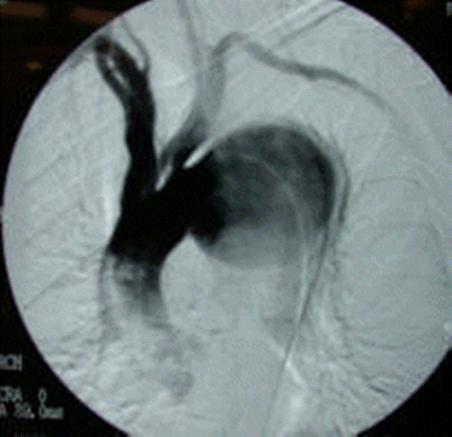
Aneurysm
A ballooning out of , or saclike formation on, an artery wall.

Slide 3
Aneurysm
Et:
Dz
Congenital defects
Injuries
Symptoms:
Pain & pressure
No symptoms
Tx:
Sx removing the damaged area of bld vessel and replacing it c/ a plastic graft or another bld vessel

Slide 4
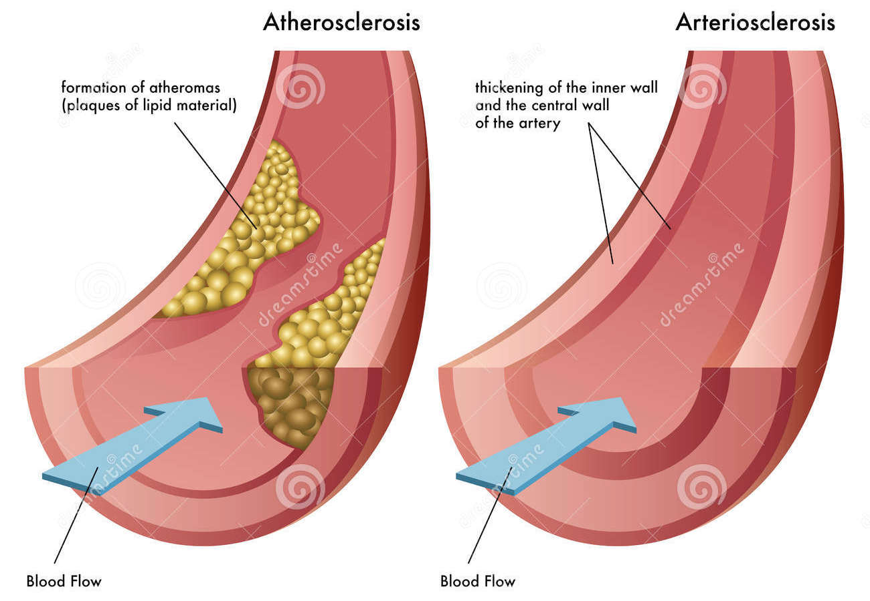
Arteriosclerosis – A hardening or thickening of the arterial walls, resulting in a loss of elasticity and contractility.
Atherosclerosis – When fatty plaques are deposited on the walls of the arteries.

Slide 5
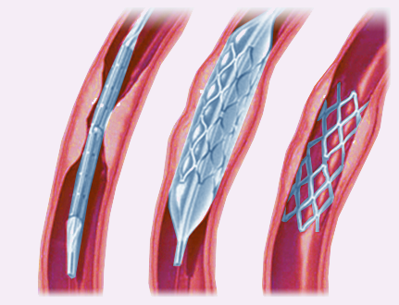
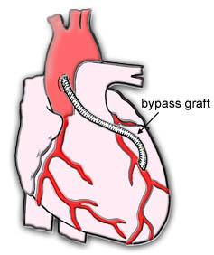
Treatment for Atherosclerosis
Angioplasty, may be used to remove or compress the deposits, or to insert a stent to allow blood flow.
By-pass surgery

Slide 6
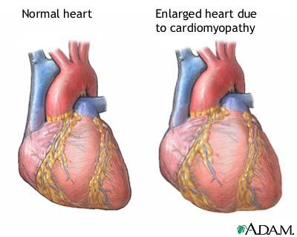
Congestive Heart Failure (CHF) – A condition that occurs when the heart muscle does not beat adequately to supply the blood needs of the body.

Slide 7
Congestive Heart Failure (CHF)
Symptoms:
Edema
Dyspnea (difficulty breathing)
Cyanosis (bluish color)
Distention of neck veins
Weak, rapid pulse
Cough with pink, frothy sputum
Tx:
Cardiac drugs
Elastic support hose
Oxygen therapy
Bedrest
Low-sodium diet

Slide 8
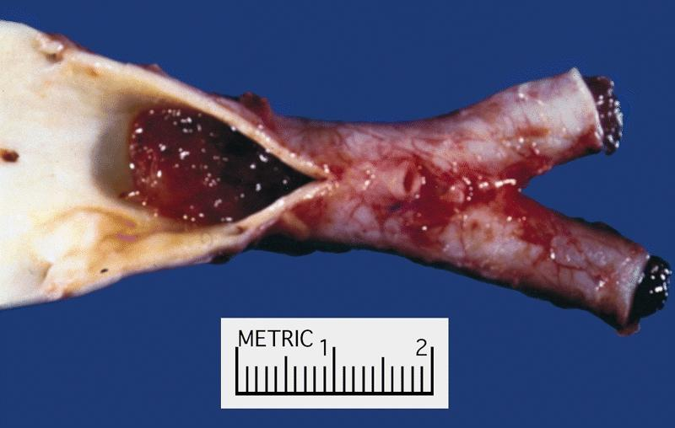
Embolus – A foreign substance circulating in the bldstream.
Air, bld clot, bacterial clumps, fat globule, or other similar substances.
Blockage may occur

Slide 9
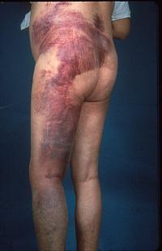
Hemophilia – An inherited disease that occurs almost exclusively in males but can be carried by females. Unable to clot.

Slide 10
Hypertension – High blood pressure. Above 140 systolic, 90 diastolic. 140/90
Risk Factors:
Family Hx, race, obesity, stress, smoking, aging, and diet high in saturated fat.
Treatment:
Anti-hypertension drugs, diuretics, limit stress, stop smoking, better diet

Slide 11
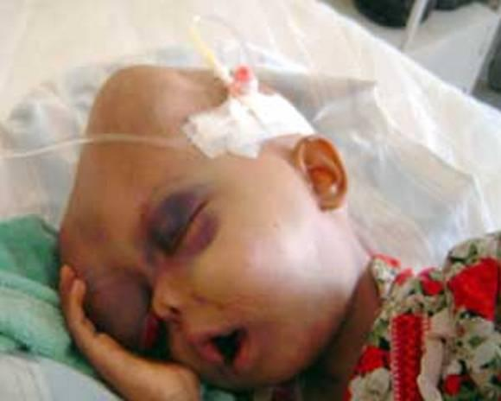
Leukemia – A malignant disease of the bone marrow or lymph tissue. A high number of immature WBC.
Symptoms:
Pyrexia (fever), Pallor (loss of color)
Fatigue
Anemia
Bleeding gums
Excessive bruising
Joint pain

Slide 12
Myocardial Infarction (Heart Attack) – When a blockage in the coronary arteries cuts off the supply of blood to the heart.
Symptoms:
Severe crushing pain that radiates to the arm, neck & jaw
Pressure in the chest
Perspiration & cold, clammy skin
Dyspnea (difficulty breathing)

Slide 13
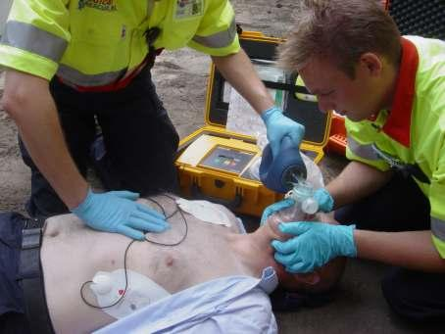
Myocardial Infarction (Heart Attack)
Treatment:
CPR, AED ASAP!
Control of BP
No smoking or stress
Regular exrs
Wt control

Slide 14
Phlebitis – An inflammation of a vein.
Thrombophlebitis: A thrombus (clot) in a vein.
Varicose Veins – Dilated, swollen veins that
have lost elasticity and cause
decreased bld flow.
From pregnancy, prolonged sitting or standing, heredity factors.
Tx: exrs, support hose, avoid long periods of standing, surgery

Slide 15
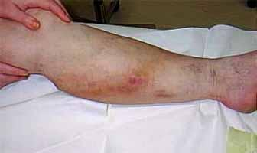
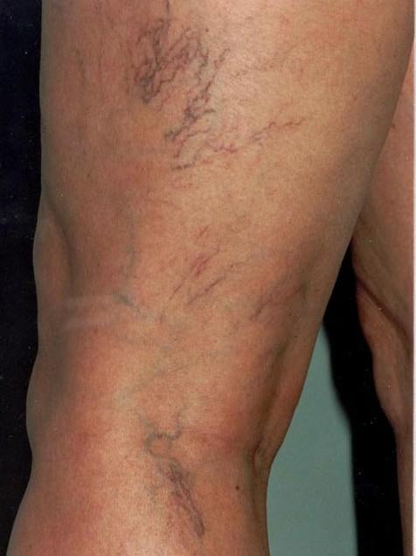
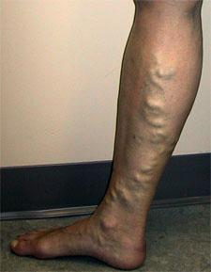
Phlebitis
Varicose veins

