Slide 1
Today’s Agenda: 3/27/15
Warm-up assignment on Google Classroom; practice labeling respiratory structures.
TO: Explain the breathing and respiratory process.
State Standards:
1:3 Analyze basic structure and function of the human body.
1:5 Describe common diseases and disorders of each body system.

Slide 2
Respiration
Def: the physical & chemical processes by which the body supplies its cells & tissues c O2 needed for metabolism & relives them of the CO2 formed in energy-producing reactions.
Subdivided into three parts:
External Respiration
Internal Respiration
Cellular Respiration

Slide 3
1. External Respiration
AKA – breathing
Def: exchange of O2 and CO2 between the lungs and the outside envir’t.
Consists of inspiration – air enters body, passed to alveoli through concentration gradient (think biology)
Consists of expiration – expels the CO2 put into alveoli from the deoxygenated bloodstream

Slide 4
2. Internal Respiration
Def: includes the exchange of CO2 and O2 b/w cells and the lymph surrounding them; oxidative process of E- in cells.
After inspiration – alveoli are rich c O2, therefore the greater concentration of O2 in the alveoli/bld diffuses into the tissue cells (producing oxygenated blood).
At the same time – CO2 concentration increases in the tissues to a point where it will diffuse out of the cells and back into the blood so that it can exit the body through the lungs (thus producing deoxygenated blood).

Slide 5
3. Cellular Respiration
AKA – oxidation
Def: use of oxygen to release energy stored in nutrient molecules such as glucose; this chemical rxn occurs inside cells.
Heat/light energy is oxidized when wood burns, heat energy is oxidized when glucose is metabolized inside our cells for energy.
CO2 and water is given off as waste
CO2 goes back to lungs
Water goes to kidneys to be urine

Slide 6
Mechanisms of Breathing
Two part process:
1. Inhalation/Inspiration: intercostal mm lift the ribs up/out thus increasing volume in lungs, and the dome shaped diaphragm contracts. As a result, atmospheric pressure increases so that air rushes all the way down to alveoli.
2. Exhalation/Expiration: intercostal mm and diaphragm relax, thus the ribs move down. The alveoli collapse and the atmospheric pressure decreases so that air CO2 will rush out of the body.

Slide 7
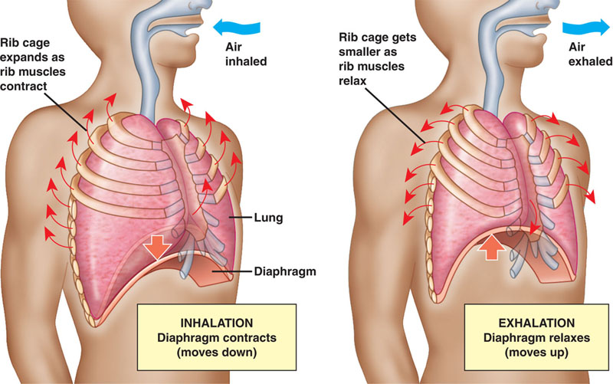

Slide 8
Respiratory Movements
Coughing – a forceful exhalation to clear the lower respiratory tract
Hiccoughs – spasm of the diaphragm and glottis
Sneezing – similar to cough but air is forced through the nose to clear the upper respiratory tract
Yawning – believed to be cause by the need to increase O2 c/in the blood

