Slide 1
Warm Up
The heart is about the size of a/an:
Egg
Apple
Peanut
Pumpkin
2. What would happen if a small hole developed in the septum?
The heart would stop pumping
Blood would move between the right and left sides of the heart
The blood from the pulmonary artery would enter the aorta.
Blood would not flow into the coronary arteries.
3. When blood leaves the left atrium, where does it go next?
Aorta
Left Ventricle
Right Atrium
Pulmonary artery
4. After blood leaves the right atrium, what valve prevents back flow?
Tricuspid
Mitral
Pulmonary
Aortic
Where does digestion begin?
Stomach
Small intestine
Esophagus
Mouth

Slide 2
Assisting with a bedpan.
As a CNA you are taught the proper way to assist someone who has to use the restroom, but is unable to get up, and must rely on a bedpan. Remember regular elimination of body waste contributes to good health!

Slide 3
Equipment and Supplies
Bedpan (with cover)
Toilet Tissue
Basin
Soap
Wash cloth
Towel
Disposable gloves
Pen or pencil

Slide 4
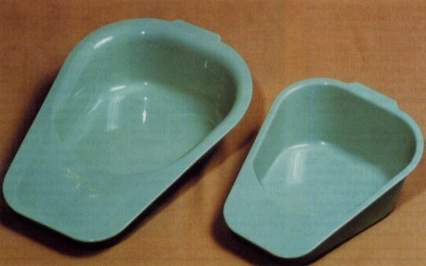
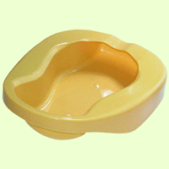
Main Types of Bedpans
Fracture Bedpan: Is designed for individuals with severe or physical or mobility disabilities. (Also referred as an orthopedic bedpan)
Standard Bedpan:

Slide 5
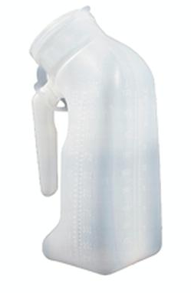
Words you Should Know
Urinate, Micturate, or Void- Emptying of the bladder, where liquid waste is stored or urine that is produced by the kidneys.
Urinal- Used by male patients when they need to urinate; a bedpan is used by females.
Defecate- Having a bowel movement(BM). Discharging waste through the rectum (the materials are called feces or stool).

Slide 6
Provide privacy to the patient by closing the door, privacy curtain, and window curtain.
Provide the patient with a bedpan or urinal immediately when it is requested.
Make accurate observations of the amount and appearance of urine and stool for abnormalities or factors that may indicate disease or complications.
Check whether specimens are needed.
Amounts must be measured and recorded if an output and intake record is being kept for the patient.
Regular elimination of body wastes contributes to good health.
Death can occur if waste is not eliminated from the body.

Slide 7
Standard Precautions
Hands must be washed frequently; gloves must be worn and eye protection.
Some agencies have special spray units in the bathrooms to rinse and clean bed pans and urinals. The bed pan must be disinfected after rinsing.
After patient is discharged, it must be sterilized according to agency policy before being used by another patient.
Any areas contaminated by urine or feces must be wiped with a disinfectant.
Patients should have the opportunity to wash their hands after using bedpans or urinals.

