Slide 1
Bicep/Triceps Muscle Strains
Mechanism of Injury: overuse or traumatic forces
Overuse is more common in start of sport season or with an increase in activity level mid-season due to poor pre-conditioning.
Signs & Symptoms:
P! & tenderness in mm
Delayed pain → DOMS
Delayed Onset Muscle Soreness appears 24 – 48 hours after overuse
Tx: rest, ice, strengthening rehab

Slide 2
Bicep Tendon Rupture
Mechanism of Injury: Grade 3 strain from sudden powerful bicep contraction
Signs & Symptoms:
Hear a “pop”
Muscle belly will droop into the distal arm (“Popeye Muscle”)
Ecchymosis in upper anterior arm
Slight loss of flexion because short head typically remains attached.
Tx: rest, ice, strengthening rehab, sometimes sx

Slide 3
Bicep Long Head Tendonitis
Mechanism of Injury: repetitive overuse
Lies next to the rotator cuff tendon so often confused with impingement syndrome.
Signs & Symptoms:
Discomfort in the anterior shoulder
P! / weakness with elbow & shoulder flexion
Special Test: Speed’s Test, + for p! in bicipital groove
Tx: rest, ice, strengthening rehab

Slide 4
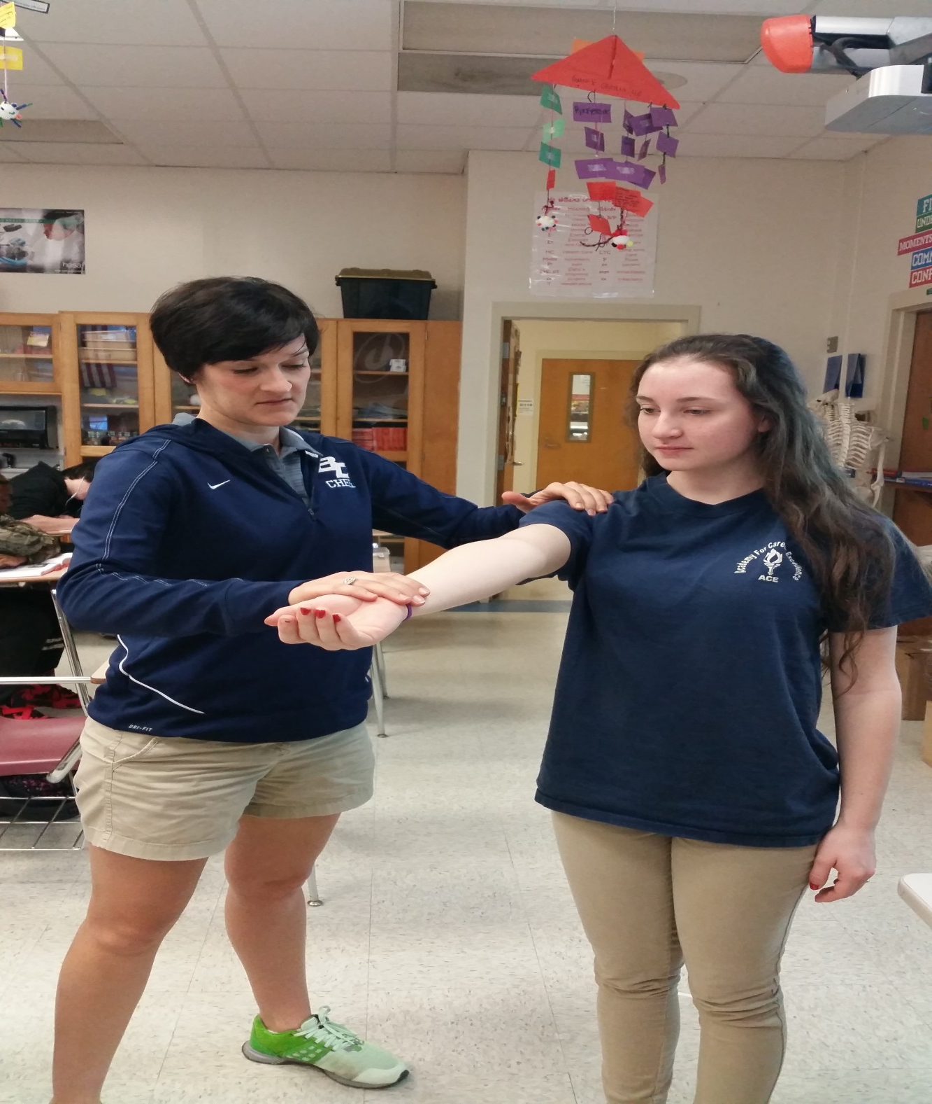
Speed’s Test for Biceps Tendonitis: Have the athlete resist a downward pressure at the wrist, + for p! in the bicipital groove (under my left fingers).

