Slide 1
Warm-up:
Identify the nerves of the arm and which area each nerve innervates.
What are the two deep muscles of the arm that we built out of clay? Also, identify which directional movement term each of those muscles control.

Slide 2
Today’s Agenda:
Students will complete warm-up.
Homework – complete any missing/late assignments to replace zeros, but will be counted as late; get progress report signed as homework grade and return on Thursday.
Today’s Objective: Discuss the superficial power muscles of the arm.

Slide 3
Superficial Power Muscles of the Arm
Double joint mms thus have two movements (cover two joints).
Lay on top of the deep single joint mms, nerves, and bld vessels thus provide not only leverage for power, but also protection.
  Notice how the deep mms are innervated from the top.
  Where do you think the superficial power mms are innervated from?

Slide 4
Biceps Brachii
How many biceps do we have?
Short/Medial Head
  O = coracoid process of the scapula
  I = radial tuberosity of the radius
  A = flex elbow/shoulder, hand supination
Long/Lateral Head
  O = supraglenoid tuberosity of the scapula
  I = radial tuberosity of the radius
  A = same as short/medial head

Slide 5
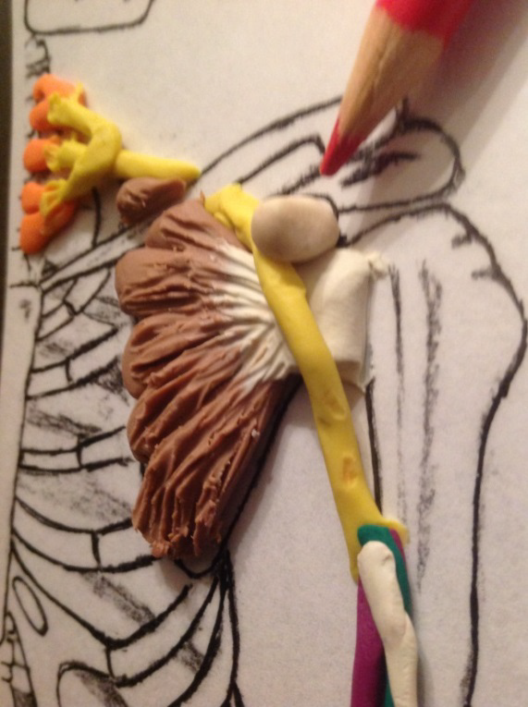
Lets raise the Coracoid Process to make it 3D.
  Make a regular M&M ivory ball.
  Roll the ball into a small short tube, then bend it into a L shape.
  Make sure it is thick enough to stand up for mm attachments and that it sticks up higher than the Subscapularis.

Slide 6
Using a Vis-à-vis ® marker, mark the attachments on their laminated boards.
  Make a dot on the clay coracoid process and mark inside the glenoid cavity for the long head attachment.

Slide 7
Form two thick tubes (start out with two pieces about the size of peanut M&M™) of terra cotta clay.
Measure the tubes on the humerus to make sure they cover about half to 2/3 of the distal part of the bone’s diaphysis (shaft).

Slide 8
Remove the tubes and taper the ends of each tube. Pinch the tapered ends of the tubes together to form one tendon.
Take two more pieces of clay, about the size of a peanut M&M™. Roll them out into carrots with thick ends about the same diameter as the bicep tubes and then taper thin for the tendons. The biceps have very long tendons.
  One can be shorter for the short head.

Slide 9
Blend the pieces together to form a belly with a long tendon. Place the pieces together to make the biceps.
Place the biceps on the arm and attach the distal attachment to the radial tuberosity.

Slide 10
Position the biceps where they fit on top of the brachialis. Run the short head’s tendon to the coracoid process and trim to fit. Run the long head’s tendon up through the bicipital groove (intertubericle groove), up through and into the glenoid cavity. (This tendon runs superior to the cavity in reality.) Trim to fit.

Slide 11
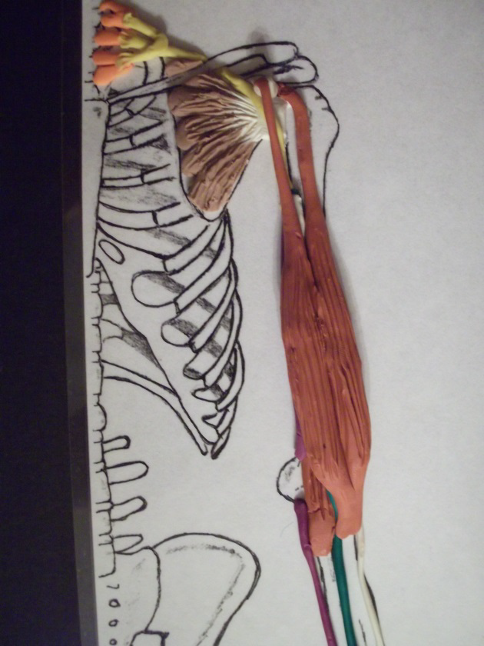
Notice how the nerves run under this big muscle. The Musculocutaneous nerve innervates the biceps from the underneath. The biceps also protects the nerves.

Slide 12
Triceps Lateral Head
Tri= 3 parts or heads to this muscle. Each part will descript its location on the arm.
  O = proximal and medial humerus
  I = olecranon process (actually attaches to the triceps medial head tendon)
  A = extends the elbow and rotates the arm laterally
Using a Vis-à-vis marker, mark the O & I of the Triceps lateral head

Slide 13
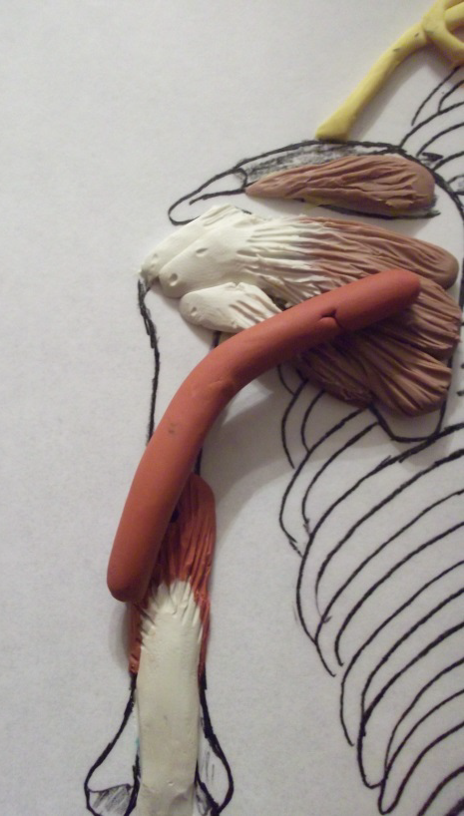
Students make a tube of terra cotta clay out of a ball about the size of a peanut M&M™. Place the tube onto the insertion point and lay over it over origin.

Slide 14
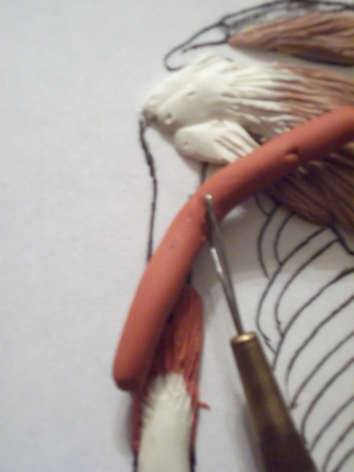
Mark the tube where the it needs to be cut. Cut and trim and attach the muscle. The radial nerve will innervate this muscle from underneath

Slide 15
Striate the muscle to show that the attachment pulls on the tendon of the triceps medial head.

Slide 16
Triceps Long Head
Tri= 3 parts or heads to this muscle. Each part will descript its location on the arm.
  O = medial boarder of the scapula under the Teres minor tendon
  I = olecranon process (actually attaches and pulls onto the triceps medial head’s tendon)
  A = extends elbow and shoulder

Slide 17
Using a Vis-à-vis ® marker, have students mark the attachments on their laminated boards. Because the origin is under the Teres minor, use a colored pencil to slip under and lift up the muscle.

Slide 18
Form a tube with a tapered end and place it onto the attachment sites to measure that it will be long enough. The long head’s insertion is more distal than the lateral head’s insertion.

Slide 19
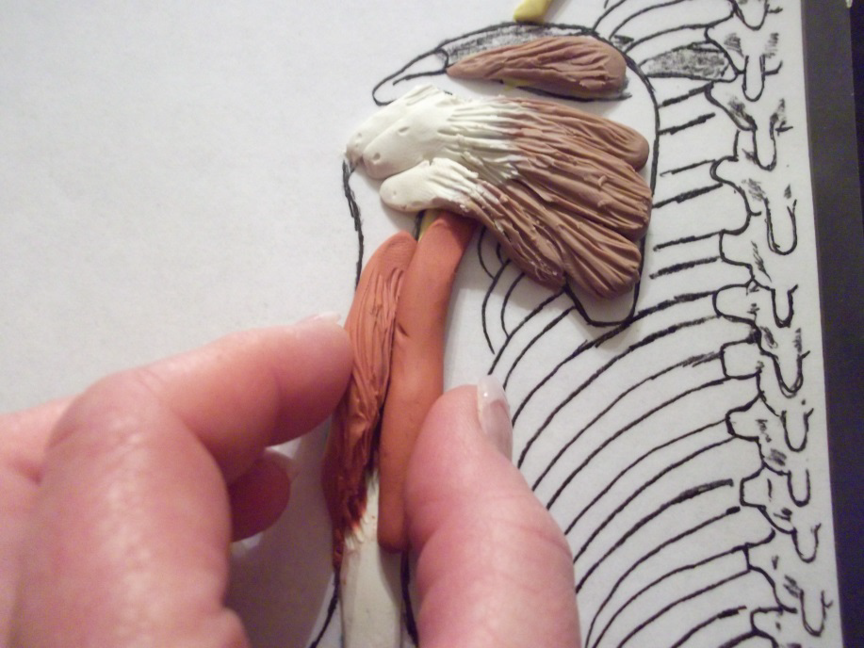
Remove the tube and flatten the narrow end to form the tendon. Now it will fit under the Teres minor muscle.

Slide 20
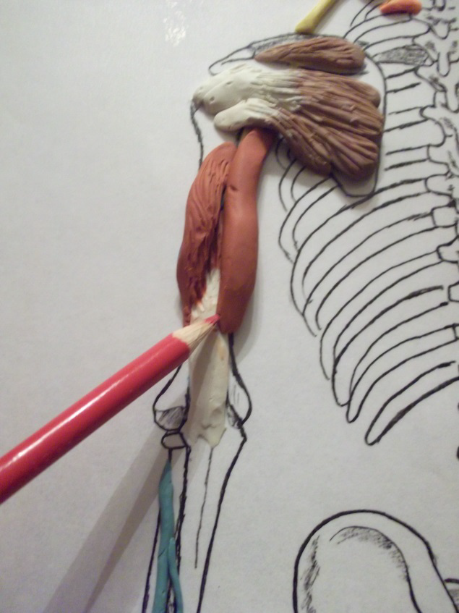
Double check to make sure the insertion of the long head is longer than the lateral head and there is contact with the medial head’s tendon.

Slide 21
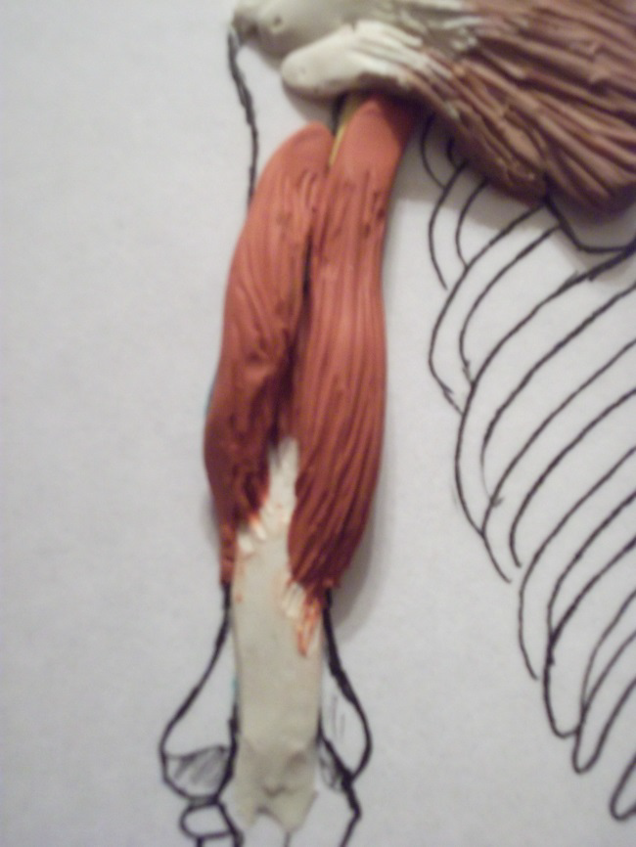
Striate to show how the muscle would pull on the tendon.

