Slide 1
Today’s Agenda:
Complete warm-up assignment on Google Classroom. You have ten minutes. (5 points participation grade)
When finished, get your tablet ready for notes. Also get your:
  Clay Card
  Clay Kit
  Cutting tool
  Vis-a-vie marker
    10 points participation grade
  3. Complete the closure question on Google Classroom. (5 points participation grade)

Slide 2
Four Nerves of the Arm
All four nerves are going to branch off the brachial plexus (yellow piece of clay) that we made to represent all the ‘hook-ups’ that these four nerves create at the lower cervical area.
Roll out four strands of clay. One:
  White
  Purple
  Light Blue
  Green

Slide 3
1. Ulnar Nerve ☺
On the ventral side of the arm (anterior), attach the strand (magenta/purple) for the ulnar nerve to the end of the yellow piece on the medial humerus.
The ulnar nerve just travels through the brachial area (upper arm) and only innervated flexors on the medial side of the forearm.

Slide 4
Stop the strand just above (superior) to the medial epicondyle and then restart it below (posterior) to the epicondyle. (Remind students that the nerve goes behind this epicondyle, so we stop and start the clay to show that it goes behind the bone. Also, remind students that hitting this nerve is what is known as the ‘funny bone’.

Slide 5
Once the ulnar nerve reemerges from the under the medial epicondyle, it will run along the ulna on the ventral side down to the last three digits of the hand. It will only innervate the medial side of the middle finger.

Slide 6
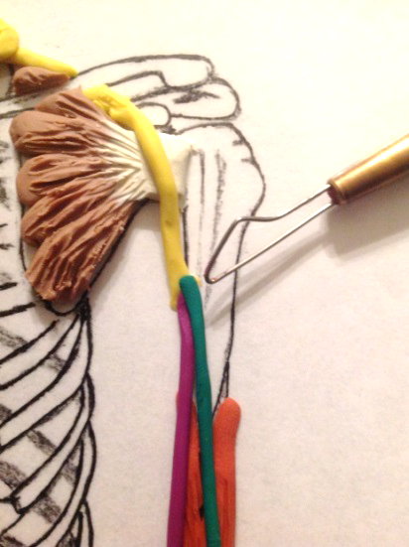
2. Medial Nerve
The medial nerve also just travels through the brachial area and only innervates flexors below elbow, but on the lateral side of the ventral arm.
Attach the strand for the ulnar nerve (green strand) to the end of the yellow piece on the medial humerus.

Slide 7
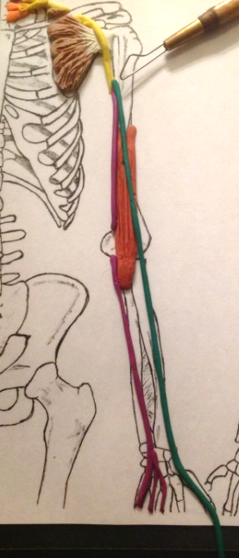
Students run the strand straight down the middle of the arm and stop it at the wrist. Attach smaller strands to innervate the thumb, index finger, and middle finger to the medial nerve.

Slide 8
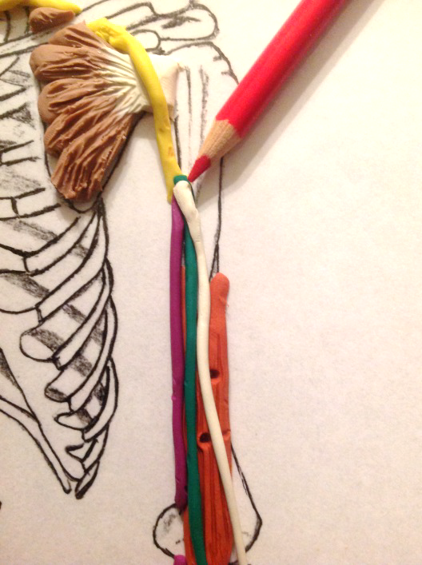
3. Musculocutaneous Nerve
This nerve will innervate the flexors ABOVE the elbow and become just a sensory nerve below the elbow.
Carefully roll the medial nerve to the medial side of the Brachialis muscle.
Using apencil, form only two openings in the belly of the Brachialis muscle.

Slide 9
Using the white strand of clay, attach the strand to the end of the yellow strand, and run it down the middle of the Brachialis, over the cubital, and then stop it half-way down the radius.
Innervate the Brachialis using two small strands of clay. Place into the openings from the belly of the muscle to the Musculocutaneous nerve.

Slide 10
All three ventral/anterior nerves of the arm:

Slide 11
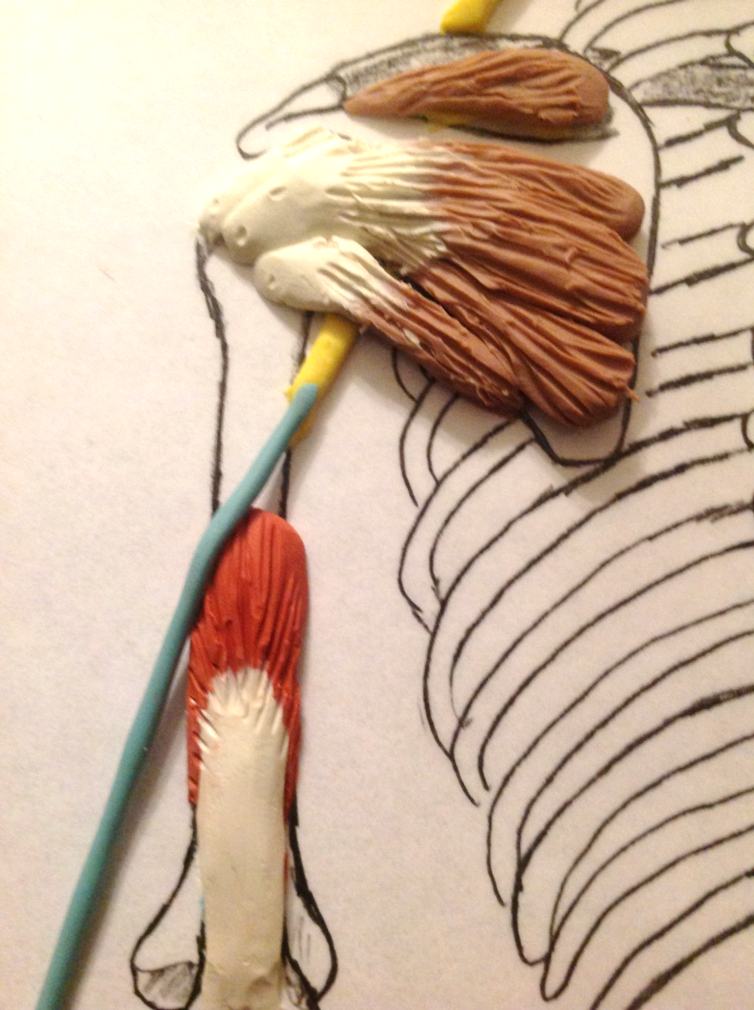
4. Radial Nerve
Radial nerve innervates the entire dorsal side of the arm!
  Notice that there are only 4 major nerves to the arm and 3 of them are to the ventral side. Because there are more flexors and nerve innervation to the ventral side, then flexion is dominate over extension. This is why when a person feels poorly, is tired, or hurt, they go into ‘fetal position’. Fetal position is all flexion.
Starting on the dorsal side of the arm, use the light blue strand and attach it to the end of the yellow strand.

Slide 12
The radial nerve runs besides the tricep’s medial head, lateral into the radial groove of the humerus, and goes ventral for a moment. It will ‘hook’ around the radial tuberosity and cut back to the dorsal side of the forearm.
Notice how the radial nerve runs along the dorsal side of the radius. Take the strand down to the end of the middle finger.

Slide 13
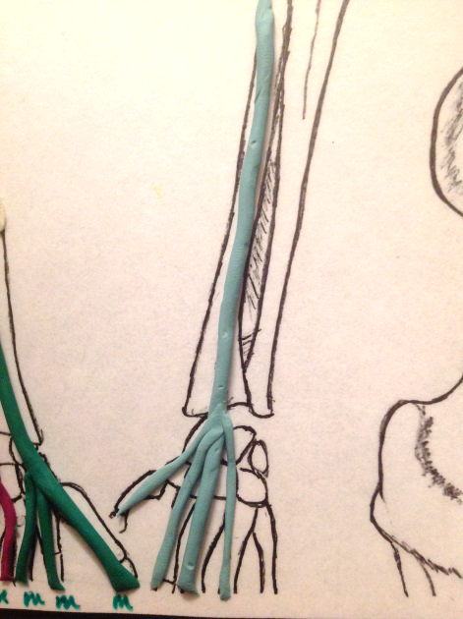
Branch the end of the radial nerve to the thumb and first three digits.
The radial nerve innervates all the extensors to the hand, but only has sensory to the thumb and first three digits.

Slide 14
Make a small branch off the radial nerve just below the elbow going to the ulna. This branch innervates the flexors to the small (pinkie) digit.

Slide 15
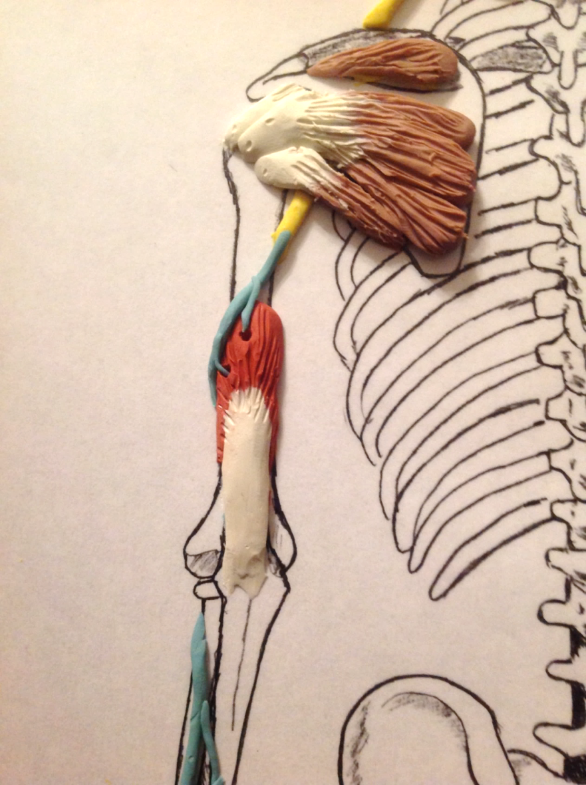
Innervate the triceps medial head with the radial nerve. Make two openings in the muscle and two small strands. The radial nerve innervates the muscles as it passes over the top of it.

Slide 16
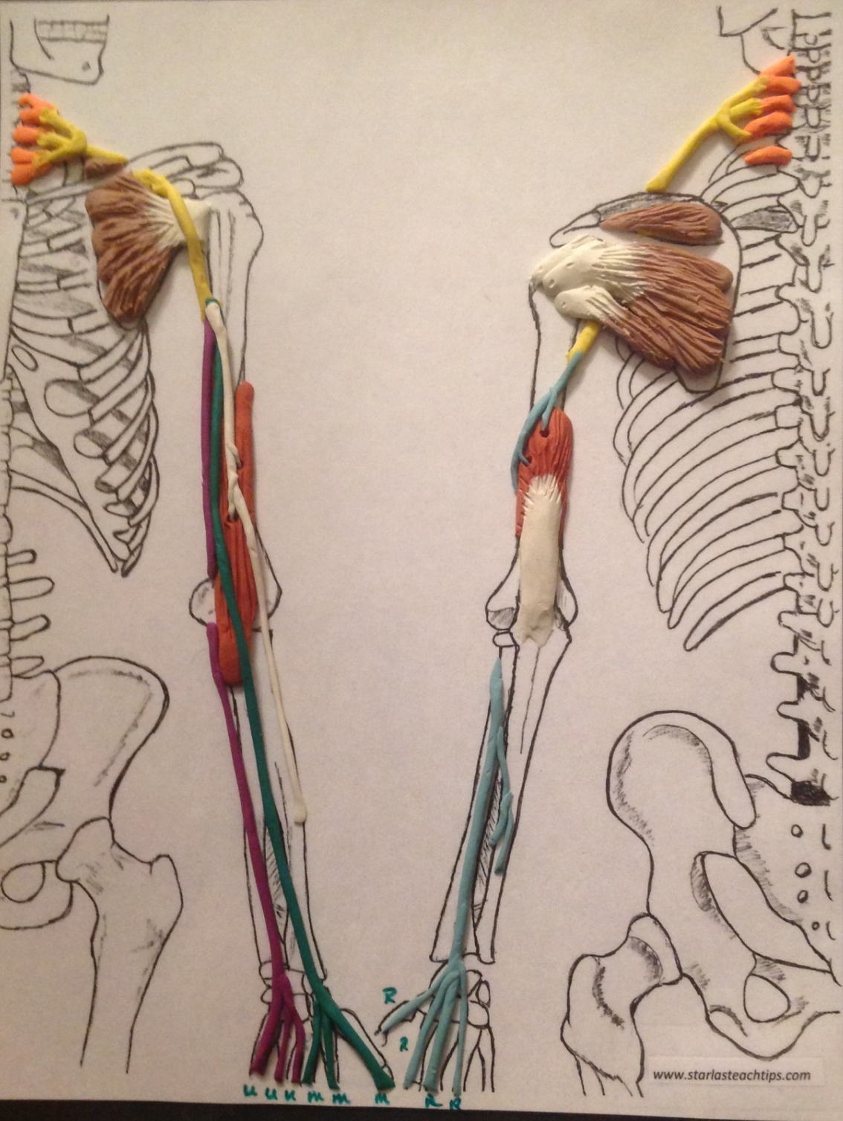
All four nerves of the arm:
Take a picture with your tablet to study at home.

