Slide 1
Today’s Agenda:
Review Shoulder Anatomy Quiz on Edmodo
Students will join Google Classroom and add it to their bookmark bar on Google Chrome.
Today’s Objective: What are two deep muscles of the upper arm?

Slide 2
Deep Muscles of the Upper Arm
Single joint muscles (cover only one joint).
Closest to the elbow joint (hinge jt)
Provide stability and anchoring for the larger superficial muscles.
Use Terra Cotta clay for the muscles.

Slide 3
Brachialis
Remember! When a regional term or bone name is at the beginning of the muscle’s name…it gives away its origin.
O = halfway down the anterior humerus
I = proximal ulna (attaches to both the lateral and medial side of the arm)
A = flexes elbow (a muscle on the ventral side is ALWAYS a flexor!)
Using a Vis-à-vis marker, mark the O & I of the Brachialis

Slide 4
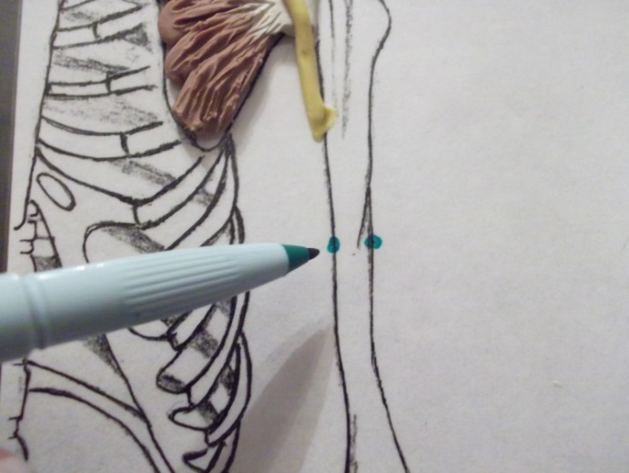
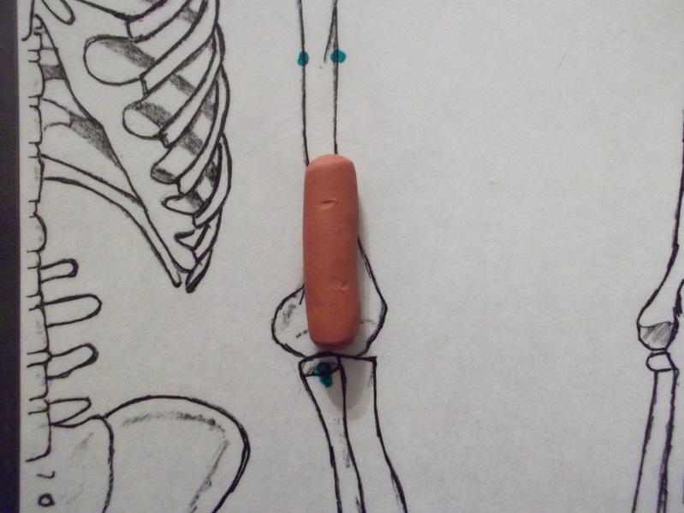
Using a Vis-à-vis marker, mark the O & I of the Brachialis
  Notice there are two Os!
Form a ball of Terra Cotta clay about the size of a peanut M&M™. Turn the ball into a tube and measure the tube to make sure it is about 2/3 of the distance between the attachments.

Slide 5
Turn the tube into a carrot (by tilting the hand into a 10 degree angle). Place the carrot with the narrow side up to measure. The carrot should now come close to reaching the attachments.
Using the clay tool, split the end of the carrot down the middle to form the two attachments for the origins.

Slide 6
Attach the ‘split top’ to each of the origin attachments.
Students flatten the tube (belly of the muscle) with their thumb. Finish the muscle by trimming the sides, smooth the edges and taper the bottom of the muscle to fit the insertion on the ulna.

Slide 7
Form a line where the muscle becomes tendon and then striate the belly of the muscle so that the muscle fibers would pull the ulna up.
We will leave the tendon terra cotta since we will not be able to actual see it once we add on the superficial muscles.
Brachialis is finished!

Slide 8
Triceps Medial Head
Tri= 3 parts or heads to this muscle. Each part will descript its location on the arm.
O = 1/3 of the way down on the posterior (dorsal) side of the arm
I = Olecranal process
A = Extends the arm (a muscle on the dorsal side ALWAYS extends the arm!)
Using a Vis-à-vis marker, mark the O & I of the Triceps medial head

Slide 9
Using a Vis-à-vis marker, mark the O & I of the Triceps medial head
Form a carrot of terra cotta clay (just like the one we did for the Brachialis) and place it on the board between the attachments. This time, the carrot goes with the tip downward.

Slide 10
Flatten the tube and trim to match the attachment sites.
Once again, draw in the tendon. This muscle has a large tendon because the other two heads of the triceps will borrow it to pull as a group.

Slide 11
Remove the terra cotta tendon.
Shape the tendon to ‘fit’ into the opening.
Blend the striations of the muscle into the tendon.

