Slide 1
2/09/15 Today’s Agenda:
U3 EQ: What are the common athletic injuries to the shoulder and how do they occur?
1:3 Identify major bones in the body.
1:5 Describe general injury causations and/or mechanisms.
Students will label boney anatomy of the shoulder on Jimmy, Benny, and Penny.
TO: Discuss the evaluation of management of rotator cuff and brachial plexus injuries.
Students will create an Upper Extremity Injuries Quizlet set.

Slide 2
Groups:
In the given groups to the left, label the list of structures listed below on Penny, Benny, & Jimmy. Each group member must label at least two structures bilaterally. Your label must contain the name of the structure and your initials.
Mayah, Stephen, Jason, Chelsea, Brandie, Shelby
Allicia, Michayla, Alexis, Lee, Deonte, Michael
Shallia, Kierra, Ryan, Taylor, Liz, Jessica
Clavicle
Humerus
Subscapular Fossa
Infraspinatous Fossa
AC Joint
SC Joint
Sternum
Suprspinatus Fossa
Corocoid Process
Acromion Process
Glenoid Fossa
Lateral Border
Medial Border
Inferior Angle

Slide 3
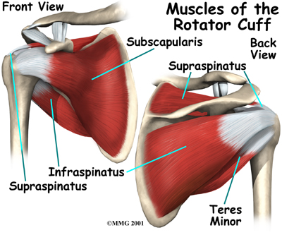
1. Rotator Cuff Strain (RC)

Slide 4
4 RC mm – mvmt ea causes
Supraspinatus – Abduction
Infraspinatus – External Rotation (lat)
Teres Minor – External Rotation (lat)
Subscapularis – Internal Rotation (med)

Slide 5
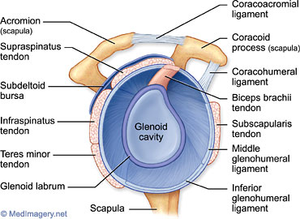
Color in RC MM on Muscles of Musculotendinous Cuff Page

Slide 6
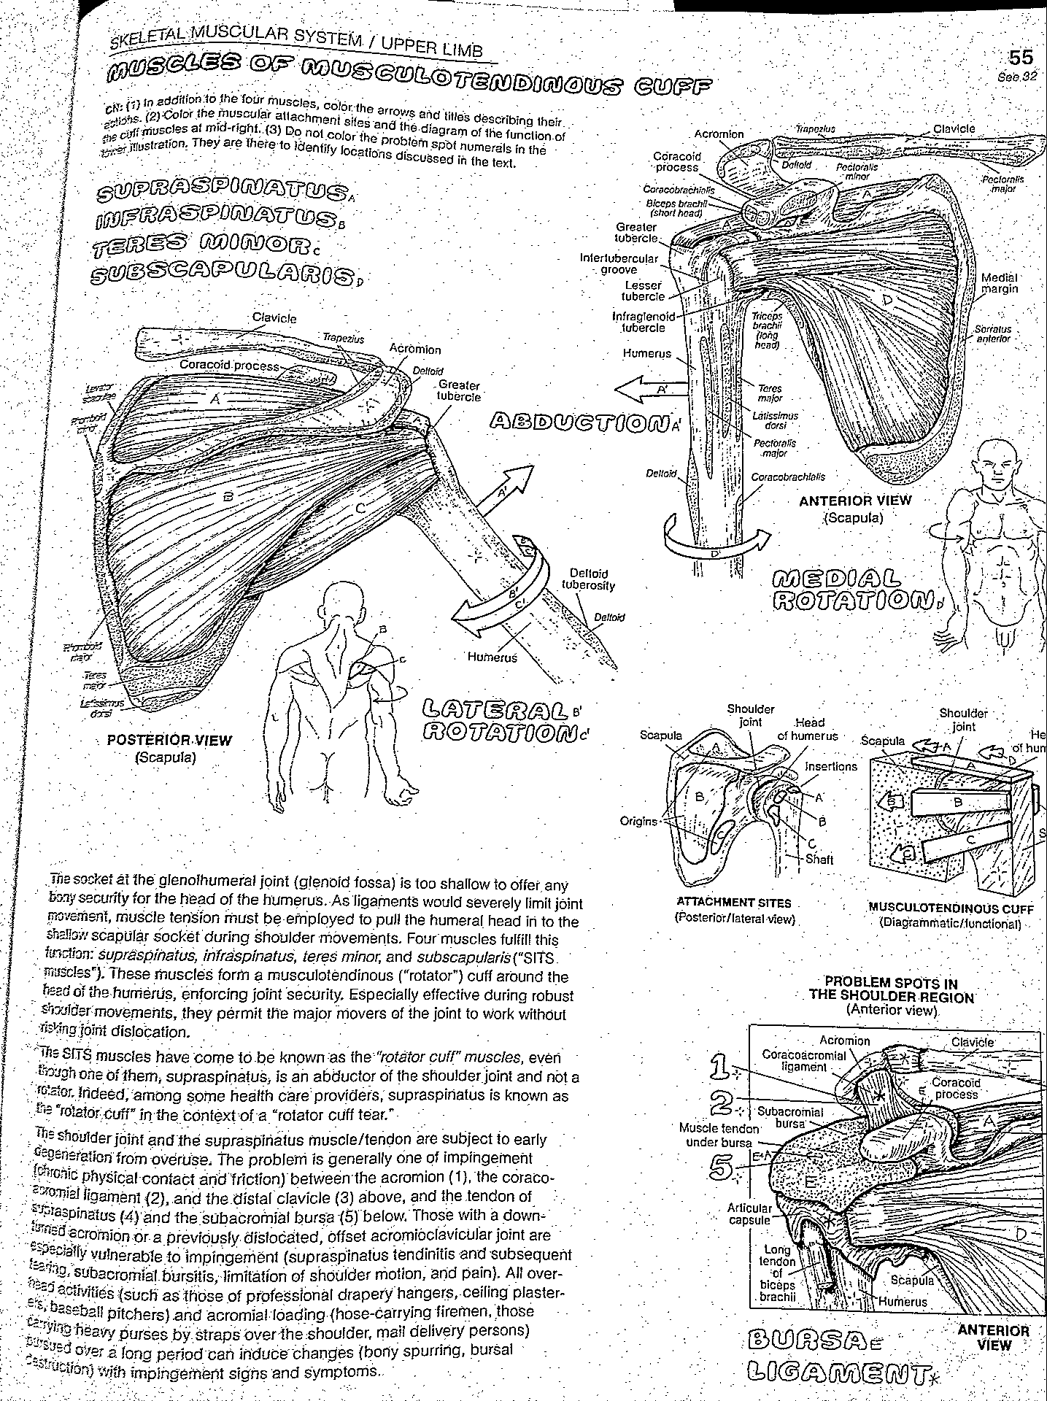

Slide 7
RC Strain or Tear
MOI: Most common is the supraspinatus
muscle…. Repetitive overhead throwing or any activity overhead c/ rotation
Seen in older adults performing ADLs,
Tears can be partial or full
S&S:
Unable to raise arm overhead → will see shoulder upward shrug hiking
“Catching” in the shoulder
Unable to sleep on affected side due to p!

Slide 8
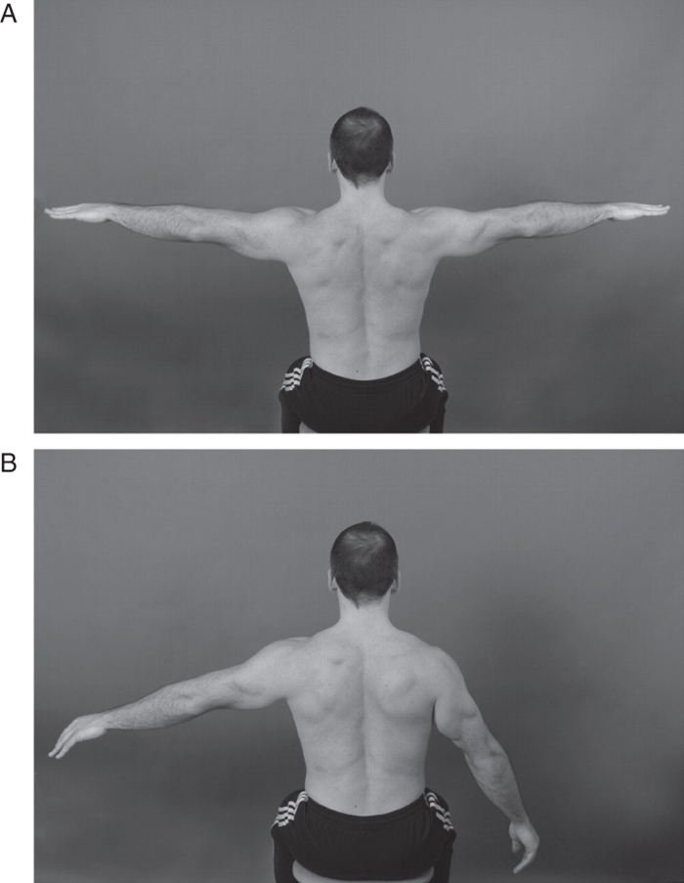

Slide 9
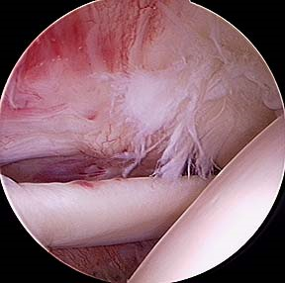

Slide 10
RC Strain or Tear
Dx: MRI to show tear
x-ray shows humeral head riding more superior
Special Tests: (bilaterally & compare results)
Drop-arm Control (look for loss of control in mid-range when lowering arm)
Empty Can Test (weakness in suprspinatus)
Test manual mm test ER and IR

Slide 11
2. “Stinger” / “Burner”

Slide 12
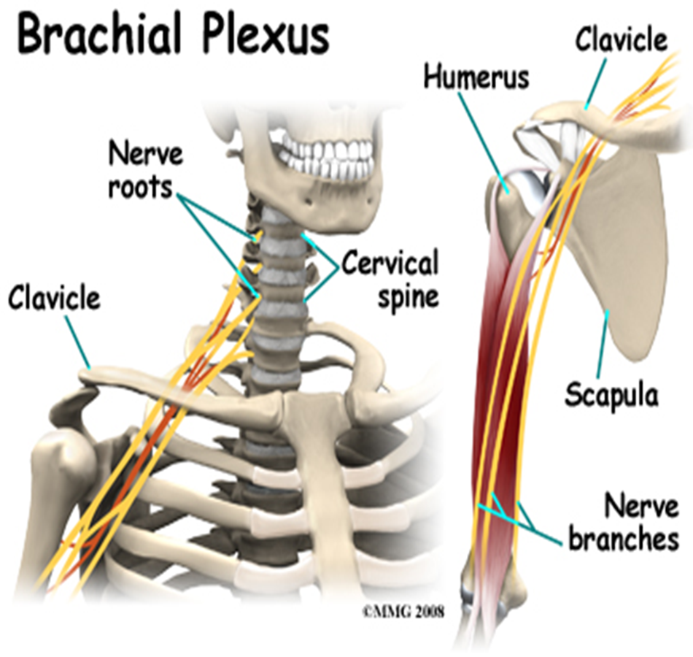
Brachial Plexus Injury
MOI: Head & neck are forcibly moved or hit to one side while the shoulder is forcibly pushed the opposite direction. As a result stretches bundles of nerves in the neck known as the brachial plexus
Brachial plexus innervates the RC from underneath the mm.

Slide 13
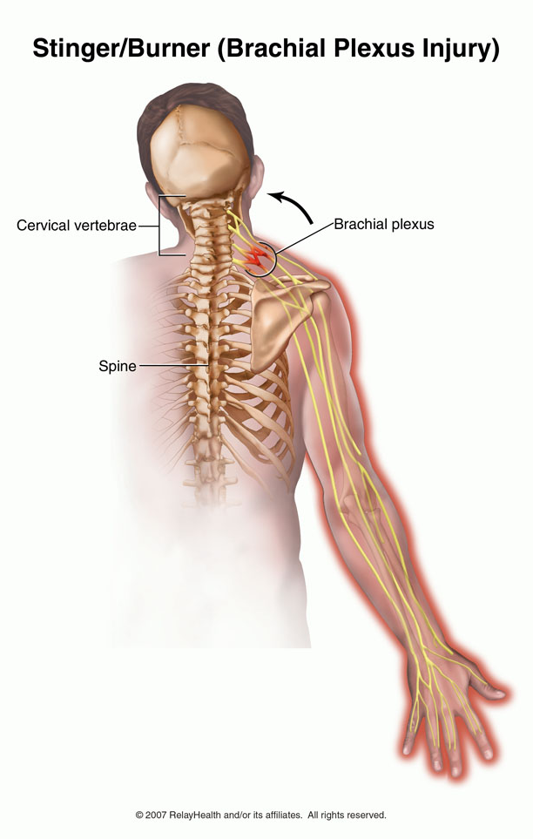
Brachial Plexus Injury
s/s:
Pain in neck & down arm
Weakness in affected arm
Arm feels on “fire” or like “pins & needles”
Last several min, hrs,
Tx:
Rest until s/s disappear
Ice 20m q 3-4 hrs
Strengthen neck mm

