Slide 1
Warm-up:
Which physical change to geriatric patients do you feel is the most devastating to the patient?
Which physical change to geriatric patients do think is the most important for you to be aware of as a health care worker?
Is it important to educate pt family members regarding changes their love ones will experience? If so, why?

Slide 2
Today’s Agenda:
Warm-up questions.
2. Review Golden Girls Job Hunting and Heart Attack Episodes.
3. TO: 5 Causes for psychosocial changes in geriatric patients.
4. Closure: Golden Girls Flu Attack Episode
U5 EQ: What special considerations should you be aware of as a health care professional

Slide 3
How does the Golden Girls Apply?
Job Hunting -
Myth 1 - Live in LTC facilities.
Lived together as roommates.
Myth 2 - Anyone over 65 is old
They all were very active and didn’t seem to consider themselves as old.
Myth 3 - Incompetent
They were cognitively aware of happenings.
Myth 4 - Live in poverty
They did not live in poverty by looking at their home and belongings.
Myth 5 - Unhappy and lonely
Very happy together and fun-loving friends
Myth 6 - Lose interest in work
Rose wanted to continue to work.
Myth 7 - Bored
Obviously had active social lives
Heart Attack-
Integumentary -
Wrinkles, hair loss were obvious
Circulatory -
Pressure in chest, thought to be MI
Respiratory -
High-pitch voices
Nervous -
Talk loud, Sophia’s memory
Digestive -
Referenced dentures
Reproductive -
Sexual desire for the Italians

Slide 4
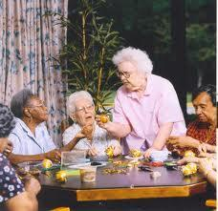
1. Work & Retirement
Associate feelings of self-worth c career.
Proud to state professional career
Retirement is often viewed as end of working yrs.
Fill time with part-time jobs, volunteer work, or clubs.
However, some feel a major sense of loss.
Lose: social contacts, feel useless = depressed

Slide 5
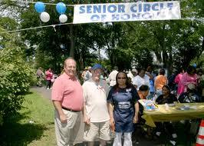
2. Social Relationships
Children marry & move
Lose contact c fam
Widowed
Can be devastating
Friends pass
Fewer social contacts
Church & community groups
New friends and purpose

Slide 6
3. Living Environments
Most prefer to remain in their homes where they feel secure.
Some find staying in their home a burden to maintain.
Physical disabilities may move them out.
Move in c child
Switch caretaker roles
Long-term care (LTC)
Make their room their own
Residents not pts

Slide 7
4. Independence
What can lead to a loss of independence?.
Physical disability
Illness
Decreased mental ability
Care should allow as much independence as possible
Self-stick strips to replace buttons

Slide 8
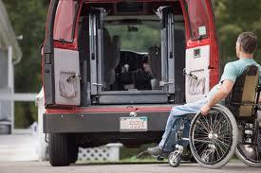
5. Dz & Disability
Dz – any condition that interferes c the normal function of the body
Diabetes, heart disease
Disability – phy/mental defect that interferes c normal functions
Hearing impairments, visual defects
Both usually sudden – no time
for adjustment

Slide 9
Golden Girls Flu Attack
As we have in the past two classes, we will watch Golden Girls Season 1 Episode 21 Flu Attack. As you watch the episode try to find ways to relate the psychosocial changes to the episode. If you can also relate physical changes as well. You are to turn in your summary to Edmodo. The assignment name is Golden Girls Psychosocial Changes. This is due at the end of class.
Please note that these assignments are being graded. Many of you failed to turn in the summaries from the previous two episodes. Those assignments were 40 points of your participation grade that went in this past Friday, 1/30

