Slide 1
Today’s Agenda: 9/2/14
Students will complete warm-up.
TO: What are the levels of organization within the human body as well as the major structures of each?
Homework - read pages 59-72 in your textbook (stop at the heading "Body Positions").
Homework - study for directional, cavities, and quadrant quiz on Thursday. You will not be given a word bank.
Students will have remaining class time to turn in Directional Term Song on Edmodo (ybbstb).

Slide 2
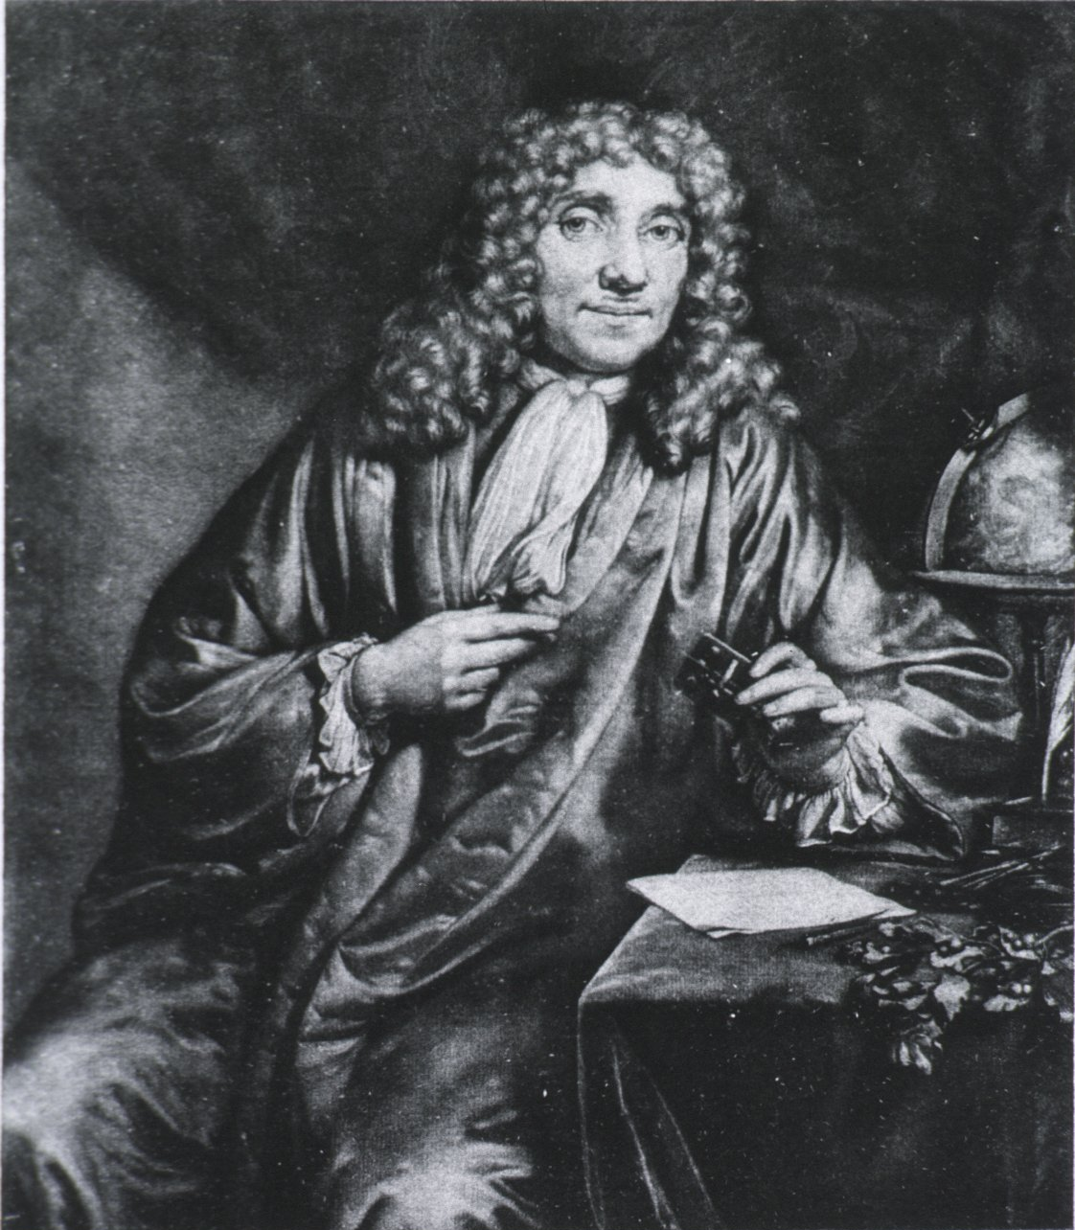
A Dutchman, Anton van Leeuwenhoek, invented the microscope in the 1600’s while trying to get a closer view of the weave of fine cloth.
He experimented with various sets of lenses and was astonished to find that pond water, tartar from his teeth, and other substances contained tiny living organisms.

Slide 3
With his discovery, researchers could now determine that the cell was the unit of life in the human body, and its organization into tissue, groups of tissues to make an organ, and organs to make systems.
This concept is known as the levels of organization.

Slide 4
Cytology is the study of cells, including their origin, structure, functions, and pathology.
Histology is the study of tissues.
There are four basic types of tissues:
1. epithelial
2. connective
3. muscle
4. nerve

Slide 5
1. Epithelial tissue - found throughout the body, makes up the covering of external and internal surfaces
Pick 2 examples: skin, linings of digestive system, urinary system, respiratory system.

Slide 6
Connective tissue- most widespread tissue type in the human body.
- It forms bones, cartilage, tendons, ligaments.
- It provides a framework for the body, holds organs in place, connects body parts, and allows for movement of joints.
- It also supports the body’s nerves and capillaries.
Example - Fat (adipose tissue)
- Is a type of connective tissue that
provides storage of energy in the body
and insulates against heat loss

Slide 7
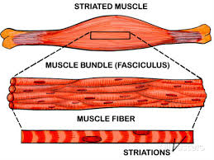
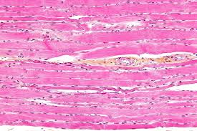
Muscle tissue – categorized as :
Voluntary – conscious control of the person
Skeletal – muscle; aka striated
Involuntary – little or no control over the
movement
Smooth – found in walls of hollow internal structures; pick 2 intestines, bladder, blood vessels, uterus
Cardiac – heart muscle under electronic control

Slide 8
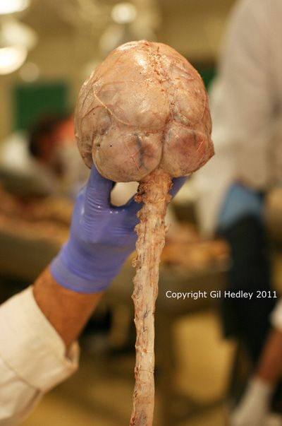
Nervous tissue – makes up the nerves and is specialized to conduct nerve impulses
Pick 2 examples: brain and spinal cord, nerves throughout the body.

Slide 9
The four tissues types combine in various ways to produce organs.
Organs are body structures that work in harmony within body systems to carry on specialized functions in a living being.

Slide 10
Internal organs of the body are called viscera and are located in the various body cavities.
Not all organs are internal and not all are localized like the heart and liver.
Sweat glands, hair, and skin are also considered body organs.

Slide 11
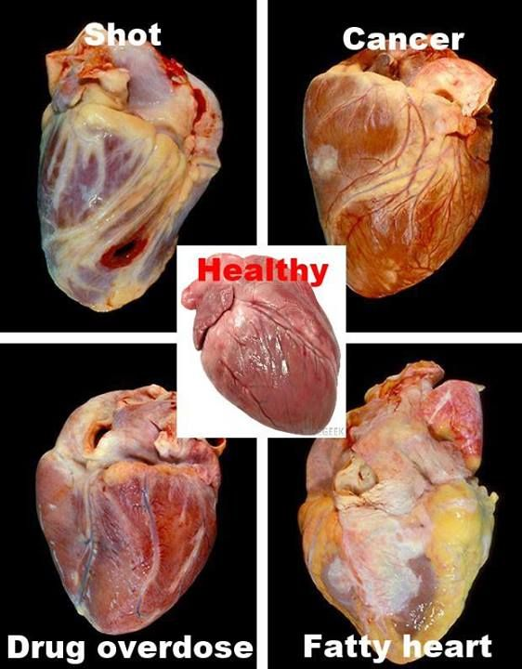
A Body System is comprised of several related organs that work together to perform a complex function.
There are 11 body systems:
1. Cardiovascular
system - heart, blood
vessels

Slide 12
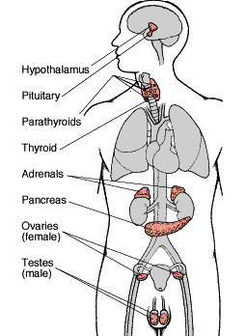
2. Endocrine system – thyroid gland, pituitary gland, adrenal glands, testes, ovaries, parathyroid gland, pineal gland

Slide 13
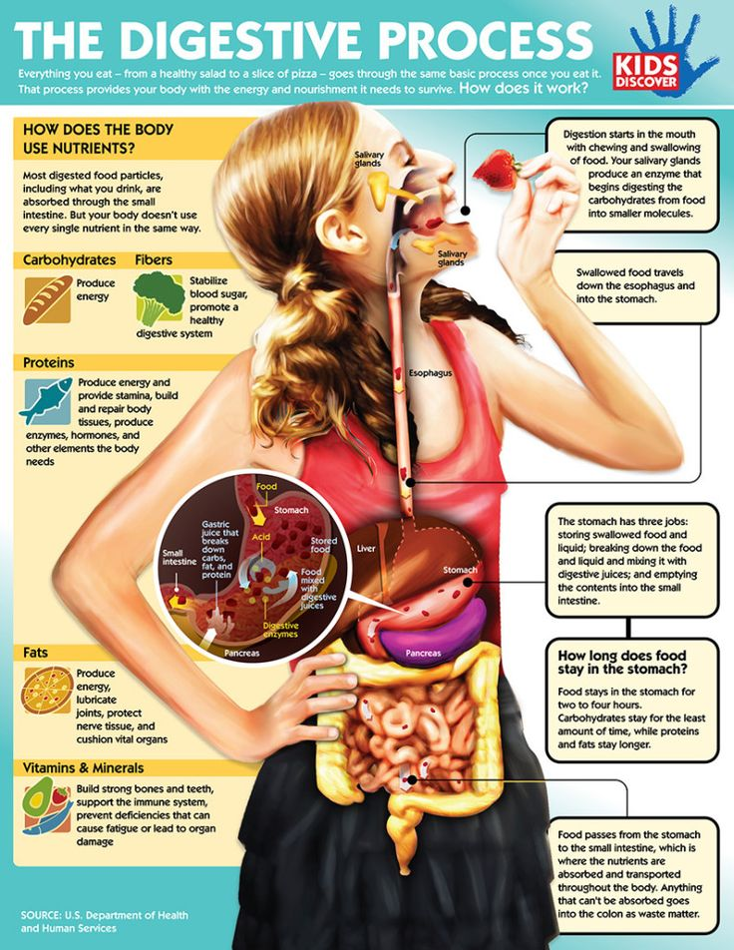
3. Digestive system – mouth, pharynx, esophagus, stomach, small intestine, liver, gallbladder

Slide 14
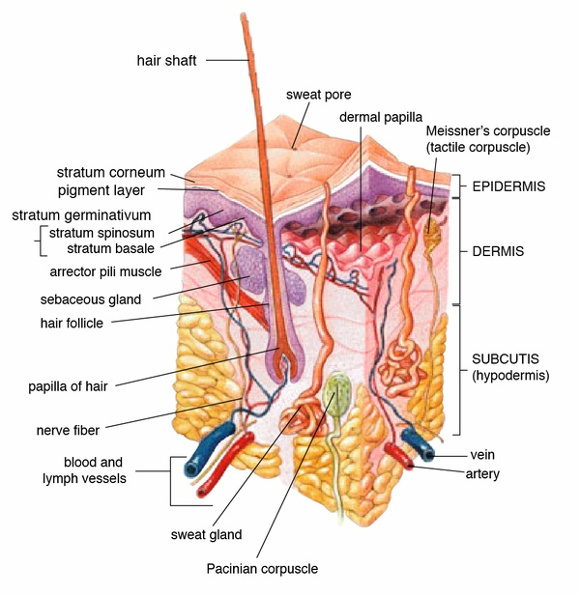
5. Integumentary system – skin, sweat glands, sebaceous glands, hair, nails

Slide 15
6. Musculoskeletal system – muscles, tendons, bones, joints, cartilage

Slide 16
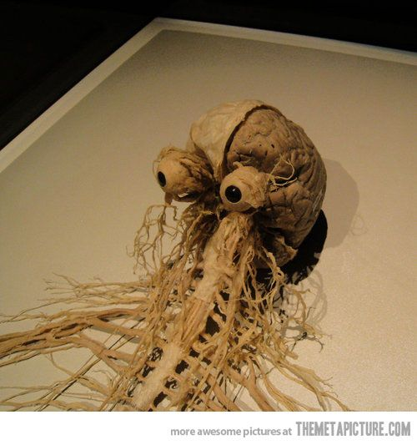
7. Nervous system – brain, spinal cord, nerves

Slide 17
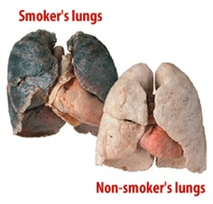
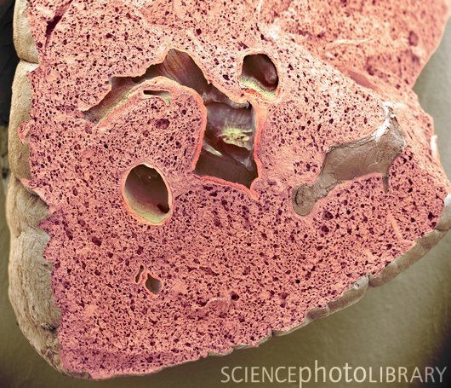
8. Respiratory system – nose pharynx, larynx, trachea, bronchial tubes, lungs

Slide 18
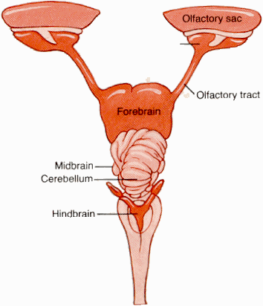
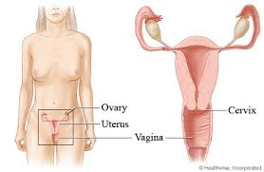
9. Reproductive system – testes, prostrate gland, ovaries, fallopian tubes, uterus

Slide 19
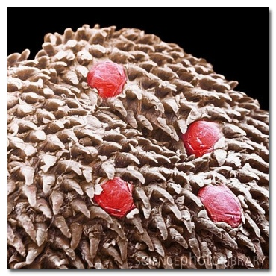
10. Special senses – eyes, ears, nose, tongue, sensory organs of skin

Slide 20
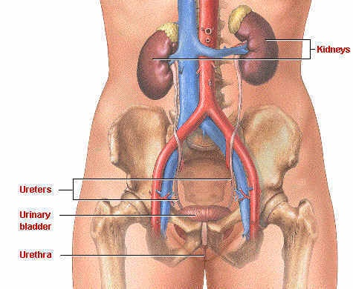
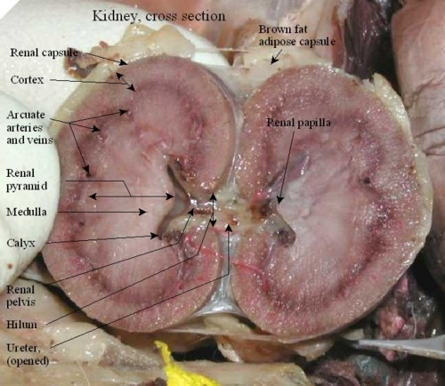
11. Urinary system – kidneys, ureters, urinary bladder, urethra

