Slide 1
National Assessment Warm-up: (write questions and answers)
Describe the difference between negligence and malpractice.
List the five microorganisms?
What are the WNL of BP?
Define the following word parts:
Angio- -ectomy
Cyst- Peri-
Bucc- -sarcoma

Slide 2
CNA Skill #1 Bed Making
Students will complete warm-up questions.
TO: Distinguish the different types of beds and what are the correct steps for making a hospital bed?
Students will practice making a hospital bed AND setting up an open bed for an adm pt.
SC Standards:
7:3 Apply principles of body mechanics and patient safety during transfers and positioning and in all areas of healthcare activities.
8:1 Act responsibly as a team member.

Slide 3
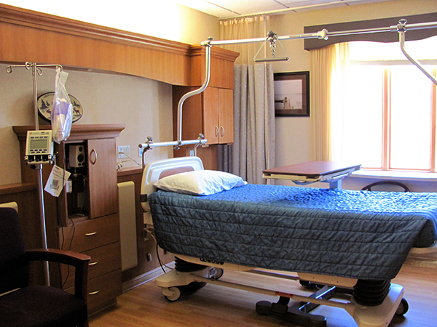
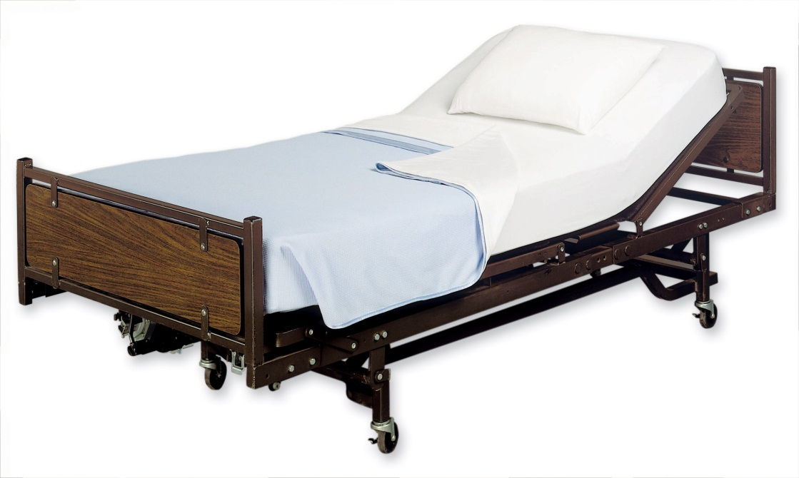
1. Closed Bed:
following pt d/c
& room cleaning
2. Unoccupied /
Open Bed:
during shower
or chair time;
for adm pt;
“welcome”

Slide 4
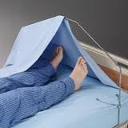
3. Occupied bed – linens changed with patient in bed, usually following a bath.
4. Surgical Bed – for post op pts; fanfold sheets to far side; at ht of stretcher.
Bed Cradle - placed on bed under the top sheet to prevent linen from touching parts of pt’s body.

Slide 5
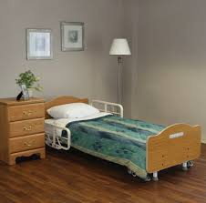
Low Bed – often has mat on floor; used for pt at high risk for falls

Slide 6
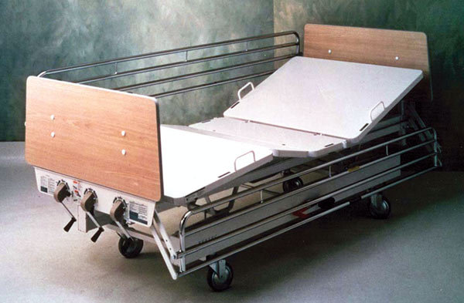
Gatch Bed –uses cranks to manipulate; phasing out due to CNA injury

Slide 7
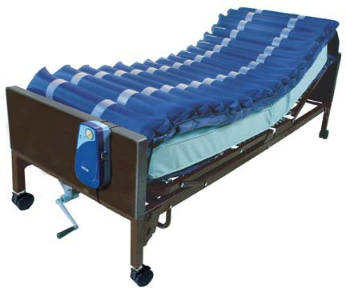
Low Air Loss Bed – for pressure ulcer prevention/tx or burn pts

Slide 8
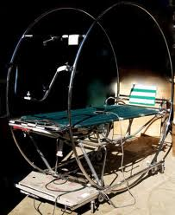
CircOlectric Bed (Stryker) – pt can move themselves vertically

Slide 9
Bedmaking
Changed:
Daily in acute care facility
2-3x/wk in LTC
Always if soiled
Raise bed to waist ht for good body mechanics.
Never touch/hold the sheets to your body.
Unfold sheets on the mattress; do not unfold by holding the sheets up in the air.
Always lower bed to lowest ht when finished.
Replace over bed table, signal cord, side rails.

Slide 10
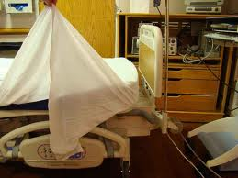
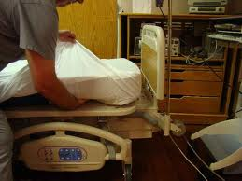
Mitered Corners
Holds linens firmly in place under mattress.
Also used on stretchers
Not used c fitted sheets

Slide 11
Contaminated Linen
Draw sheets – run from pt’s shoulders to knees; used to protect the mattress; if soiled
can change c/out having to change all linens.
To change:
Roll dirty linen up while removing from bed
Place into pillowcase.
Hold away from body.
DO NOT place on the floor.
Put into appropriate hamper.
Wash your hands afterwards.

Slide 12
Contaminated Linen
If contaminated by blood, bodily fluids, urine, or feces:
Use standard precautions
Place in a bag and seal
Place in a 2nd bag and label before sending to laundry.
Wash hands!

Slide 13
Clean Linen
Store in a closed closet
DO NOT touch to uniform
Only bring to room what you will use; any extra linens are considered contaminated.

