Slide 1
Warm-Up:
What is the name of the nerves that innervate the rotator cuff mm of the shoulder?
Where does this group of nerves start and stop?
What do we call the section of nerves that branch off of the spinal column?
In regards to boney markings what do the two following terms mean:
  Tubercle
  Fossa

Slide 2
A
B
C
F
D
E

Slide 3
Important Word Parts to Know
Sub-
  Less, under
Infra-
  Beneath, below
Supra-
  Above, higher in position

Slide 4
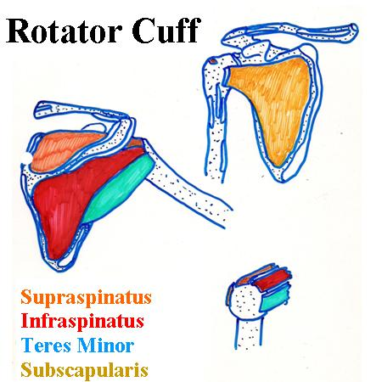
Shoulder Musculature
Rotator Cuff
  Motion: Raise arm above 90˚
  4 muscles -
    Supraspinatus
    Infraspinatus
    Subscapularis
    Teres Minor

Slide 5
Building the muscles of the RC:
Subscapularis – only one of four on anterior aspect.
  Origin – subscapular fossa
  Insertion – lesser tuberosity of the humerus
  Action – flexes/stabilizes the humerus
  Mark O and I with dry erase marker.
  Make 4 to 5 small carrots of clay.

Slide 6
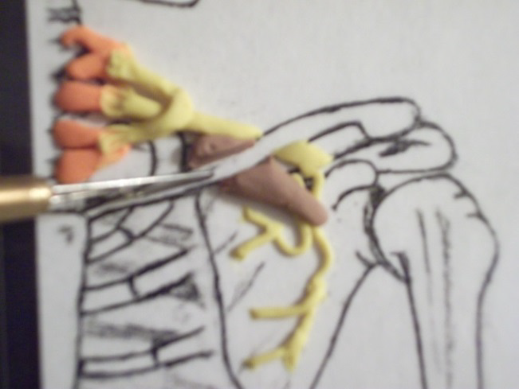
1st carrot – place it onto the subscapular fossa on the anterior skeleton; notice how the muscle is going over the nerve, meaning the muscles are innervated from underneath.
Cut the portion of the carrot out that covers the clavicle; the clavicle is anterior to the subscapularis.

Slide 7
Stack the rest of the 4 to 5 carrots side-by-side so they fill in the subscapular fossa. The Subscapularis is actually a large fan made up of many smaller fan shaped muscle. It is quite strong!
Using white/ivory clay form a small tear drop.

Slide 8
Place the white clay (which is the tendon) onto the lesser tuberosity and onto the ends of the fans.
Blend the tendon into the muscles (looks better when you blend the lighter clay into the darker clay). Trim the attachment on the lesser tuberosity.
Place striations into the clay to show the direction of pull. They always point to the muscle’s attachment.

Slide 9
Finished subscapularis!

Slide 10
Add the final part of the Brachial Plexus piece as it travels over the Subscapularis.

Slide 11
Next three rotator cuff muscles are SIT and on posterior aspect!
SIT - Supraspinatus
  O – Supraspinatus fossa
  I - Superior part of the greater tuberosity
  A – elevates the proximal humerus
        Mark O and I with dry erase marker
        Form another small carrot
        Place the tube into the supraspinatus fossa; point the end of the carrot to make it look as if it is going under the acromial process.

Slide 12
Flatten carrot so that it fills the fossa.
Trim to make sure the muscle stops at the acromial process (since it goes underneath to get to the humerus).
Small white mini M & M into a tube then flatten to be suprapsinatus tendon.
Start the tendon at the edge of the acromial process and bring it over the ‘S’ of the greater tuberosity; trim so clean to tuberosity insertion.

Slide 13
SIT - Infraspinatus:
  O - Infraspinous fossa
  I - posterior (next to the supraspinatus tendon) on the greater tuberosity
  A - pulls head of humerus backwards (extends shoulder)
                Mark O and I with dry erase marker.
                Make three carrots (just about the same size as the supraspinatus carrot).
                Stack them into the Infraspinous fossa with the tips coming together towards the humerus.

Slide 14
Form a small flat carrot or triangle of white clay for the infraspinatus’s tendon.
  Place the white tendon onto the three (four) ends of the carrots and blend. Cut and trim the tendon to only attach to the ‘I’ of the tuberosity.

Slide 15
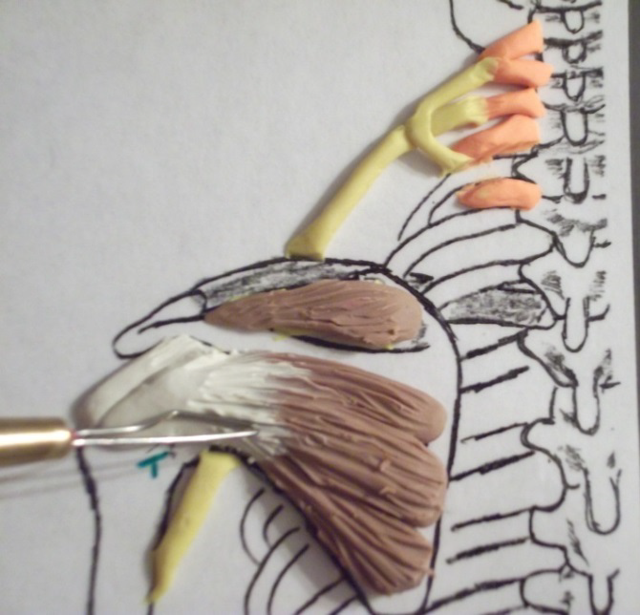
Striate to show how the muscle fibers of each part pull on the tendon. All the parts form the entire muscle known as the Infraspinatus.
Supraspinatus and Infraspinatus finished!

Slide 16
SIT - Teres Minor
  O - Lateral margin of the scapula about 2/3 down from the glenoid cavity
  I - Inferior/Posterior (next to the Infraspinatus tendon) part of the greater tuberosity
  A - pulls proximal humerus back and downward (rotates posteriorly)
  Mark O and I with a dry erase marker.

Slide 17
Form a tube about the same diameter as the carrots made for the other muscles.
Place the tube to make sure it is just short of the attachment ‘T’.
Add a small piece of white clay to the end of the tube for the tendon.
Attach the tendon to the ‘T’ for the insertion. Blend the clay so that the tendon looks natural coming out of the muscle.
Striate the Teres minor and the rotator cuff is finished!

Slide 18
Baseballs and Rotator Cuffs
Baseball represents the head of the humerus.
Palm represents the glenoid fossa.
Thumb represents the Subscapularis tendon.
Index finger - Supraspinatus Tendon
Middle finger - Infraspinatus Tendon
Ring finger= Teres minor

