Slide 1
Today’s Agenda:
Warm-up:
http://padlet.com/lwill/HST2
TO: Identify 9 physical changes in geriatric pts.
Golden Girls Heart Attack Episode
U5 EQ: What special considerations should be taken when caring for the geriatric population?
1. Aging Myths - 7
2. Physical Changes - 9
.

Slide 2
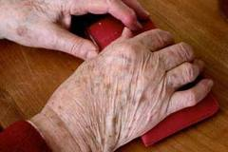
9 Physical Changes of Elderly
1. Integumentary System
Glands less active
Hair loss
Less circulation = cold skin &
poor healing
Adipose tissue layer of skin
diminishes = lines/wrinkles
Senile Lentigines
(aka Liver Spots)
Dark yellow- or brown
colored spots
TO

Slide 3
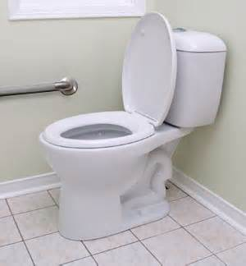
Physical Changes of Elderly
2. Musculoskeletal System
Loss in mm tone, volume, strength = gradual loss in ht
Osteoporosis
Loss in Ca causes bones to be brittle = fx
Arthritis
Inflammation of the joints = stiffness, p!, rigid
Should be encouraged to exrs as much as they can
Diets rich in protein, Ca, & vitamins can help

Slide 4
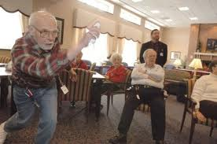
Physical Changes of Elderly
3. Circulatory System
Heart mm weakens + narrow blood vessels =
Less blood flow = possible inc BP
Mod exrs prevent thrombus
Blood clot
Can result in CVA/MI
Anti-embolism stockings

Slide 5
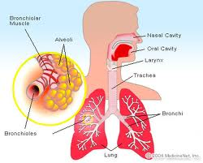
Physical Changes of Elderly
4. Respiratory System
Rigid rib cage
Alveoli (air sacs) thinner
Larynx weakens = high pitch,
weaker voice
Emphysema = dyspnea
Alveoli lose their elasticity
Bronchitis = dyspnea
Bronchioles become inflamed
TO
???

Slide 6
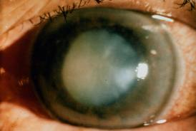
Physical Changes of Elderly
5. Nervous System
Dec in all senses
Dec in peripheral vision
Dec in hearing = talking louder
Loss of brain cells due to dec bld flow
Slows reaction, remembering, &
interpretation
Cataracts
Lens of the eye are cloudy
Glaucoma
Pressure of eye inc

Slide 7
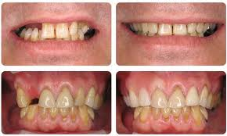
Physical Changes of Elderly
6. Digestive System
Fewer digestive enzymes produced
Slower peristalsis (mvmt of food)
Teeth lost, need replacement
Dysphagia
Difficulty swallowing
(less saliva & gag reflex)

Slide 8
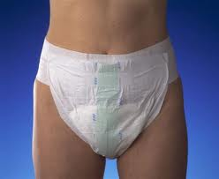
Physical Changes of Elderly
7. Urinary System
Kidneys dec in size/less efficient at making urine
Bladder’s ability to hold urine dec
Nocturia
Freq urination at night disrupts
sleep patterns
Incontinence
Inability to control urination due
to loss of muscle tone
Many will drink less to solve both=
dehydration

Slide 9
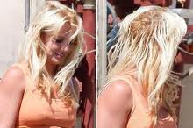
Physical Changes of Elderly
8. Endocrine System
Imbalance of hormones =
Less effective immune system = more prone to disease
Intolerance to glucose
Lower basal metabolic rate (rate at which we use energy at rest) makes them feel cold/tired
less alert

Slide 10
Physical Changes of Elderly
9. Reproductive System
Dec in estrogen = thinner vaginal walls = inc vaginal inf
Redistributed fat = sagging breasts
Dec in testosterone = slower sperm production / erection
Testes become smaller
Sexual desire does not diminish c/ age
Can improve muscle tone/circulation/dec arthritis pain
LTC allow married couples to share rooms

Slide 11
What does this mean to the HC Professional?
Changes occur at different rates for all pts.
Need to recognize changes and provide methods to adapting & coping c/ them.
Tolerance, patient, and empathy are essential.

Slide 12
Closure
Watch Golden Girls Job Heart Attack Episode, apply as many physical changes for geriatric pts as you can by using examples from the episode. Explain each change in paragraph form, turn into Edmodo by the end of class.

