Slide 1
Ch. 21 The Shoulder
TO: Discuss the Shoulder Girdle Complex to include the structure and scapulothoracic mechanics.
Lecture 1

Slide 2
The Shoulder Girdle Complex
Shoulder is a very complex joint
Ball & socket (synovial)
Large range of motion, but at the expense of giving up stability
Shoulder Girdle made up of:
Bones
Ligaments
Cartilage
Muscle

Slide 3
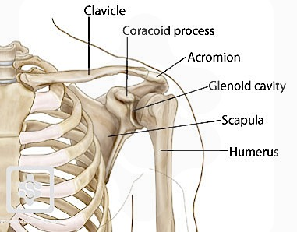
Shoulder Girdle Anatomy
Comprised of 5 bones:
Thoracic cage (ribs)
Scapula (shoulder blade)
Humerus
Sternum (breast bone)
Clavicle (collar bone)

Slide 4
Shoulder Girdle Anatomy
Thoracic cage (ribs)
Provides a site for the scapula to attach

Slide 5
Shoulder Girdle Anatomy
Scapula
Flat bone on posterior/dorsal aspect of the body
Moves on the thoracic cage
“Socket” → glenoid cavity
Acromion process
Upper/lateral aspect of scapula → hard spot on top of shoulder

Slide 6
Shoulder Girdle Anatomy
Humerus
Upper arm bone
“Ball” → head of humerus

Slide 7
Shoulder Girdle Anatomy
Clavicle
“collar bone”
Located on anterior/ventral aspect of the body
Moves with the sternum and part of the scapula (acromion)

Slide 8
Shoulder Girdle Anatomy
Sternum
“Breast bone”
Provides a site for clavicle and ribs to attach along the anterior chest

Slide 9
The Shoulder Articulations
Shoulder is a ball & socket joint
4 primary articulations:
1. Glenohumeral joint
Glenoid + humerus
2. Acromioclavicular
Acromion + clavicle
3. Sternoclavicular
Sternum + clavicle
4. Scapulothoracic → not a “true joint”
Scapula + thoracic cage

Slide 10
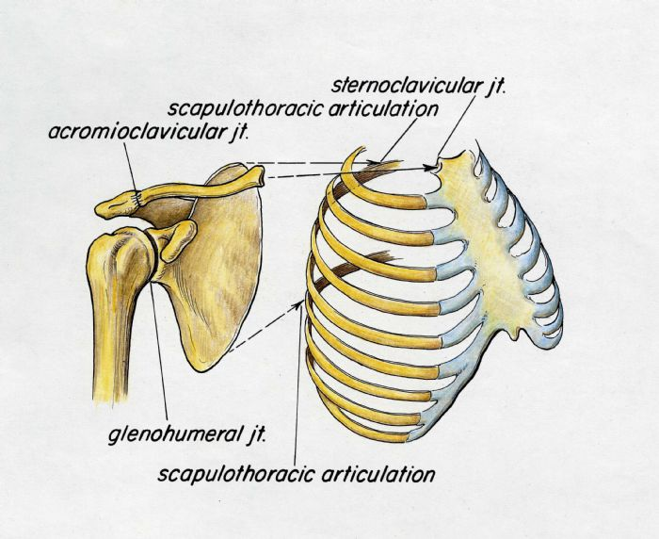
The Shoulder Articulations

Slide 11
The Shoulder Motions
Ball & Socket joint provides circumduction → a combination of all movements
Specifically
Forward flexion
Extension
Abduction
Adduction
Horizontal abduction
Horizontal adduction
Internal rotation
External rotation

Slide 12
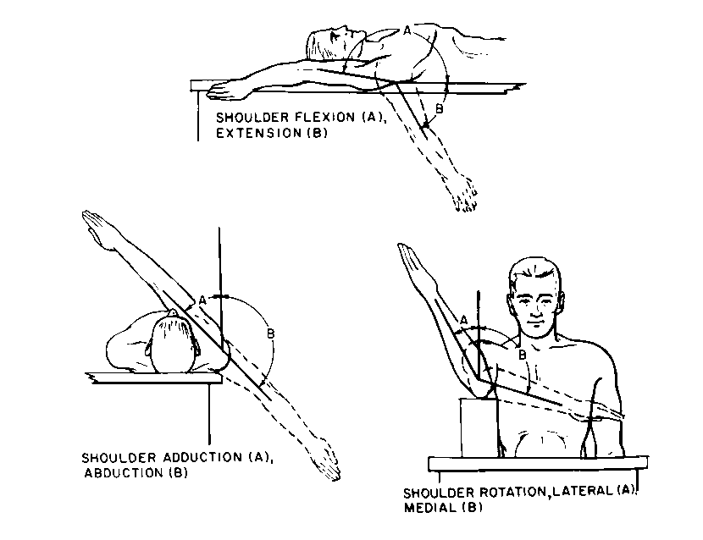
The Shoulder Motions

Slide 13
Simon Says!!!

